Slide 1
Care Management Services
Allison Hirschorn
Associate Director, Coverage and Reimbursement
American Society of Clinical Oncology
New Jersey Society of Oncology Managers
June 8th, 2023

Slide 2
Definition and Purpose of Care Management Services

Slide 3
Care Management Services
Managing and supporting patients with a single high-risk condition or multiple chronic conditions.

Slide 4
Goals of Care Management
Improve care coordination and collaboration.
Reduce hospital admissions or services.
Engage patients and caregivers in the care plan.

Slide 5
Care Management Services
Quality Care
Improved patient outcomes
Management and Support

Slide 6
Care Management Services
Chronic Care Management
Two or more chronic conditions expected to last at least 12 months.
Complex Chronic Care Management
Two or more chronic conditions expected to last at least 12 months; medical decision making of moderate or high complexity.
Principal Care Management
One single, high-risk condition expected to last 3 months.

Slide 7
Presentation Topics
Practice requirements to provide care management services.
Clinician care delivery activities.
How to appropriately code and report the services to payers.
Reimbursement for care management

Slide 8
Medicare Utilization of Care Management Services

Slide 9

National Center for Chronic Disease Prevention and Promotion
About Chronic Diseases

Slide 10
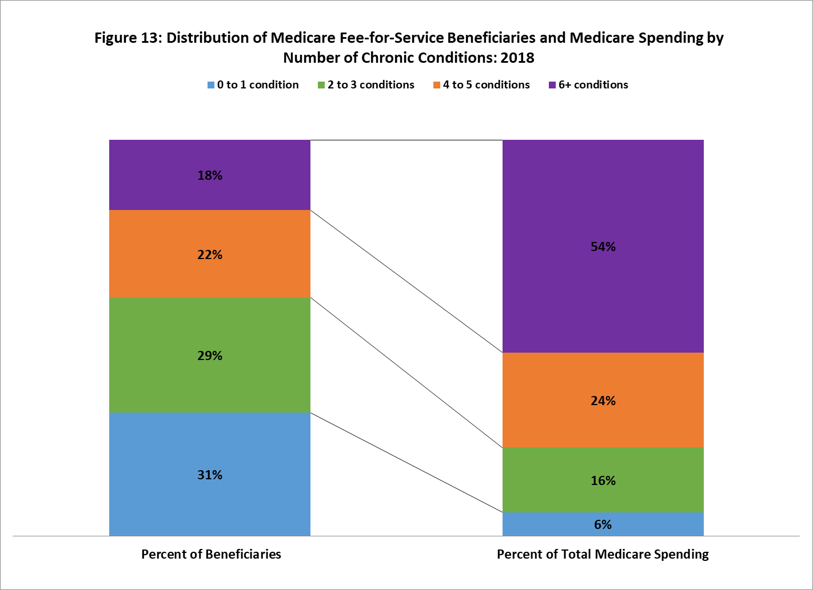
Centers for Medicare and Medicaid Services
Chartbook and Charts- Chronic Conditions Charts: 2018

Slide 11
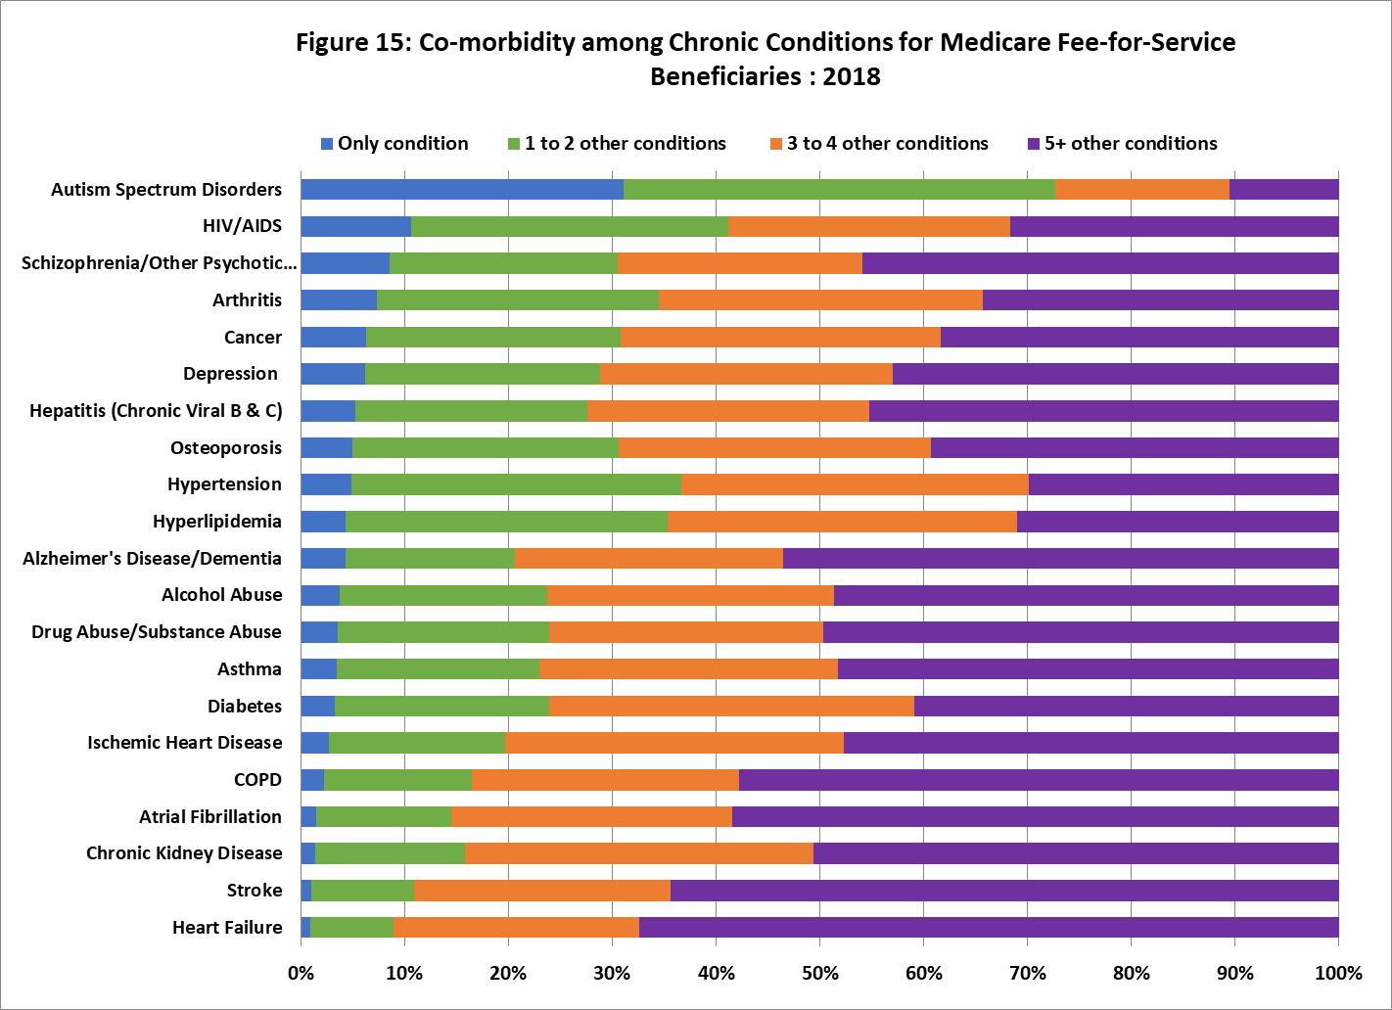
Most beneficiaries diagnosed with cancer have multiple chronic conditions.
Centers for Medicare and Medicaid Services
Chartbook and Charts- Chronic Conditions Charts: 2018

Slide 12
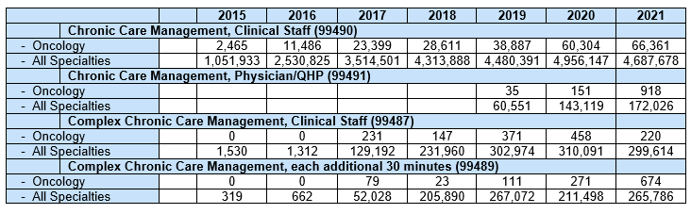
Medicare Utilization
Care Management Services
CPT Copyright 2022 American Medical Association. All rights reserved. CPT® is a registered trademark of the American Medical Association.
Centers for Medicare and Medicaid Services. Physician/Supplier Procedure Summary, 2015-2021, data.cms.gov

Slide 13
Care Management Services
Challenges
Identification
Clinical Staff Availability
Reporting
Patients in need of care management.
Staff providing the service on a regular basis.
Understanding how to report the services to payers.
Implementation
Practice processes and protocols.

Slide 14
Care Delivery

Slide 15
What’s included in a comprehensive care plan?
Problem list
Outcome and prognosis
Measurable treatment goals
Symptom management
Planned interventions
Medication management
Community and social services
Coordination of care
Review schedule
Centers for Medicare and Medicaid Services. MLN909188 – Chronic Care Management (cms.gov)
CPT® 2022 Professional Edition. Chicago, IL: American Medical Association, 2021.

Slide 16

ASCO Cancer Treatment Plan
Cancer care history
Treatments received
Medication doses
Surgeries
Any additional treatment that was provided
American Society of Clinical Oncology. N.d. ASCO Cancer Treatment and Survivorship Care Plans | Cancer.Net

Slide 17
Care Management Services Activities
Includes both face-to-face and non-face-to-face activities over a calendar month:
Transition management.
Communication with patient and/or caregiver.
Assessment and support for treatment regimen.
Communication with other healthcare professionals.
Development and updating of the care plan.
Patient and/or caregiver education.
Ongoing review of patient status.
CPT® 2022 Professional Edition. Chicago, IL: American Medical Association, 2021

Slide 18
Care Management Activities
Addressing SDOH
Tool for reducing geographic and racial/ethnic disparities in health.
Addressing a patient’s SDOH may be part of the care plan required as part of a care management service in addition to work performed by the physician/QHP or clinical staff.
Includes communication and coordination with home- and community-based clinical service providers. Also accounts for non-face-to-face communication with the patient/family/caregiver.
Centers for Medicare and Medicaid Services. “Chronic Care Management”.
https://www.cms.gov/Outreach-and-Education/Medicare-Learning-Network-MLN/MLNProducts/Downloads/ChronicCareManagement.pdf

Slide 19
Care Team
Physician
Physician’s Assistants
Clinical Nurse Specialists
Nurse Practitioners

Slide 20
Physician
Develop a comprehensive care plan and assessment.
Clinical staff
Educate patient and/or caregiver.
Address all health issues (medical and psychosocial)
Focus on patient’s chronic condition(s)
Reconcile medications list (including those prescribed by other providers).
Manage care transitions.
Share information with other health care providers.
Provide guidance and direction to clinical staff
Respond to patient inquiries.
Role of the Physician vs. Clinical Staff
Clinical staff provides services under the direction of a physician or qualified healthcare provider.
Requires general supervision to report as “incident-to.”
Centers for Medicare and Medicaid Services. “Chronic Care Management.” MLN909188 – Chronic Care Management (cms.gov)
CPT® 2022 Professional Edition. Chicago, IL: American Medical Association, 2021.

Slide 21
Quality Programs and Initiatives

Slide 22








ASCO/COA Oncology Medical Home
Patient Engagement
Chemotherapy Safety (QCP)
Availability &
Access to Care
Goals of Care, Palliative
& End of Life Discussions
Evidence-based
Medicine
Pt Centered Cancer Care
Quality Improvement
Equitable and Team- based Care
Woofter, Kim, Erin B. Kennedy, Kerin Adelson, Ronda Bowman, Rachel Brodie, Natalie Dickson, Rose Gerber, et al. “Oncology Medical Home: Asco and COA Standards.” JCO Oncology Practice 17, no. 8 (2021): 475–92. https://doi.org/10.1200/op.21.00167.

Slide 23
Enhanced Oncology Model (EOM)
Practice Administration Requirements
24/7 access to care
Patient navigation services
Care planning
Screening for SDOH
Centers for Medicare and Medicaid Services. July 2022. Enhancing Oncology Model | CMS Innovation Center

Slide 24
Practice Administration and Workflow

Slide 25
Care Management Services
Practice Administration Requirements
24/7 access to physicians or other qualified health care professionals or clinical staff.
A designated member of the care team to provide continuous care.
Timely access and management for follow-ups.
Timely access to clinical information through an EHR.
Coordination and integration of care among all service professionals.
A physician or other qualified health care professional overseeing the activities of the care team.
CPT® 2022 Professional Edition. Chicago, IL: American Medical Association, 2021.

Slide 26
Required Actions for Care Management Services
Obtain patient consent.
Cost sharing.
Termination of services.
Assign a designated care team lead.
Ensures continuity of care.
Establish, implement, revise, or monitor care plan.
Record data in electronic health record.
One practitioner per month
Serve as a point of contact.
Share with patient and/or caregiver.
Share with other healthcare providers.
Demographics.
Medications.
Medical problems.
(*Applies to chronic care and complex chronic care management services.)
Centers for Medicare and Medicaid Services. N.d. “MLN Booklet 909188: Chronic Care Management”. MLN909188 – Chronic Care Management (cms.gov)

Slide 27
Steps for Practice Administration
Establish a workflow.
Define the care management process.
Prepare for reimbursement.
Establish ongoing monitoring and quality improvement.
Identify opportunities with commercial payers.
Leverage digital tools.
Health Quality Innovation Network. “Chronic Care Management Toolkit.” https://www.khconline.org/files/CCM-Toolkit.pdf
Notes:
Reminder- how practices prepare for reimbursement.

Slide 28
Practice Administration Implementation
Guides and Resources
American Society of Clinical Oncology
Practice Administration, Reporting, and Reimbursement Guide
Centers for Medicare and Medicaid Services
Connected Care Toolkit
National Association of Community Health Centers
Value Transformation Framework
Agency for Healthcare Research and Quality
Care Management Issue Brief

Slide 29
Coding and Reporting

Slide 30
Care Management Services Comparison
Chronic Care Management | Complex Chronic Care Management | Principal Care Management
Two or more chronic conditions expected to last at least 12 months (or until the death of the patient). |  | One complex chronic condition expected to last at least 3 months.
Service time is per calendar month (not date of service).
Significant risk of death, acute exacerbation/decompensation or functional decline.
A care plan is established, implemented, revised, or monitored.
 | Moderate or high complexity medical decision making. | Management of the condition is complex due to comorbidities.
CPT Copyright 2022 American Medical Association. All rights reserved. CPT® is a registered trademark of the American Medical Association.
CPT® 2022 Professional Edition. Chicago, IL: American Medical Association, 2021.

Slide 31
CPT Codes
Service | Physician or Qualified Healthcare Professional | Clinical Staff
Chronic Care Management | 99491: First 30 minutes, personally provided by a physician or qualified healthcare professional 99437: Each additional 30 minutes (limited to 2x per month) | 99490: First 20 minutes of clinical staff time directed by a physician or qualified healthcare professional 99439: Each additional 20 minutes (limited to 2x per month)
Complex Chronic Care Management | No CPT code. Must still provide direction to clinical staff. Time spent on clinical staff activities personally performed by the physician/QHP may be counted towards the clinical staff time. | 99487: First 60 minutes of clinical staff time directed by a physician or other qualified healthcare professional 99489: Each additional 30 minutes
Principal Care Management | 99424: First 30 minutes, personally provided by a physician or qualified healthcare professional 99425: Each additional 30 minutes | 99426: First 30 minutes of clinical staff time directed by a physician or qualified healthcare professional 99427: Each additional 30 minutes (limited to 2x per month)
See full CPT ® code descriptions and guidelines in the AMA CPT Professional Edition 2022
CPT® 2022 Professional Edition. Chicago, IL: American Medical Association, 2021.

Slide 32
Time Requirements
All time is total time per calendar month (not date of service).
Must perform at least the number of minutes indicated in the code description (mid-point rule does not apply).
Primary codes may only be reported once per calendar month. The add on services cover additional time during the month (limited to 2x a month for CCM and PCM services).
https://www.hhs.gov/guidance/sites/default/files/hhs-guidance-documents/payment_for_ccm_services_faq2019_updateclean012819.pdf Centers for Medicare and Medicaid Services. “Frequently Asked Questions about Billing Medicare for Chronic Care Management Services.” March 2016. Frequently Asked Questions About Billing Medicare for CCM Services
NGS Medicare. “Care Management: Principal Care Management.” https://www.ngsmedicare.com/documents/20124/121705/2330_0222_princ_care_final_508.pdf/ce5d4dab-52df-bea2-3291-0dc981ff4222?t=1644859745549
CPT® 2022 Professional Edition. Chicago, IL: American Medical Association, 2021.

Slide 33
Activities That Do Not Count Towards Time
Telephone E/M services
Medication therapy management-Pharmacist
Online digital E/M services
Prolonged E/M Services (different day than E/M)
Patient/caregiver training INR monitoring
ESRD services
The time of these services do not count towards the time of care management service.
CPT Copyright 2022 American Medical Association. All rights reserved. CPT® is a registered trademark of the American Medical Association.
CPT® 2022 Professional Edition. Chicago, IL: American Medical Association, 2021.

Slide 34
Date of Service
What is the date of service?
The appropriate date of service (DOS) for CCM, CCCM, and PCM services is the date the time requirement was reached.
CPT Copyright 2022 American Medical Association. All rights reserved. CPT® is a registered trademark of the American Medical Association.

Slide 35
Reporting Example: Date of Service
January 18th
20 minutes of clinical staff time
January 25th
^{40 minutes clinical staff time}
^{Date of Service: January 25th}
60 minutes of clinical staff time (CPT code 99487)

Slide 36
Clinical Staff and Physician Work
Clinical staff and the physician/QHP cannot both report a care management service in the same calendar month.
If the physician personally performs any of the care management services and those activities are not used to meet the criteria for a separately reported physician service code (ex. 99424 or 99491), then the clinician time may be counted toward the clinical staff time of the applicable service.
If a physician personally performs the clinical staff activities but does not bill for that time, his or her time can be counted towards the clinical staff time.
CPT® 2022 Professional Edition. Chicago, IL: American Medical Association, 2021.

Slide 37
Reporting
Example: Chronic Care Management (CCM)
Physician and Clinical Staff Time
Date | Practitioner Time
January 13th | 20 minutes of clinical staff time
January 20th | 20 minutes of physician time (not applied to the time criteria for a physician CCM service)
January 28th | 20 minutes of physician time(not applied to the time criteria for a physician CCM service)
Total Time Attributed to clinical staff in the calendar month | 60 minutes Report 99490 for DOS January 13th (20 minutes) Report 99439 2x- once for date of service January 20th and January 28th Note: CPT code 99439 may only be reported twice in a calendar month.

Slide 38
CMS Initiating Visit Requirement
Chronic Care Management Services
Applies to a new patient or patient not seen within 1 year prior to the start of the chronic care management service. One of the following services must be performed:
Annual Wellness Visit (AWV).
Initial Preventive Physical Exam (IPPE).
E/M visit.
CMS VMCG, CMS/CM/PCG/DPIPD, and CMS. 2016. “Chronic Care Management Services.” https://www.cms.gov/Outreach-and-Education/Medicare-Learning-Network-MLN/MLNProducts/Downloads/ChronicCareManagement.pdf.

Slide 39
Care Management Services
Code Selection
How many conditions are being managed?
Who provided the service?
Were the time requirements for the code(s) met?
How long is the condition expected to last?
CPT Copyright 2022 American Medical Association. All rights reserved. CPT® is a registered trademark of the American Medical Association.

Slide 40
Care Management Services
Principal Care Management Service (PCM)
Single condition
Is the condition expected to last at least 3 months?
Yes. Who provided the service?
No. A PCM service may not be reported.
Physician or QHP. Did the service add up to 30 minutes or more?
Clinical staff. Did the service add up to 30 minutes or more?
Yes. Report CPT code 99426 and if appropriate, 99427.
No. A PCM service may not be reported.
Yes. Report CPT code 99424 and if appropriate, 99425.
No. A PCM service may not be reported.
Single, high-risk condition requiring moderate or high complexity medical decision making.
CPT Copyright 2022 American Medical Association. All rights reserved. CPT® is a registered trademark of the American Medical Association.

Slide 41
Care Management Services
Chronic Care Management Services (CCM)
Two or more
Is the condition expected to last at least 12 months?
Yes. Who provided the service?
No. A CCM service may not be reported.
Physician or QHP. Did the activities add up to 30 minutes or more per calendar month?
Clinical staff. Did activities add up to 20 minutes or more per calendar month?
Yes. Report codes 99491 and, if appropriate 99437.
No. A CCM service may not be reported.
Yes. Report codes 99490 and if appropriate, 99439.
No. A CCM service may not be reported.
Yes. Combine the time of the physician/QHP and staff. Report 99426 and 99427, if appropriate
Two or more chronic conditions.
CPT Copyright 2022 American Medical Association. All rights reserved. CPT® is a registered trademark of the American Medical Association.

Slide 42
Care Management Services
Complex Chronic Care Management Services (CCCM)
Two or more chronic conditions requiring moderate or high-level MDM.
Are the patient’s conditions expected to last at least 12 months?
Yes. Did the service add up to 60 minutes or more?
Yes. Report CPT codes 99487 and if appropriate, 99489.
No. A CCCM service may not be reported.
No. A CCCM service may not be reported.
CPT Copyright 2022 American Medical Association. All rights reserved. CPT® is a registered trademark of the American Medical Association.

Slide 43
Documentation Requirements
Narrative detailing need for care management services.
Beneficiary eligibility for the service.
Comprehensive care plan (with measurable goals) established, implemented, revised or significantly monitored.
Patient or caregiver must be given a copy of the care plan.
Discussion narrative with beneficiary and his/her prior permission acceptance (verbally for patients who have been seen in the practice within past 12 months or written for those who have not).
Documentation of verbal acceptance and explanation to the patient.
Note regarding that the beneficiary may terminate consent at any time.
Support services rendered.
Time spent on services.
Noridian Healthcare Services. “Chronic Care Management.” June 2019. Chronic Care Management (CCM) - JE Part B - Noridian (noridianmedicare.com)

Slide 44
Reimbursement

Slide 45



Clinician Reimbursement
Chronic and Complex Care Management Services
Principal Care Management Services
Only one clinician per beneficiary per calendar month.
More than one clinician per beneficiary if the patient experiences an exacerbation of more than one complex chronic condition simultaneously.

Slide 46
Example: Multiple Clinician Reporting
The patient’s primary care physician reported a chronic care management service on the 8th of the month. Their oncologist reported a chronic care management service on the 10th.
Because the primary care physician has already reported and billed a chronic care management service in the calendar month, the oncologist is unable to receive reimbursement for the CCM service performed on the 10th.

Slide 47
RVUs and Payments
Chronic Care Management
CPT | Provider | Time | Non-Facility RVU | Non-Facility Payment
99490 | Staff | First 20 min | 1.85 | $62.69
99439 | Staff | Add ’l 20 min | 1.4 | $47.44
99491 | Physician | First 20 min | 2.51 | $85.06
99437 | Physician | Add ’l 30 min | 1.77 | $59.98
Complex Chronic Care Management
CPT | Provider | Time | Non-Facility RVU | Non-Facility Payment
99487 | Staff | First 60 min | 3.93 | $133.18
99489 | Staff | Add’l 30 min | 2.08 | $70.49
Principal Care Management
CPT | Provider | Time | Non-Facility RVU | Non-Facility Payment
99426 | Staff | First 30 min | 1.81 | $61.34
99427 | Staff | Add ’l 30 min | 1.40 | $47.44
99424 | Physician | First 30 min | 2.40 | $81.33
99425 | Physician | Add ’l 30 min | 1.72 | $58.29
CPT Copyright 2022 American Medical Association. All rights reserved. CPT® is a registered trademark of the American Medical Association.
Centers for Medicare and Medicaid Services, Physician Fee Schedule Look up Tool. April 2023. Overview of the Medicare Physician Fee Schedule Search | CMS

Slide 48
Resources

Slide 49
Resources and References
American Society of Clinical Oncology
Care Management Services: Practice Administration, Reporting, and Reimbursement Guide
Changchuan Jiang, Haowei Wang, Qian Wang, Binbin Zheng, and Charles L. Shapiro. “Cancer survivors with multiple chronic conditions: A rising challenge—Trend analysis from National Health Interview Survey.” Journal of Clinical Oncology 2020 38:15_suppl, e24089-e24089
Dana Ketcher, Amy Otto, and Maija Reblin. “Chronic conditions among advanced cancer patients and their spouse caregivers.” Journal of Clinical Oncology 2019 37:31_suppl, 20-20
Cancer.Net. Living with Chronic Cancer
ASCO Fact Sheet: Enhancing Oncology Care Model (EOM)

Slide 50
Resources and References
Centers for Medicare and Medicaid Services
Connected Care Toolkit
MLN Booklet: Chronic Care Management Services
Chronic Conditions Prevalence, State/County 2018
Chronic Conditions among Medicare Beneficiaries: Chronic Conditions Chartbook: 2018
American Medical Association
“Get paid for the care management your physician practice delivers”
“Physician-led team-based care”

Slide 51
Resources and References
Other Information
Chronic Care Management (CCM) Toolkit: Your implementation guide for patients with chronic conditions
Provider Experiences with Chronic Care Management (CCM) Services and Fees: A Qualitative Research Study
Chronic Care Management (CCM) - JE Part B - Noridian (noridianmedicare.com)

Slide 52
Q&A

Slide 53
Questions about care management services or any other coding question may be sent to practice@asco.org.
ASCO Practice Central
Coding and Reimbursement Resources

