Slide 1
Social Determinants of Health and ICD-10 CM Z Codes New Jersey Society of Oncology Managers June 8th, 2023
Allison Hirschorn
Associate Director of Coverage and Reimbursement

Slide 2
Today’s Topics
Data and utilization
Quality programs and initiatives
Practice administration
ICD-10 CM Z Codes Describing SDOH
Connecting Z codes with CPT codes

Slide 3
Social Determinants of Health: Data and Utilization

Slide 4
What are Social Determinants of Health (SDOH)?
Conditions of an individual’s living, learning, and working environments that affect one’s health risks and outcomes.
Recognized as important predictors in clinical care and positive conditions are associated with improved patient outcomes and reduced costs.

Slide 5
What are ICD-10 CM codes?
International Classification of Diseases, 10th Revision, Clinical Modification (ICD-10-CM)
Classifying diagnoses and reason for visits in all health care settings.

Slide 6
How are ICD-10 CM codes connected to social determinants of health?
Persons with potential health hazards related to socioeconomic and psychosocial circumstances
(Z55-Z65)
Social Determinants of Health

Slide 7
Impact of Identifying Patients with Social Determinants of Health
Identifying patients with SDOH
Improved quality, care coordination, and experience of care
Reporting Z codes
Resource: USING Z CODES: The Social Determinants of Health (SDOH) Data Journey to Better Outcomes)

Slide 8
Social Determinants of Health Data Collection Challenges
Current Challenges | Potential Solutions
Lack of a standardized EHR-based screening tool. Lack of and multiplicity of codes. Lack of awareness among providers and medical coders. | Reducing reliance on clinicians to capture SDOH. Filling gaps in codes. Improving provider and medical coder education.
Notes:
Data collection using SDOH screening tools is common among different settings.
The information is not consistently translated to standardized data due to lack of technical specifications based on industry consensus.

Slide 9
Z Codes Utilization among Medicare Fee-for-Service (FFS) Beneficiaries in 2019
Among 33.1 million total Medicare FFS beneficiaries in 2019, approximately 1.59% had claims with Z codes.
CMS Data Highlight
No. 24 September 2021
Utilization of Z Codes for Social Determinants of Health among Medicare Fee-for-Service Beneficiaries, 2019

Slide 10
Z Codes Utilization among Medicare Fee-for-Service (FFS) Beneficiaries in 2019
5 Most Utilized Z codes
Z59.0
Homelessness
Z63.4
Disappearance and death of family member
Z59.3
Problems related to living in a residential institution
Z63.0
Problems in relationship with spouse or partner
Z60.2
Problems related to living alone

Slide 11
Z Codes Utilization among Medicare Fee-for-Service (FFS) Beneficiaries in 2019
Race and Ethnicity Proportions
Medicare FFS Beneficiaries with Z Codes
White (79.5%) Black and African American(8.8%) Hispanic (5.9%) Asian and Pacific Island (2.7%) American Indian and Alaska Native (0.6%)
CMS Data Highlight
No. 24 September 2021
Utilization of Z Codes for Social Determinants of Health among Medicare Fee-for-Service Beneficiaries, 2019
Notes:
Possible under-reporting

Slide 12
Why is the utilization of these codes low?
Lack of awareness regarding the codes.
Difficulty in determining when and how to report the codes.
Lack of internal processes to incorporate Z codes into the workflow.
Confusion as to who can (or should) document SDOH.
Lack of explicit financial incentives for their use.

Slide 13
Social Determinants of Health: Quality Programs and Initiatives

Slide 14
SDOH and Quality Initiatives ASCO/COA Oncology Medical Home
Patient Engagement
Chemotherapy Safety (QCP)
Availability &
Access to Care
Goals of Care, Palliative
& End of Life Discussions
Evidence-based
Medicine
Pt Centered Cancer Care
Quality Improvement
Equitable and Team- based Care

Slide 15
Enhanced Oncology Model (EOM)
EOM participants will be required to:
Develop and establish a health equity plan.
Collect and report beneficiary-level sociodemographic data.
Use health-related social needs (HRSN) screening tools.
Provide patient navigation to EOM beneficiaries.
Provide EOM beneficiaries with 24/7 access to a clinician.

Slide 16
SDOH and Quality Patient Care
National Comprehensive Cancer Control Program (CDC)
Train and maintain a culturally competent workforce.
Promoting equitable access to resources.
Accountable Health Communities Model (CMS)
Address gaps in clinical care and community services.
Identify and address health-related social needs.
Healthy People 2030 (HHS)
Access to high-quality health care services.
Increase both preventive care and cancer screenings.

Slide 17
Practice Administration

Slide 18
Integration and Implementation of SDOH into Cancer Care
Unique factors that vulnerable populations experience because of social and historical discrimination across multiple levels (individual and health care system levels) must be considered.
Social Determinants of Health and Disparities in Cancer Care for Black People in the United States
Reginald D. Tucker-Seeley
JCO Oncology Practice 2021 17:5, 261-263
Notes:
Not one size fits all!

Slide 19
Connecting Z Codes with SDOH
1. Collect SDOH data: Collect SDOH data via health risk assessments, screening tools, person-provider interaction, and self-reporting.
2. Document SDOH data: Record data in a patient’s paper or electronic health record.
3. Map SDOH data to Z codes: Select the ICD-10 CM Z code(s) that corresponds to the SDOH.
4. Analyze SDOH Z code data findings: Add to key reports and share with social service organizations, providers, and health plans.
Center for Medicare and Medicare Services: “Using Z Codes: The Social Determinants of Health (SDOH) Data Journey to Better Outcomes”
5. Identify unmet patient needs: A “Disparities Impact Statement” may be used to discover opportunities for advancing health equity.

Slide 20
Achieving Health Equity Disparities Impact Statement
Using the SDOH and Z code data:
Identify health disparities, priority populations, and needs.
Define goals and targets.
Establish a health equity strategy.
Monitor and evaluate progress.
Source: CMS Disparities Impact Statement
Updated March 2021

Slide 21
Healthcare Professional Education and Training
Initial Concern/Challenge | After Education and Program Exposure
Discomfort with screening | Participation in a screening and referral program improved provider comfort with social risk screening.
Time and workflow | Time & workflow were not burdensome, less than anticipated, or worth the time following social determinant of health program participation.
Patient/provider relationship and trust | Screening for social risks enhanced their relationship with patients or had no negative impact.
Ability to address patient needs | Overall provider concerns regarding the ability to provide resources to address needs continued.
State of the Science on Social Screening in Healthcare Settings: Summer 2022
Section Four: Healthcare Providers’ Perspectives on Social Screening
Figure 2. Effect of Program Expose on Provider Concerns

Slide 22
Identify patients with SDOH.
Connect SDOH with Z codes.
Link practice processes for SDOH to the appropriate CPT ®codes.
Evaluate progress and goals.
Addressing SDOH is a continuous process.

Slide 23
Social Determinants of Health: ICD-10 CM Z Codes

Slide 24
ICD-10 CM Z Codes
Category | Category Description
Z55 | Problems related to education and literacy
Z56 | Problems related to employment and unemployment
Z57 | Occupational exposure to risk factors
Z58 | Problems related to physical environment
Z59 | Problems related to housing and economic circumstances
Z60 | Problems related to social environment
Z62 | Problems related to upbringing
Z63 | Other problems related to primary support group, including family circumstances
Z64 | Problems related to certain psychosocial circumstances
Z65 | Problems related to other psychosocial circumstances
Chapter 21- Factors Influencing Health Status and Contact with Health Services
“Persons with potential health hazards related to socioeconomic and psychosocial circumstances (Z55-Z65)”
Source: 2023 ICD-10 CM

Slide 25
ICD-10 CM Z Codes
Z59 Problems related to housing and economic circumstances
Z59.0 Homelessness
Z59.00 Homelessness, unspecified
Z59.01 Sheltered homelessness
Z59.02 Unsheltered homelessness
Z59.1 Inadequate housing
Z59.2 Discord with neighbors
Z59.3 Problems related to living in residential institution
Z59.4 Lack of adequate food
Z59.41 Food insecurity
Z59.48 Other specified lack of adequate food
Z59.5 Extreme poverty
Z59.6 Low income
Z59.7 Insufficient social insurance and welfare support
Z59.8 Other problems related to housing and economic circumstances
Z59.81 Housing instability, housed
Z59.811 Housing instability, housed, with risk of homelessness
Z59.812 Housing instability, housed, homelessness in past 12 months
Z59.819 Housing instability, housed unspecified
Z59.82 Transportation insecurity
Z59.86 Financial insecurity
Z59.87 Material hardship
Z59.89 Other problems related to housing and economic circumstances
Z59.9 Problem related to housing and economic circumstances, unspecified

Slide 26
ICD-10 CM Z Codes: Reporting Guidelines
Z55-Z65 identify issues related to a patient’s socioeconomic situation and are not procedural in nature.
The Z codes must be accompanied by a procedure code (CPT, HCPCS, ICD-10 PCS).
The Z codes do not have to be the principal or first-listed diagnosis (primary reason for the visit).

Slide 27
ICD-10 CM Z Codes: Reporting Guidelines
Who can document SDOH and their corresponding Z code(s)?
Case Manager
Social Worker
Discharge Planner
Clinical Staff
Patient

Slide 28
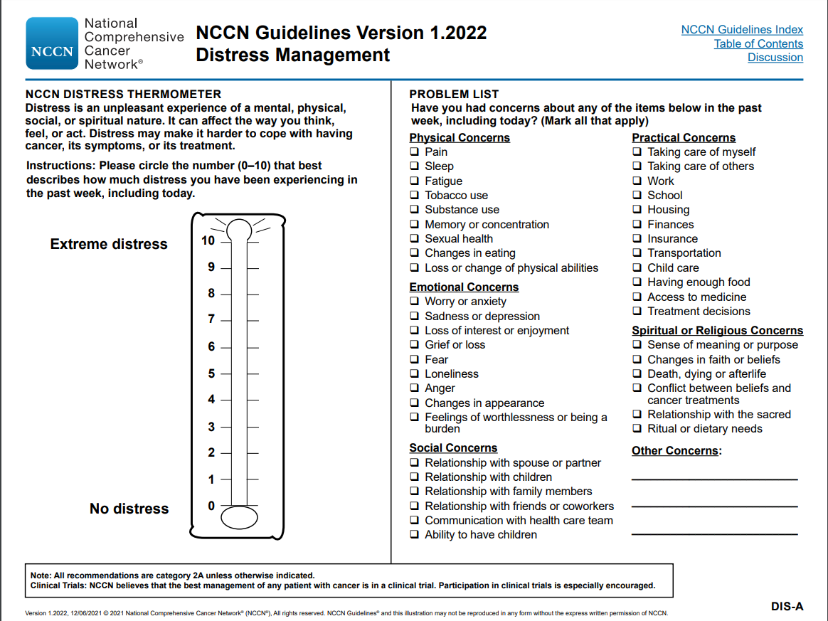
NCCN Distress Thermometer Patient Self-Reporting SDOH
SDOH
SDOH
SDOH
Source: NCCN Guidelines Version 1.2022- Distress Management

Slide 29
Example: Connecting SDOH to Z Codes
The patient indicates on the “NCCN Distress Thermometer” they are experiencing significant stress regarding medical expenses, covering rent, and unemployment.

Slide 30
Example: Connecting SDOH to Z Codes
NCCN Distress Thermometer: Practical Concerns | ICD-10 CM Z Codes: Persons with potential health hazards related to socioeconomic and psychosocial circumstances
Insurance Housing Work | Z59.81 Housing instability, housed Z59.7 Insufficient social insurance and welfare support Z56.0 Unemployment, unspecified
Don’t forget!
Code to the highest level of specificity.
Include other relevant diagnoses in the claim and medical record.
The Z code must be accompanied by a HCPCS, CPT, or ICD-PCS code.

Slide 31
Social Determinants of Health: Connecting Z codes and CPT® Codes

Slide 32
CPT
What?
ICD-10 CM
Why?

Slide 33
CPT Codes for Addressing SDOH
Evaluation and Management Services
Prolonged Evaluation and Management Services
Care Management Services
Transitional Care Management Services

Slide 34
Evaluation and Management Services
Medical Decision Making
Z code(s) may justify and support medical decision making and medical necessity.
Time
Face to face and non face to face activities can account for work associated with addressing SDOH
CPT Copyright 2022 American Medical Association. All rights reserved. CPT® is a registered trademark of the American Medical Association

Slide 35
Prolonged Evaluation and Management Services
Additional time for evaluating, assessing, and managing a new or established patient on a single date of service.
Z code may support the additional time needed (in addition to the primary E/M) working with patients who have a SDOH.
CPT Copyright 2022 American Medical Association. All rights reserved. CPT® is a registered trademark of the American Medical Association

Slide 36
Care Management Services
Management and support for patients with a single high-risk condition or multiple conditions over a calendar month.
Addressing a patient’s SDOH may be part of the required care plan in addition to work performed by the physician/QHP or clinical staff.
CPT Copyright 2022 American Medical Association. All rights reserved. CPT® is a registered trademark of the American Medical Association

Slide 37
Transitional Care Management Services
Management of patients discharged or transitioned from a hospital/facility setting to their home/community setting over 29 days.
A Z code indicates whether a patient may require attention to psychosocial needs and activities of daily living support.
CPT Copyright 2022 American Medical Association. All rights reserved. CPT® is a registered trademark of the American Medical Association

Slide 38
For full CPT code descriptions and guidelines refer to the AMA CPT® Professional Edition 2023.
CPT Copyright 2022 American Medical Association. All rights reserved. CPT® is a registered trademark of the American Medical Association

Slide 39
Resources

Slide 40
Go to practice.asco.org
Select “Coding & Reimbursement” under the “Billing, Coding, and Reporting” tab.

Slide 41
Coding and Reimbursement Resources
Available Resources
Important Updates to E/M Services in 2023
ASCO’s Guide to 2021 Changes
Coding and Reimbursement Updates
Care Management Services Practice Administration Guide

Slide 42
Resources
American Society of Clinical Oncology
Health Equity
ASCO has developed a wide range of resources to help its members and the larger cancer community better understand and address health equity issues in cancer research and care.
Care Management Services Practice Administration and Reimbursement Guide
Care management services provide continuous monitoring and support to patients over a calendar month with either a single high-risk condition or multiple conditions.
Enhanced Oncology Model (EOM) Fact Sheet
The Center for Medicare and Medicaid Innovation’s (CMMI) Enhancing Oncology Model (EOM) aims to ensure quality care is provided to fee-for-service beneficiaries who are undergoing treatment for cancer, while also reducing spending.

Slide 43
Resources
Centers for Medicare and Medicaid Services
Equity Initiatives
The CMS Office of Minority Health has designed several initiatives to eliminate disparities in health care quality and access, so that all CMS beneficiaries can achieve their highest level of health.
National Comprehensive Cancer Network (NCCN)
NCCN Guidelines Version 1.2022- Distress Management

Slide 44
Resources
National Comprehensive Cancer Control Program (CDC)
CDC’s National Comprehensive Cancer Control Program (NCCCP) has provided the funding, guidance, and technical assistance that programs use to design and implement impactful, strategic, and sustainable plans to prevent and control cancer
Accountable Health Communities Model (CMS)
The Accountable Health Communities Model addresses a critical gap between clinical care and community services in the current health care delivery system through screening, referral, and community navigation services will impact health care costs and reduce health care utilization.
Healthy People 2030 (HHS)
Healthy People 2030 sets data-driven national objectives to improve health and well-being over the next decade.

Slide 45
Wrap Up

Slide 46
Next Steps?
Evaluate current practice processes.
Learn the Z codes.
Review related CPT codes and services.
Develop an action plan or next steps

Slide 47
Questions and Discussion Questions regarding Z codes or any other billing/coding questions may be sent to ASCO staff at practice@asco.org.

