Slide 1
Title Layout alternate
NJSOM Spring Meeting
Update from D.C. on Oncology Legislative Issues/Activities
Ted Okon
Executive Director
May 2, 2024

Slide 2
The Punchline of this Presentation
Title, Text Layout
More major health care issues swirling in D.C. than ever before
  Most, if not all, impact oncology in some way
Just several years ago the one common health care theme was drug prices
  Now, the issues have expanded well beyond pharmaceutical manufacturers and increasing drug prices
  The whole health care “ecosystem” has become the focus, especially the role of middlemen and consolidating health systems
  Most (all?) issues are bipartisan
Good news is there are more hearings and legislation on the spectrum of health care issues
Bad news is that Congress is hopelessly broken, can’t get out of its own way, and won’t advance any meaningful legislation likely until the lame duck session

Slide 3
The Political Landscape
Title, Text Layout
Major election year where both sides don’t want to give the other any major victories
  Hard enough to simply keep the government open
Top issues right now have crowded out major health care issues
  Finally, Congress got the government funded and advanced foreign aid package
  No anti-PBM legislation despite Senate and House bipartisan support
  Partial “doc fix” but far from meaningful
  Even the drug price issue has taken a back seat
Typical partisan issues have turned more bipartisan
  PBMs
  Hospitals (site-neutral payments & 340B)
What’s shaping up is a “lame duck” health care package
  The elections will shape what is accomplished, if anything, in the lame duck Congress

Slide 4
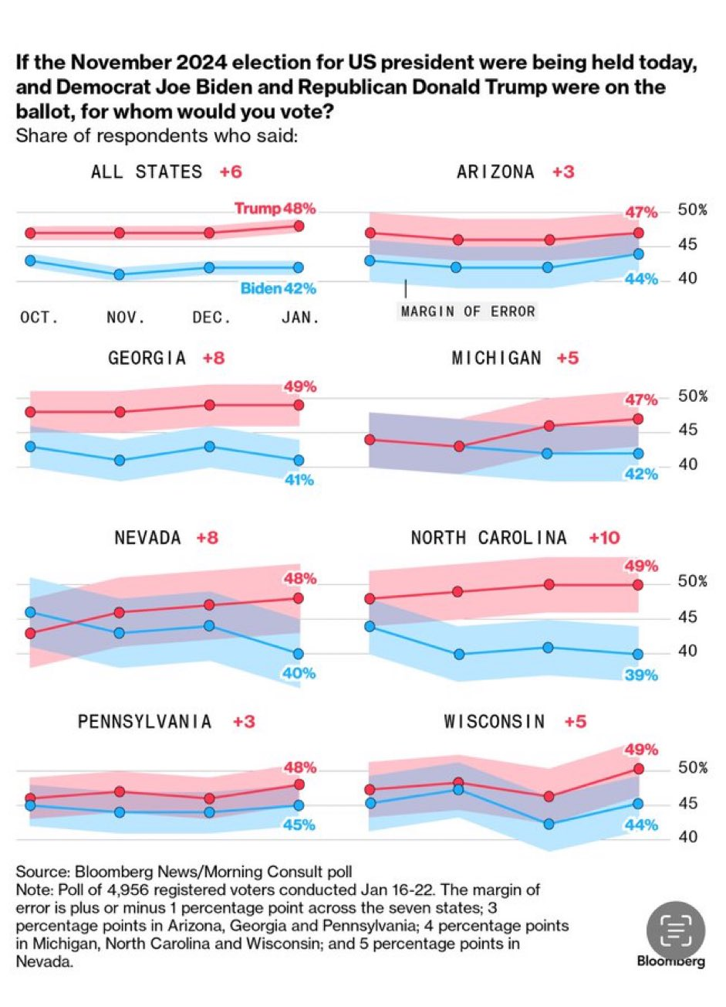
Election Handicapping
Title, Text Layout
Presidential election a moving target
  Biden’s age, state of the economy, Middle East
  Trump’s legal woes and unpopularity among a range of voters
Current Electoral Vote Projections
TRUMP
219
Electoral Votes
Battleground
93 Electoral Votes
BIDEN
226
Electoral Votes

Slide 5
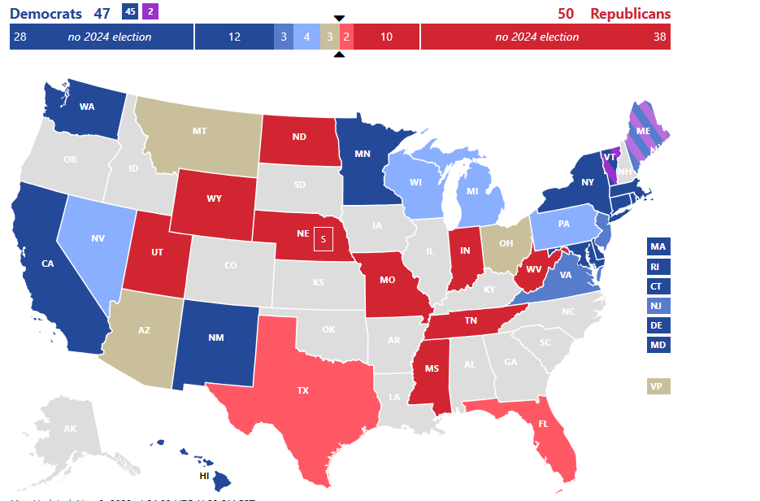
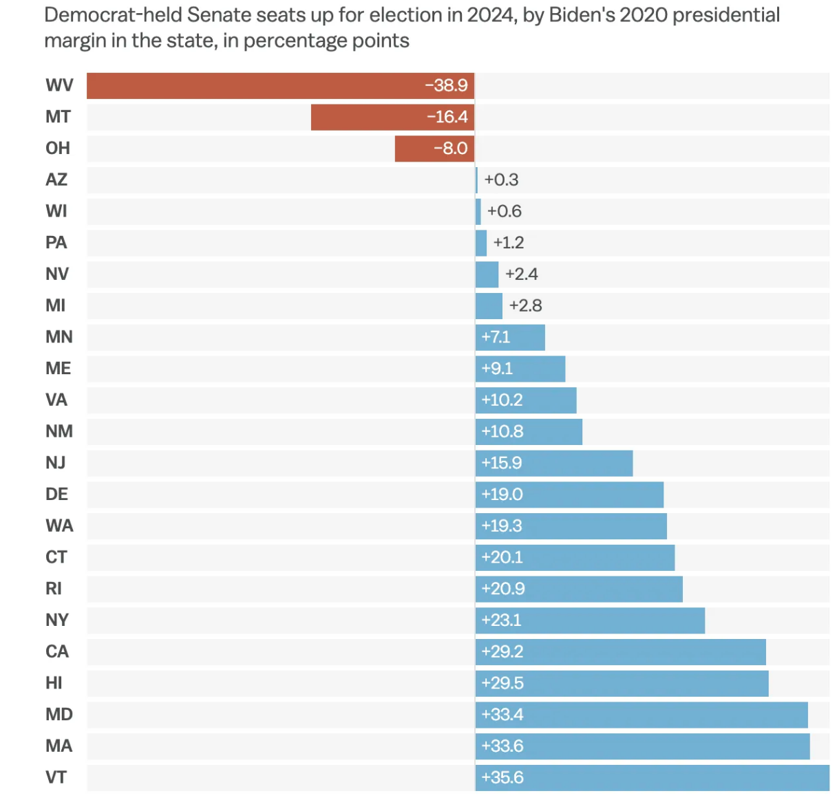
Election Handicapping (continued)
Title, Text Layout
At this time, Senate likely to go to the Republicans by a slim majority

Slide 6
Election Handicapping (continued)
Title, Text Layout
At this time, House likely goes to the Democrats
House Republicans occupy 16 districts President Biden carried in 2020.
 | Winner | Biden margin, 2020 | Republican margin, 2022 | Change
CA-27 | Mike Garcia | D+12.4 | R+8.4 | R+20.8
NY-04 | Anthony D'Esposito | D+14.5 | R+3.8 | R+18.3
NY-03 | Vacant (George Santos) | D+8.2 | R+8.2 | R+16.4
CA-40 | Young Kim | D+1.9 | R+14.4 | R+16.3
PA-01 | Brian Fitzpatrick | D+4.6 | R+10 | R+14.6
CA-45 | Michelle Steel | D+6.2 | R+6.4 | R+12.6
NY-01 | Nick Lalota | D+0.2 | R+11.8 | R+12.0
OR-05 | Lori Chavez Deremer | D+8.9 | R+2.4 | R+11.3
NY-17 | Mike Lawler | D+10.1 | R+0.8 | R+10.9
NE-02 | Don Bacon | D+6.3 | R+3 | R+9.3
NY-22 | Brandon Williams | D+7.5 | R+1 | R+8.5
NJ-07 | Tom Kean, Jr. | D+3.9 | R+3.6 | R+7.5
NY-19 | Marc Molinaro | D+4.6 | R+2.2 | R+6.8
VA-02 | Jen Kiggans | D+1.9 | R+3.4 | R+5.3
AZ-01 | Dave Schweikert | D+1.5 | R+0.8 | R+2.3
AZ-06 | Juan Ciscomani | D+0.1 | R+1.4 | R+1.5

Slide 7
Some of the Top Issues Relating to Oncology
Change Healthcare cyber attack and aftermath
Restricting oncology practices from delivering drugs to patients
PBM/insurer issues too long to list, but here are some of the most pronounced:
  Spike in prior authorizations
  Low-ball Part D reimbursements
  Restricting biosimilar use
  Mandatory mail order and white bagging
Increasing cost of hospital care
  Push for site-neutral payments
  Address 340B abuses
Drug shortages
Medicare physician pay
IRA and Medicare negotiating drug prices

Slide 8

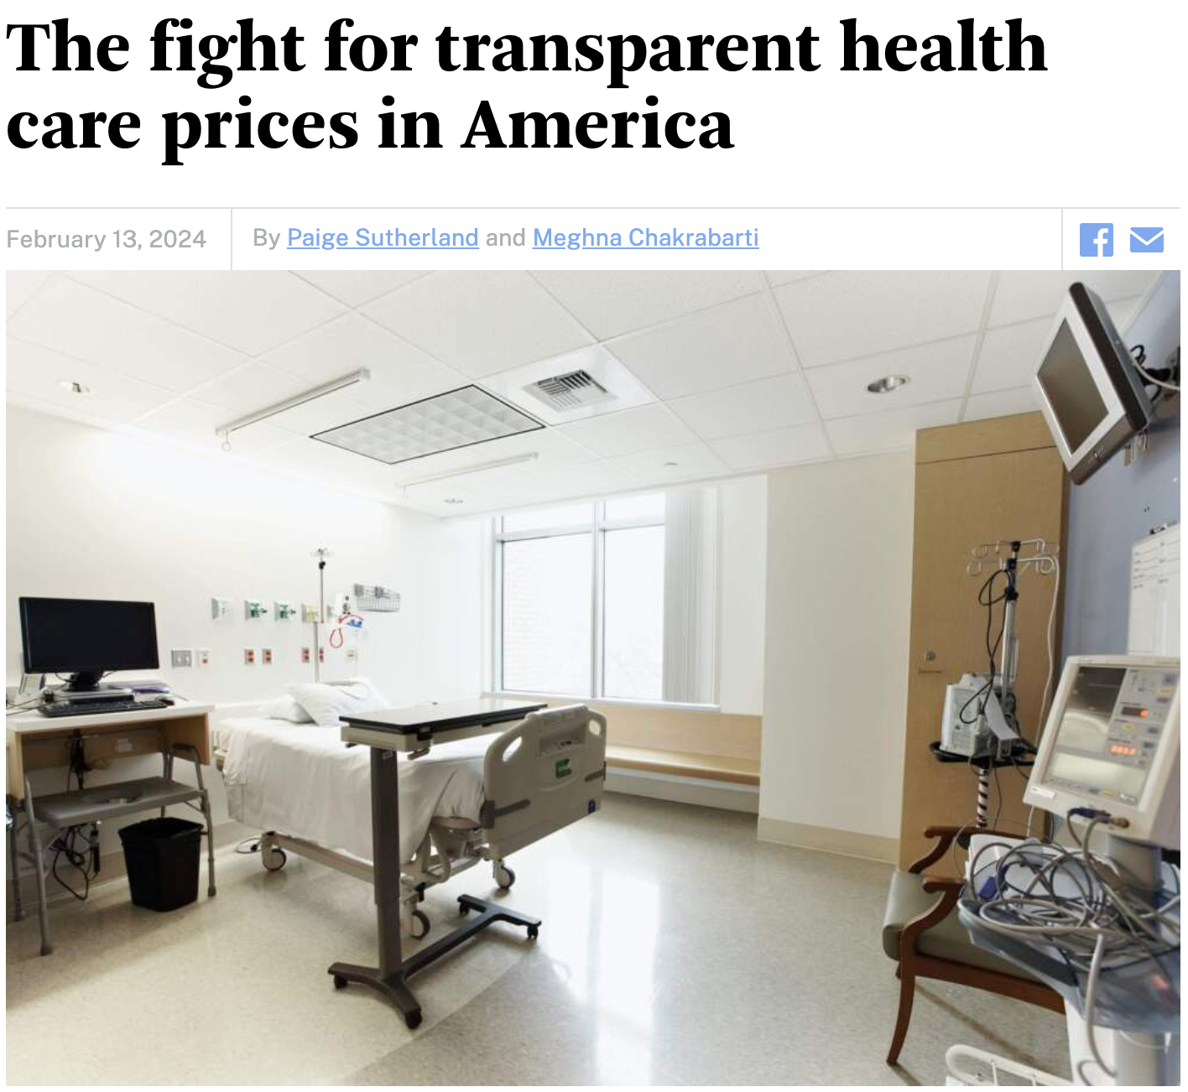
Two ”Themes” That Permeate Issues
Consolidation
  Hospital systems
  Insurers & PBMs
  Others (like Change Healthcare)
Transparency
  Hospital pricing
  PBM rebates
  340B discounts
  Insurance contracts

Slide 9
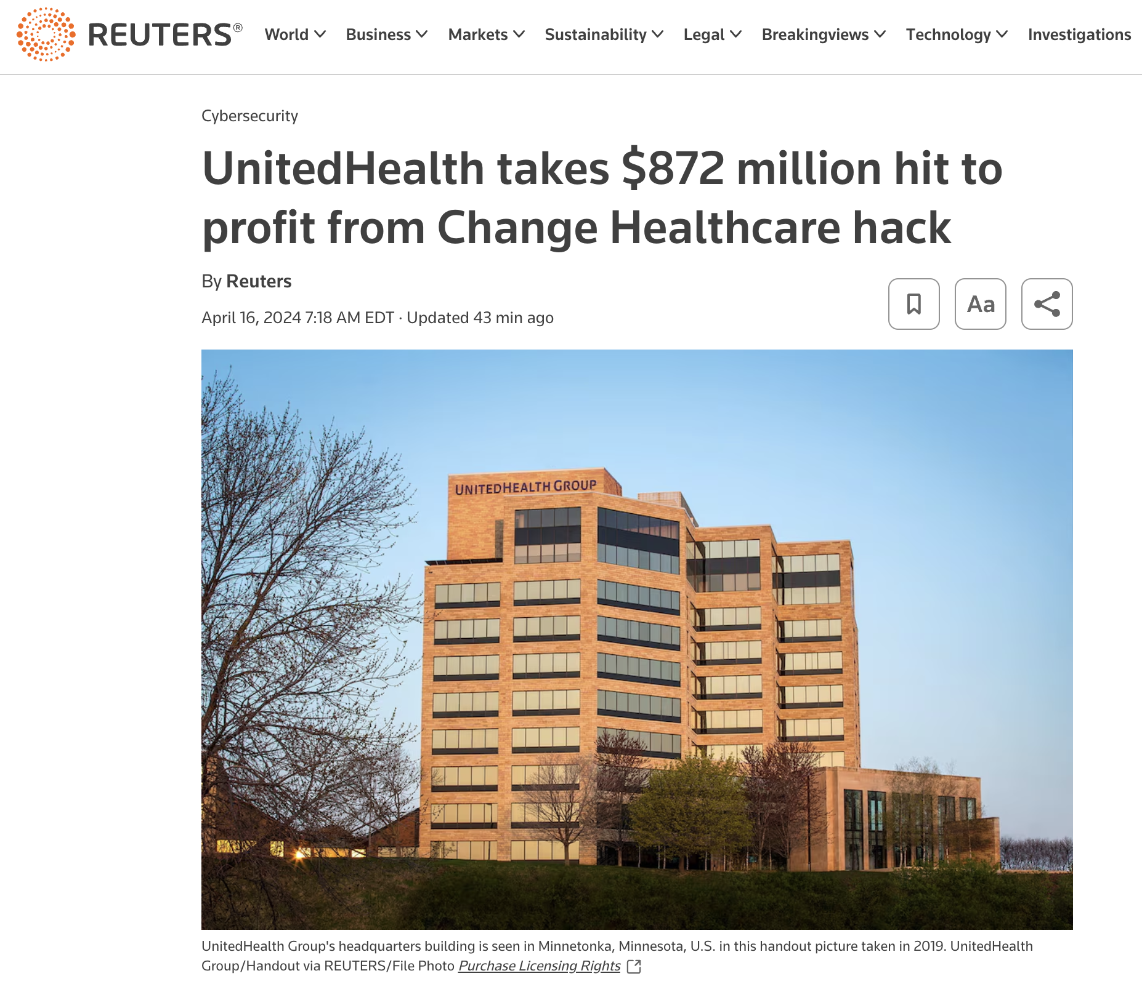
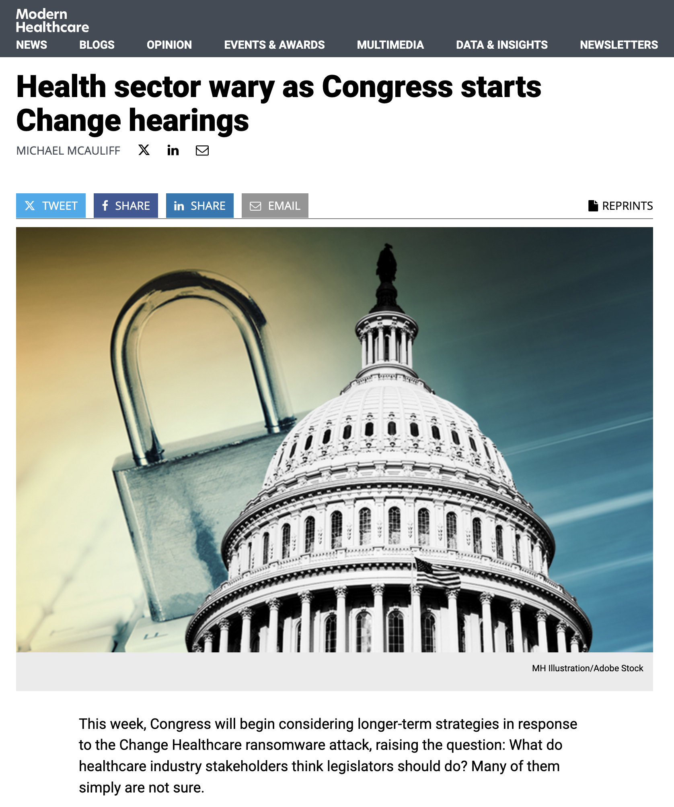
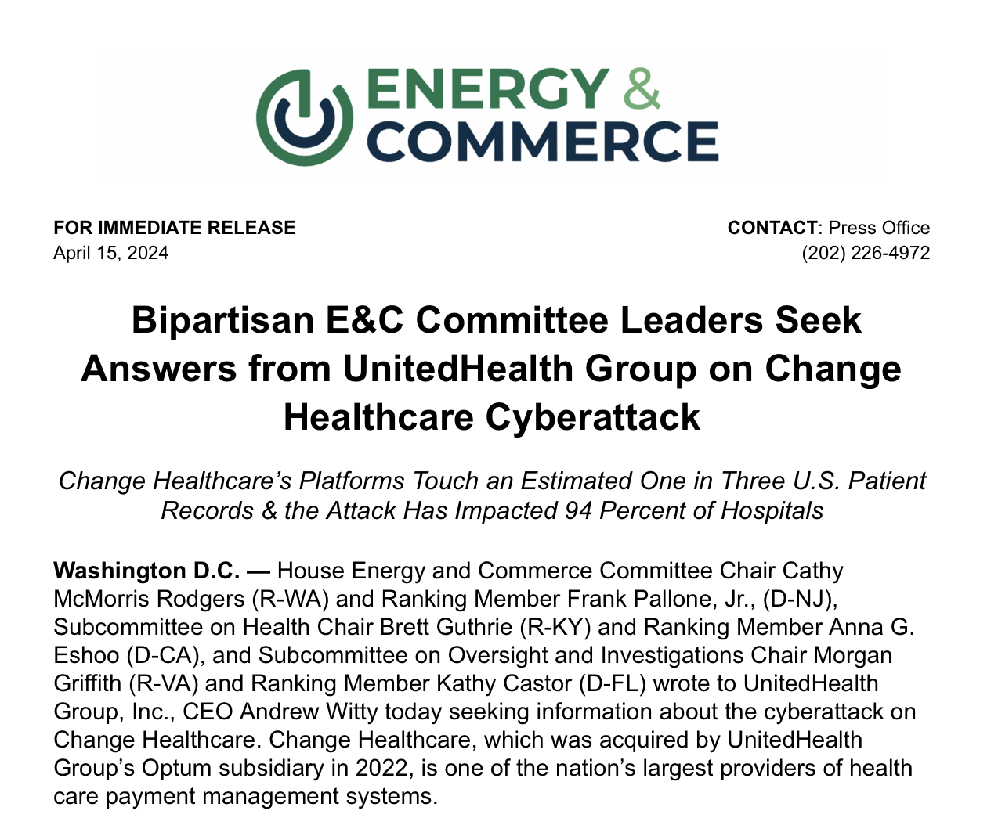
Change Healthcare Cyber Attack
Few really understood the huge footprint of (consolidated) Change Healthcare as the digital “pipe” between providers and others
Impacted a wide spectrum of everyday operations
  Prior authorizations
  Copay verifications
  Reimbursements
  Patient financial assistance
COA fully engaged with the White House & CMS
Let me know if still any issues

Slide 10
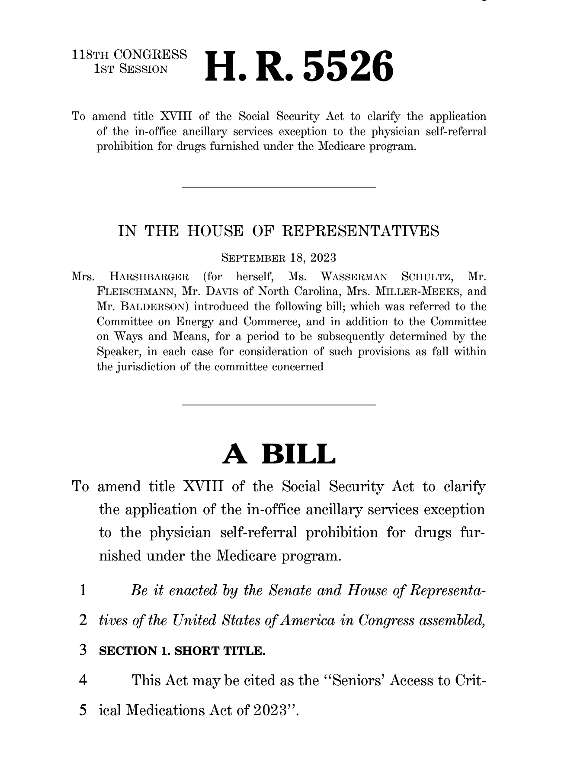
The Stark Issue
CMS using the Stark law to stop practices from delivering drugs (or even caregivers from picking up drugs for patients)
COA working with Congress to get legislation advanced to stop CMS
  H.R. 5526: Bipartisan bill with 61 members sponsoring
  S. 3458: Bipartisan bill (identical to House version) recently launched
House bill passed the Energy & Commerce Health Subcommittee
COA suing HHS/CMS
  Motion for preliminary injunction denied
  Oral arguments recently held
FOIA request to uncover what prompted CMS to issue Stark FAQ
This ties back to PBMs

Slide 11
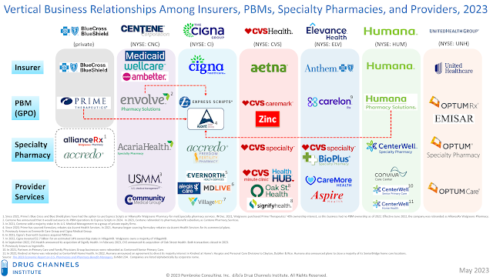
The Consolidation of Insurers & PBMs

Slide 12
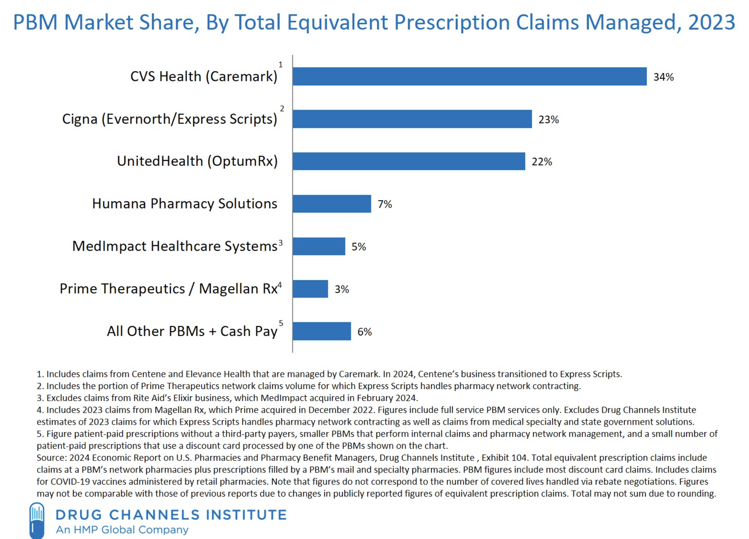
Top 6 PBMs Control 94% of Rx Drug Market

Slide 13
Implications of Insurer/PBM/Etc. Consolidation
Insurers increasingly dictating treatment decisions
  Leverage based on market size
  Owning physicians
Utilization management being utilized more by insurers
  Prior authorizations
    Now using AI
  Step therapy
Increasingly dictating higher cost therapies that are the most profitable drugs to the insurer/PBM
Fueling drug prices by demanding rebates
Dictating where and how patients receive treatment
  Mandatory mail order
  White bagging

Slide 14
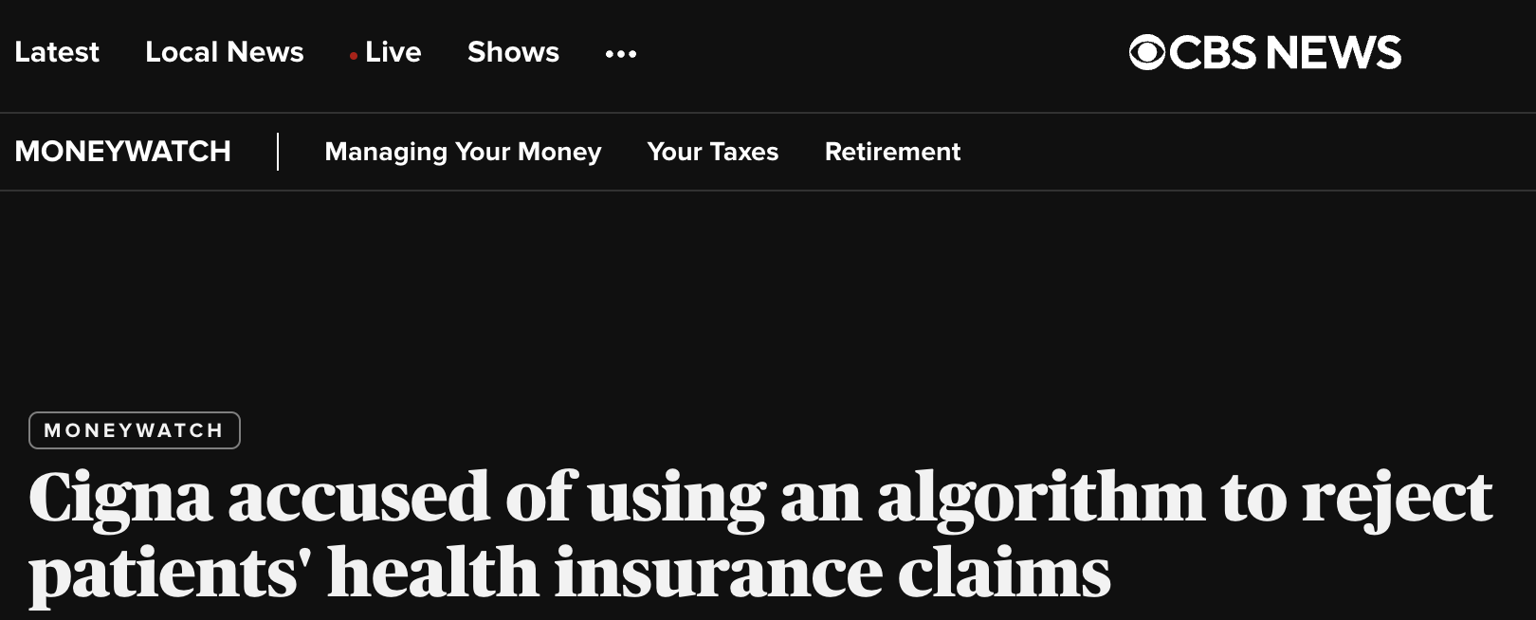

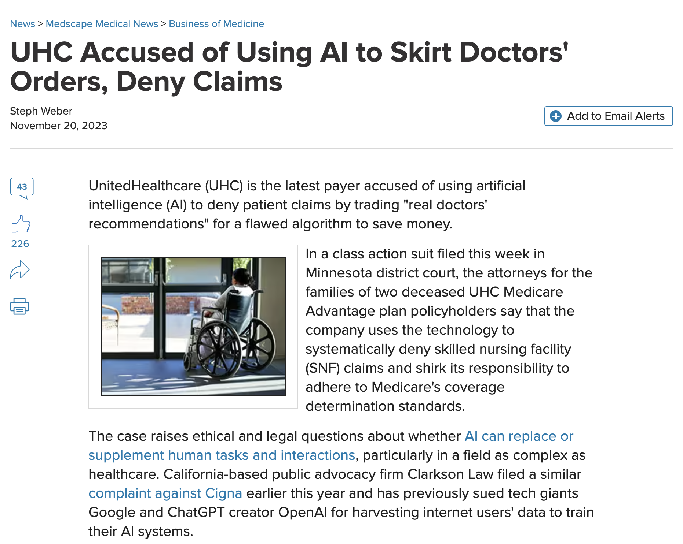
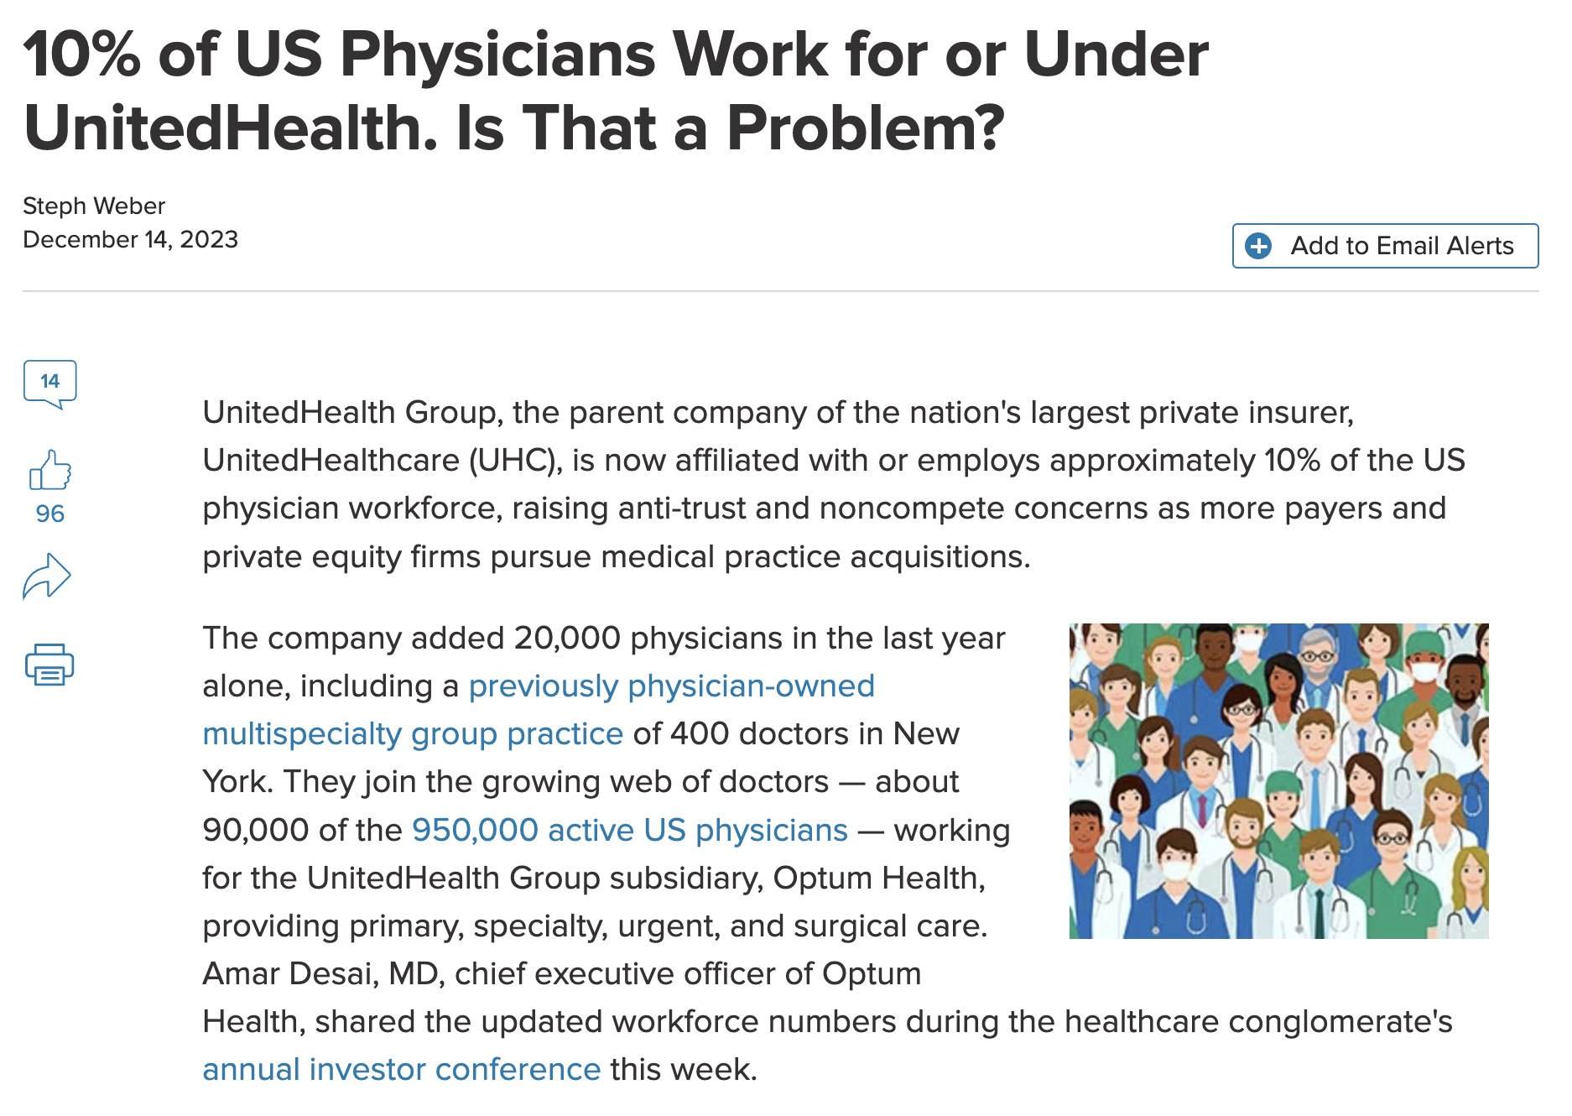
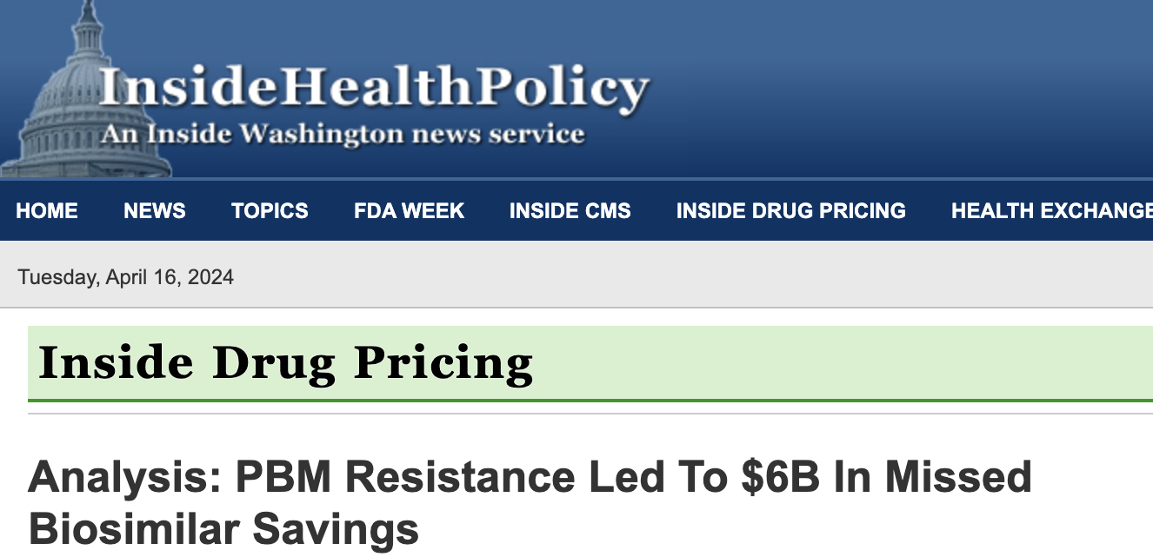
Just a Few Headlines…

Slide 15
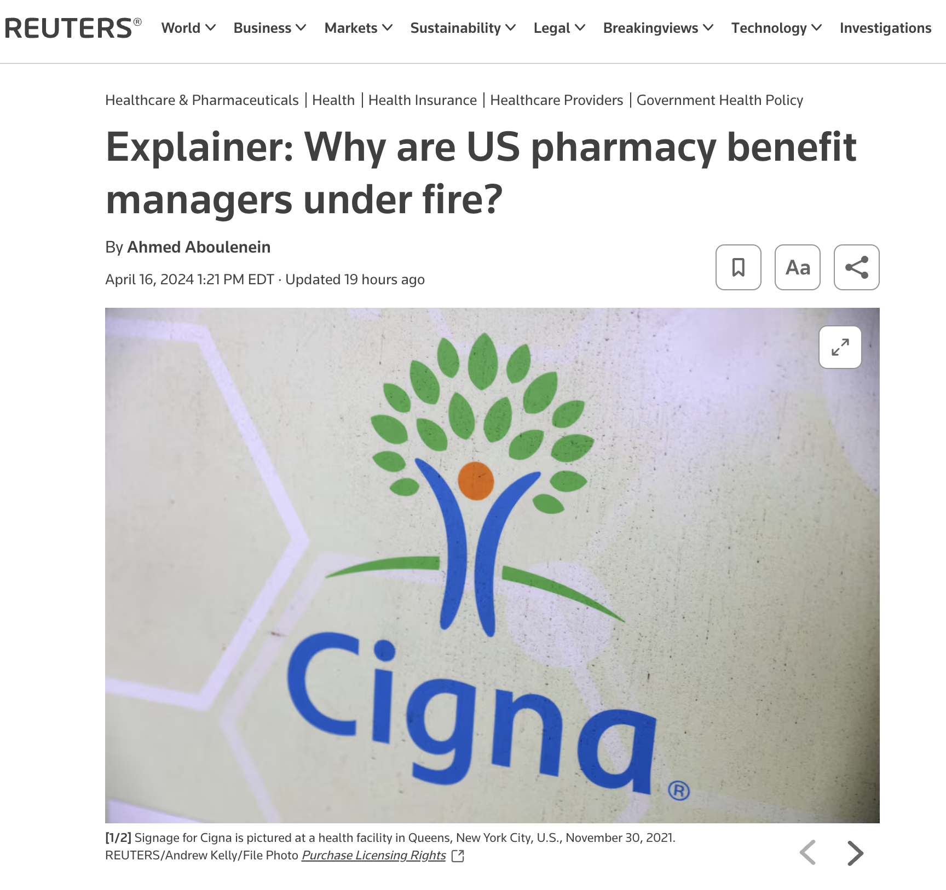
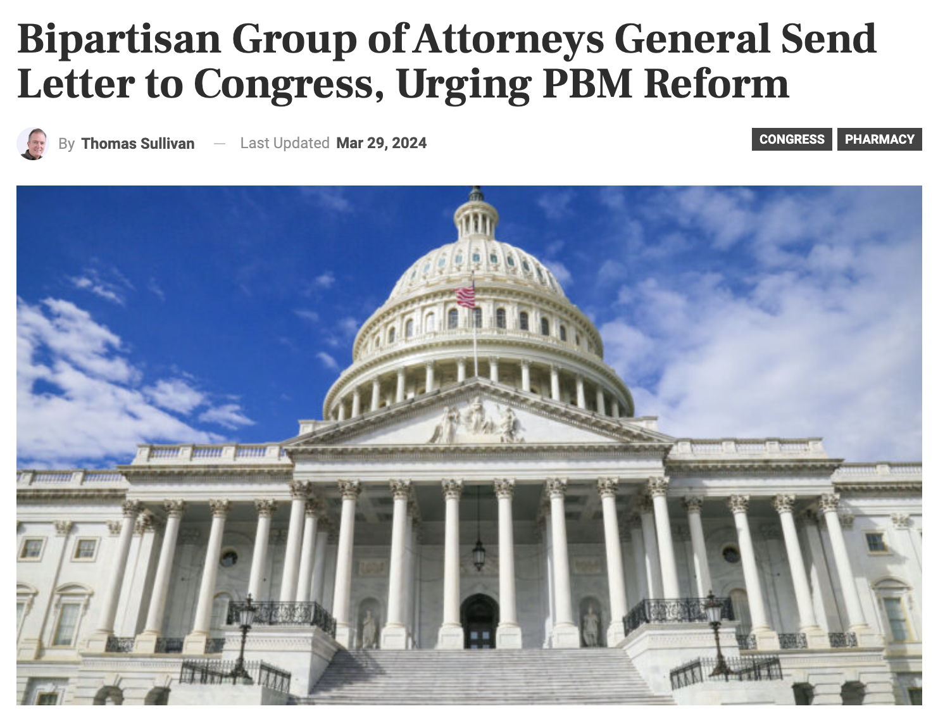
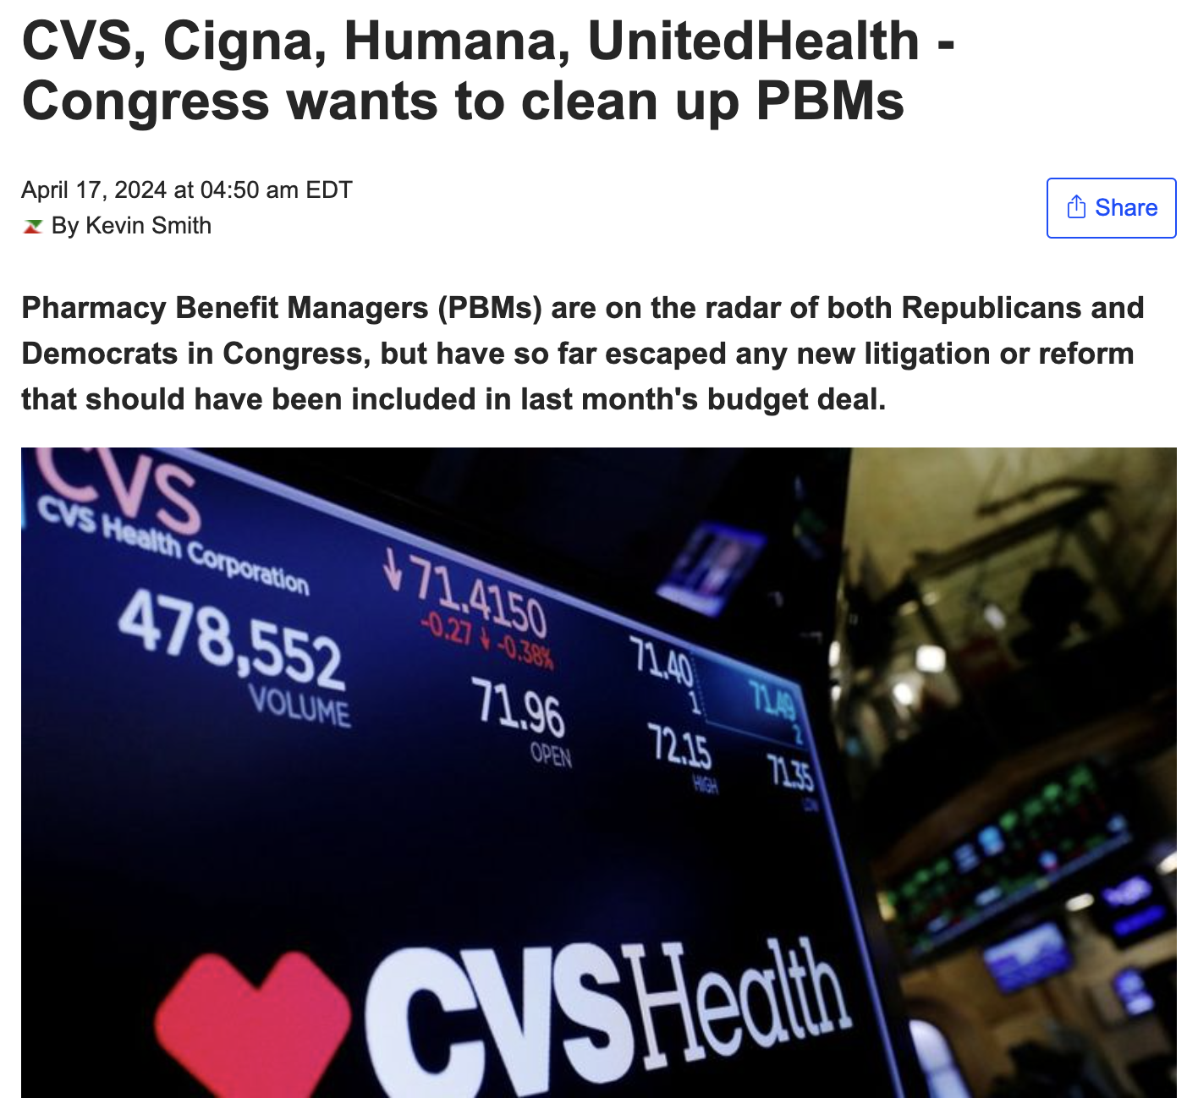
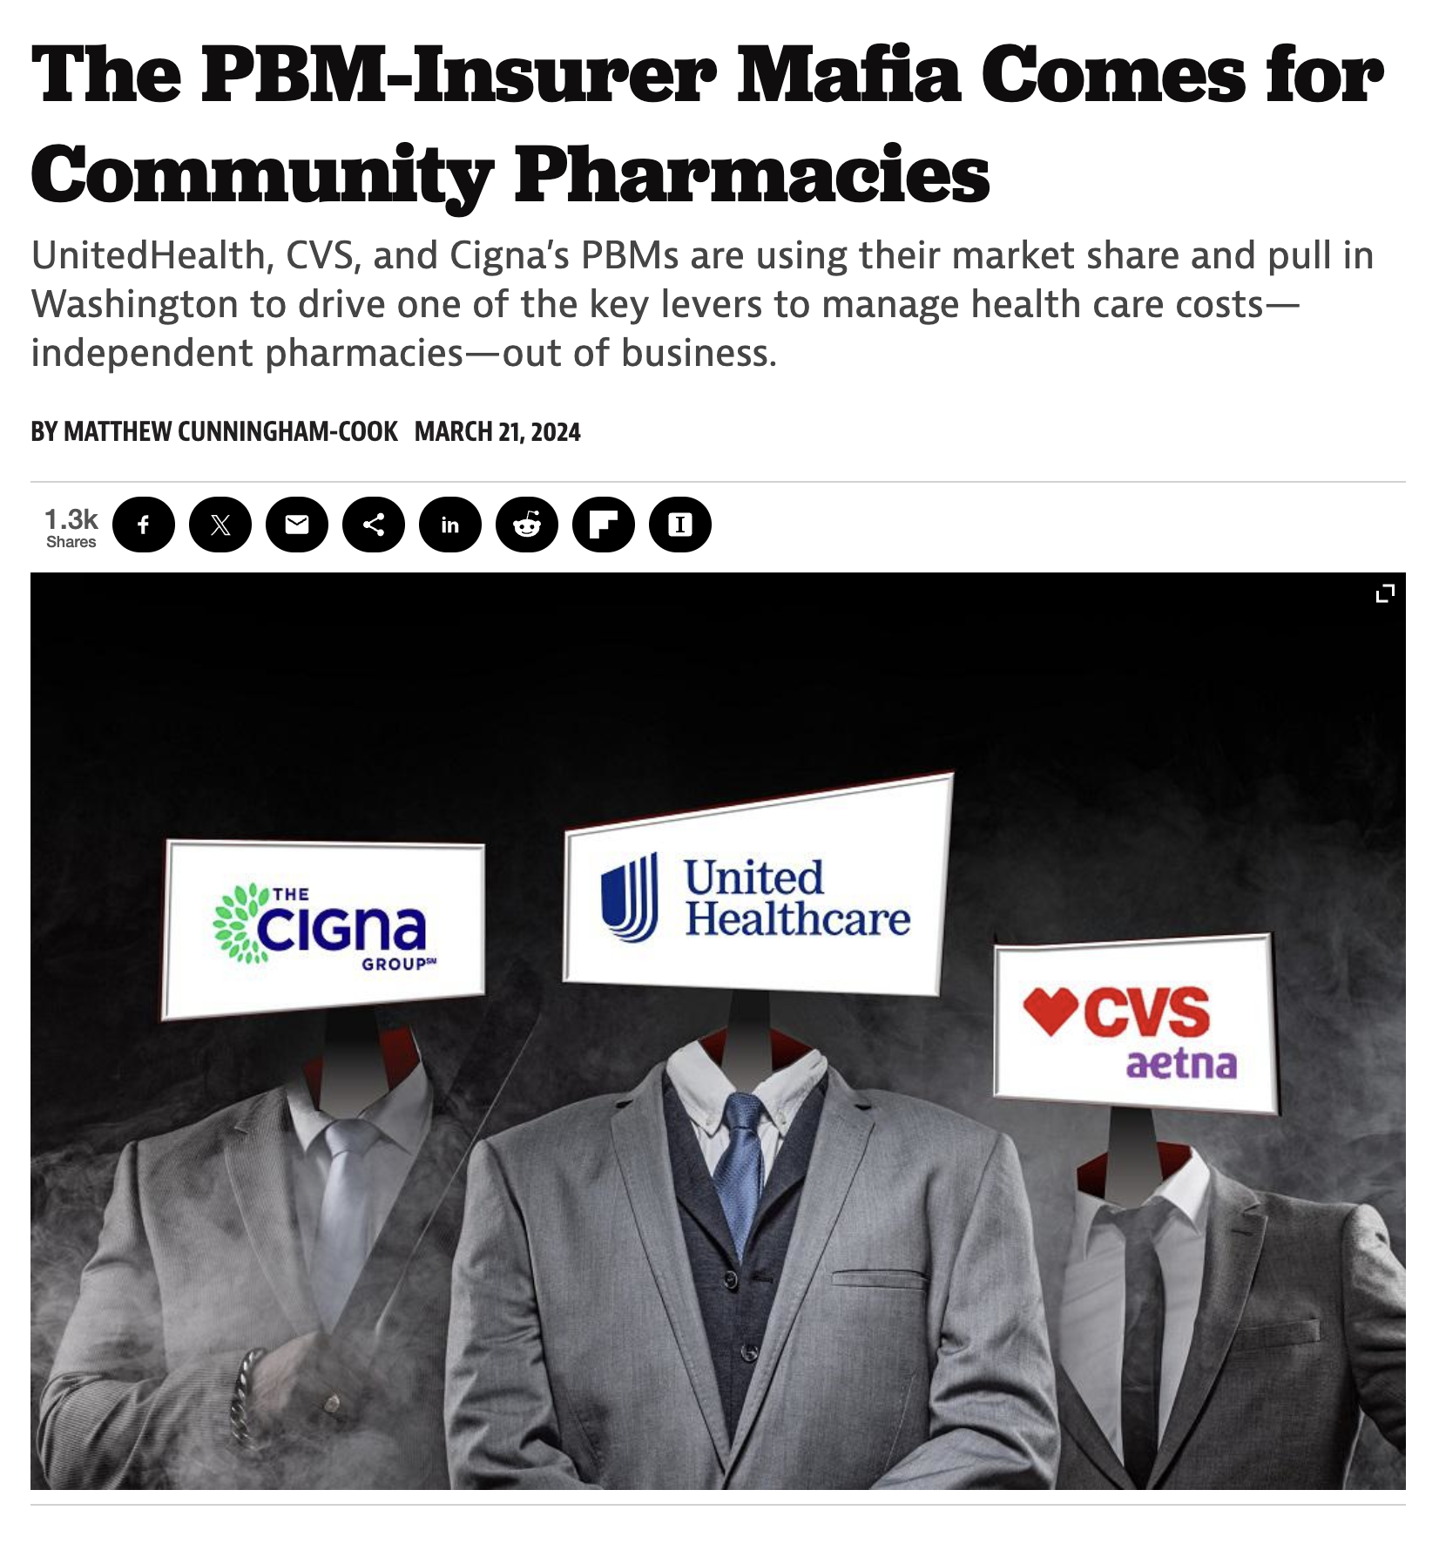
Federal & State Pressures on PBMs

Slide 16
Low-Ball PBM Reimbursement
Eliminated retroactive DIR fees starting 1/1/24
  But expected PBMs to jack down Part D reimbursement to make up for lost DIR fee revenue
Preliminary look at PBM reimbursement, especially Express Scripts, shows this is what has happened
  Net 2023 reimbursement (reimbursement plus DIR fees) AWP minus 20%
  2024 reimbursement AWP minus 25%
Letters to ESI and CMS, copying Congress
Engaging congressional committees
Looking at possible legal action and legislation
Held a webinar on to engage practices
Now seeing ESI ”bonus pool” popping up

Slide 17
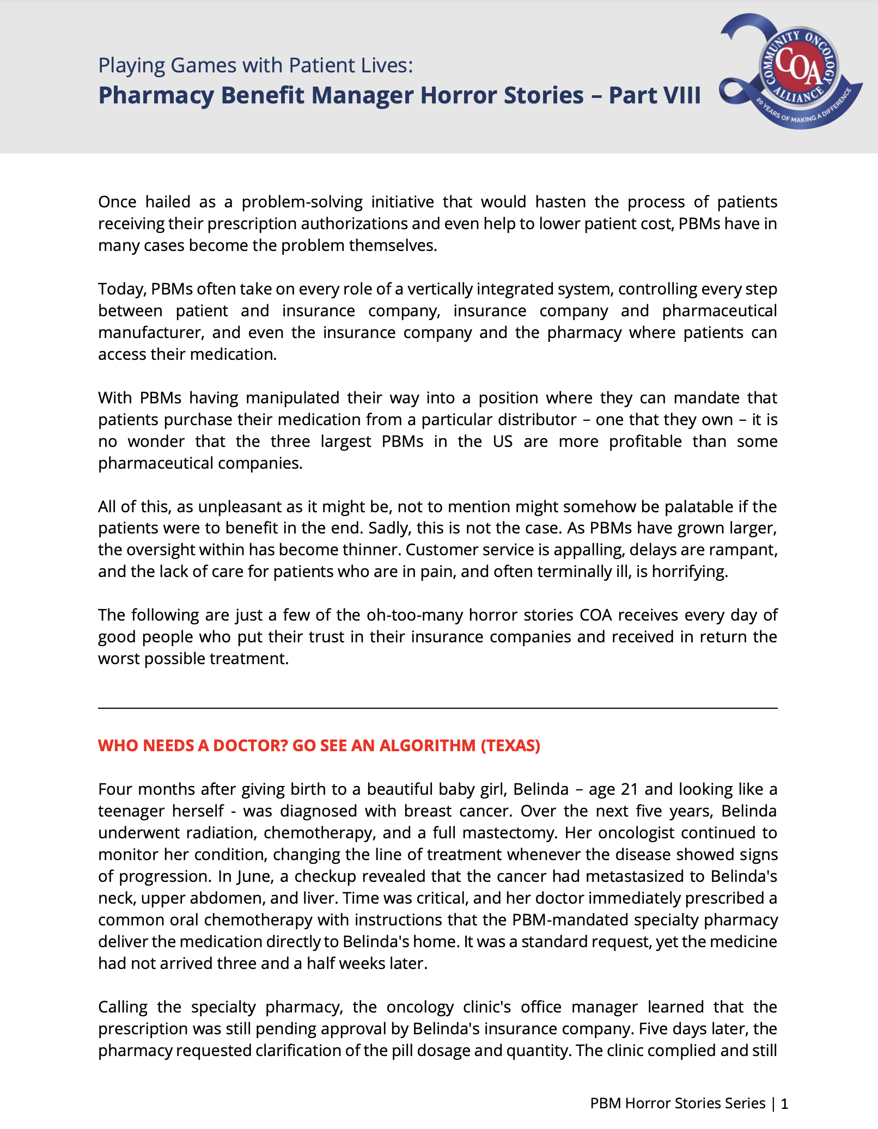
Documenting PBM Abuses
COA has published 8 volumes of PBM patient horror stories
  Latest version out today and another one out next week
Detail very specific cases of where patient care is impeded and harmed at the hands of PBMs

Slide 18
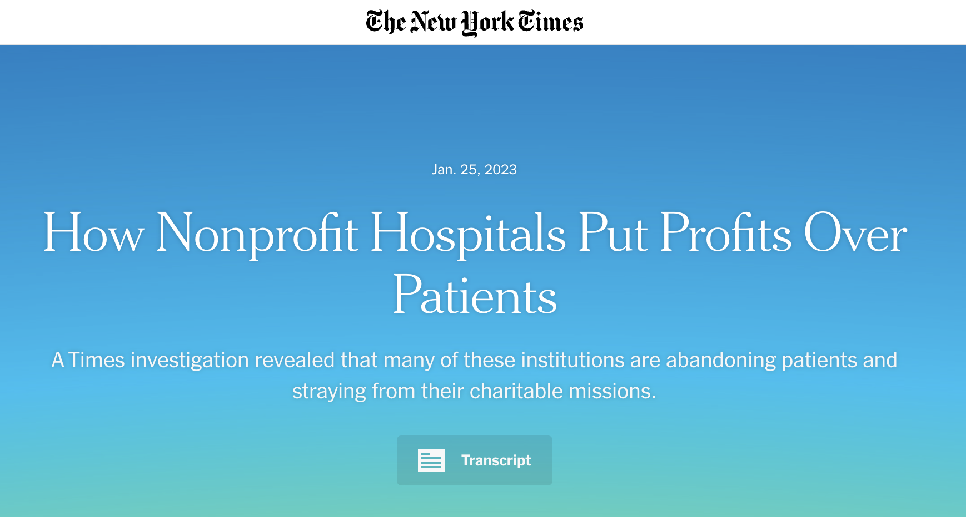
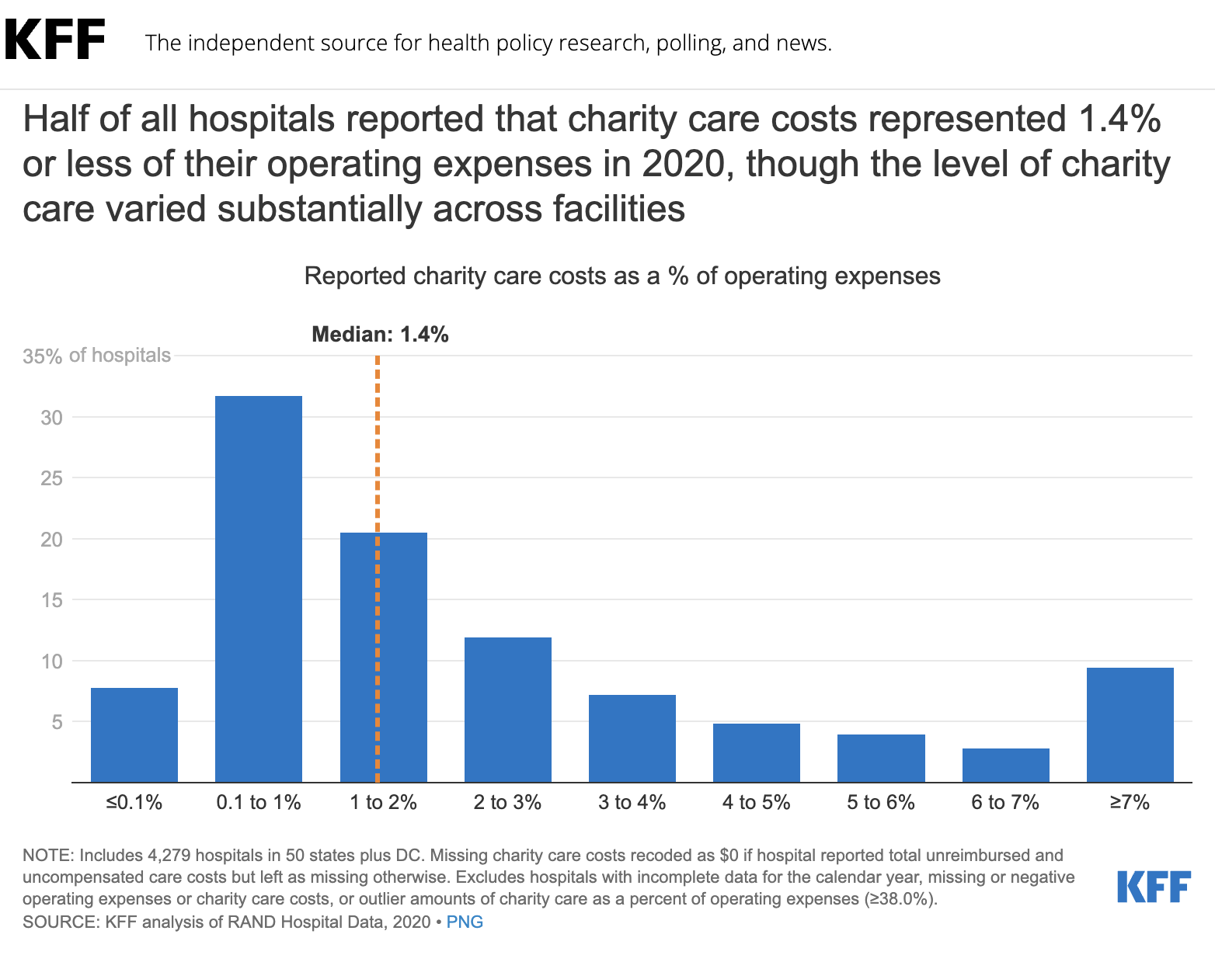
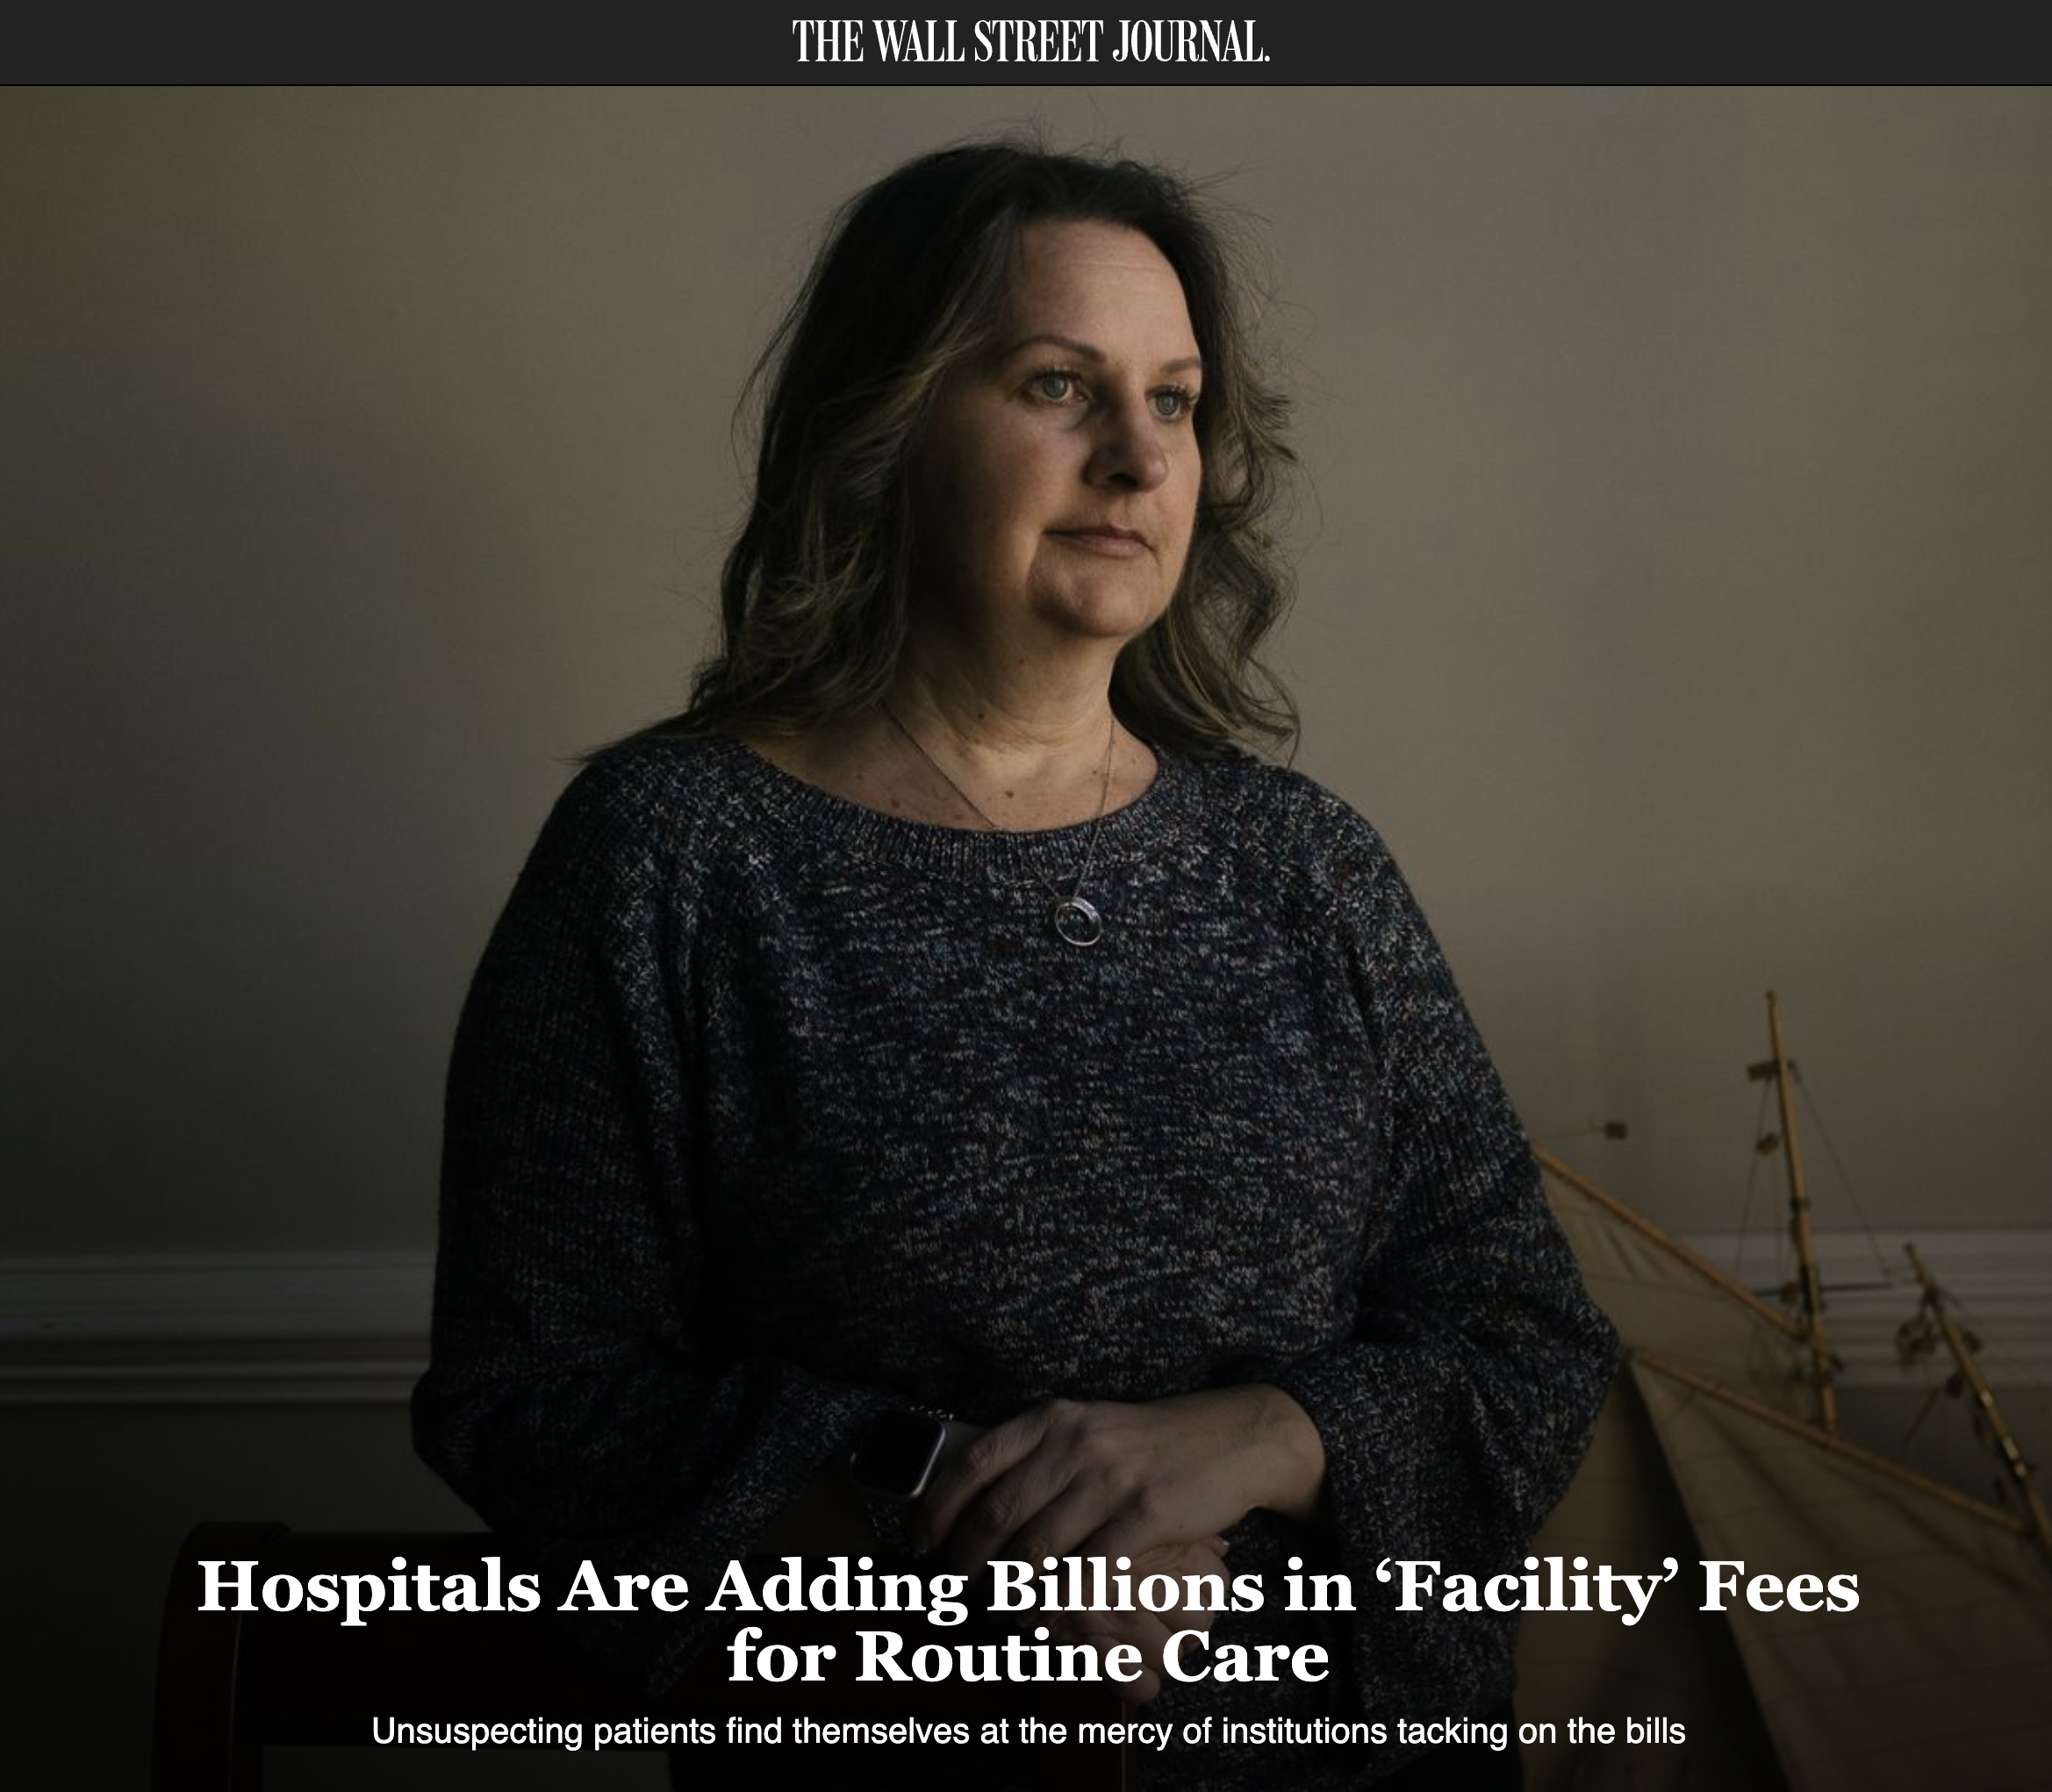
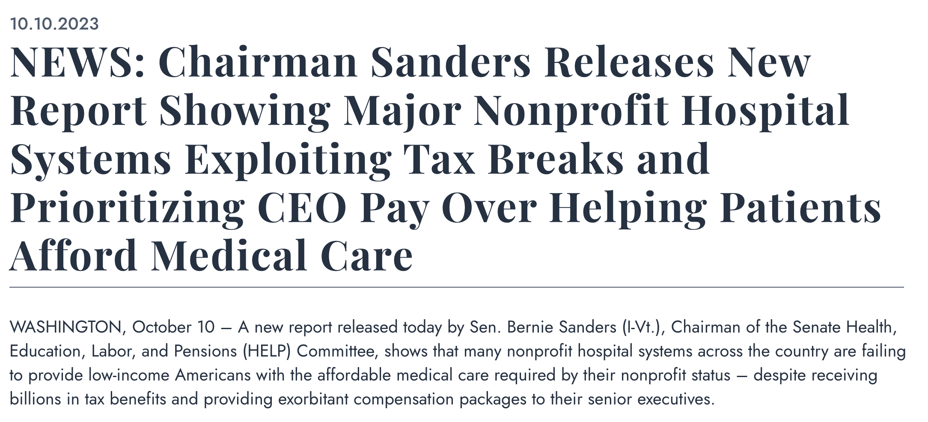
Hospital Issues in the Legislative Spotlight

Slide 19
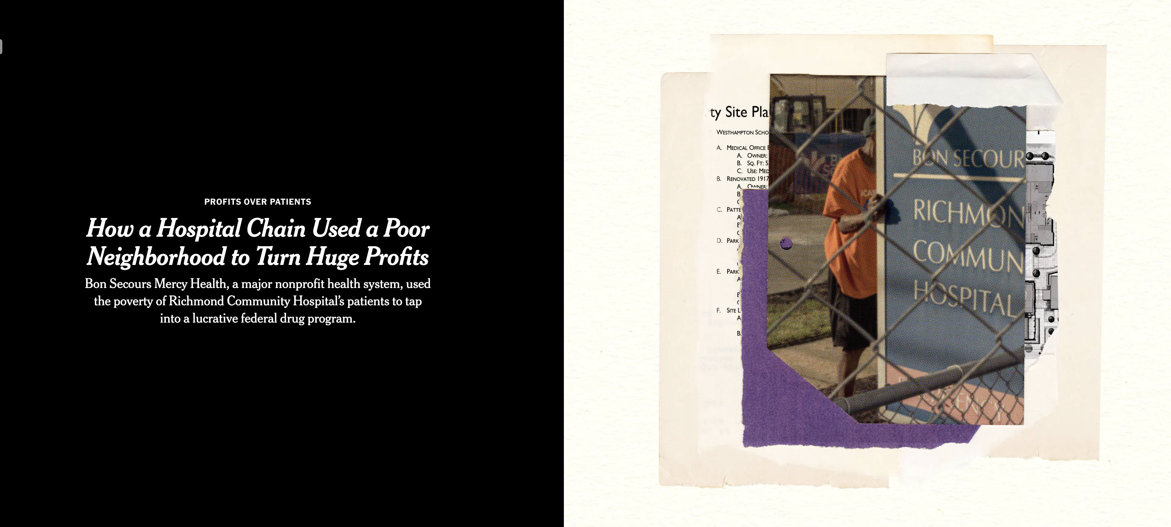
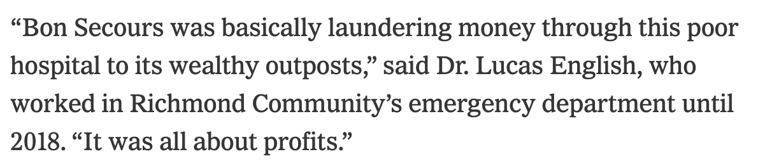
Spotlight on the 340B Drug Discount Program

Slide 20
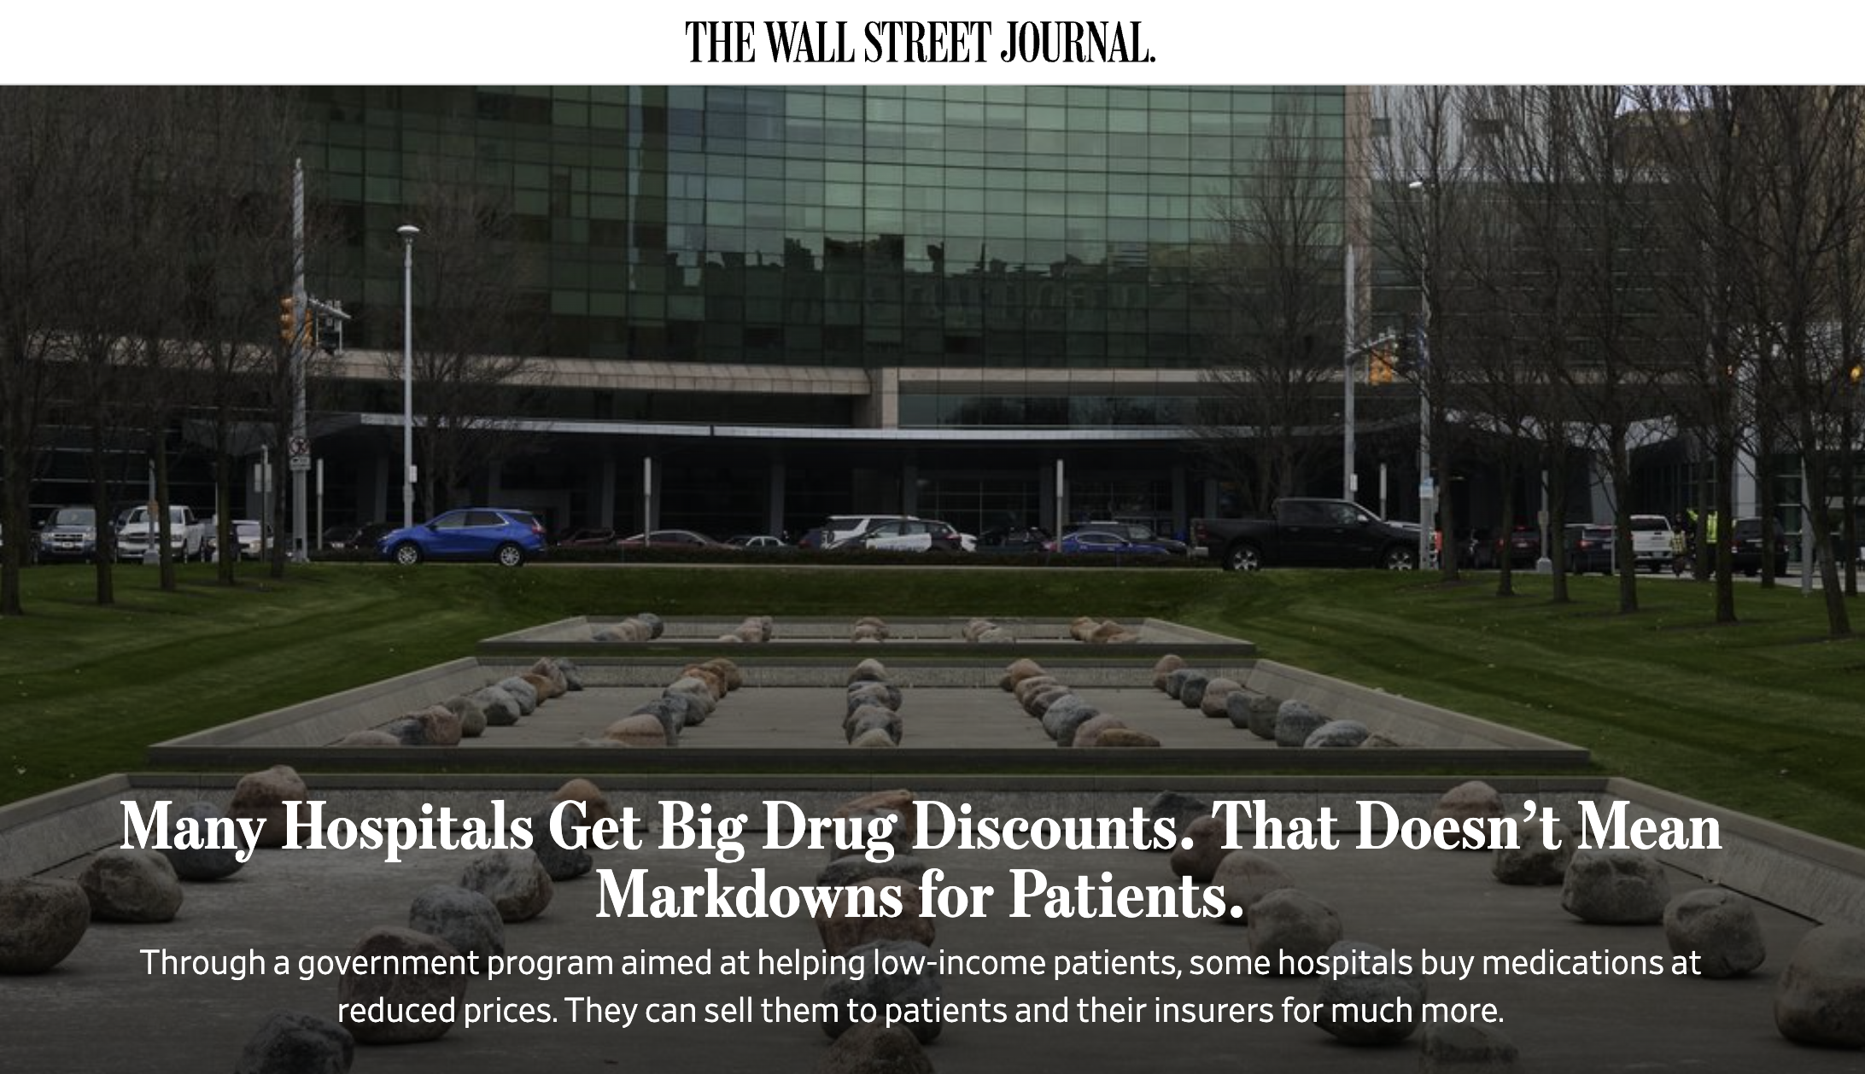
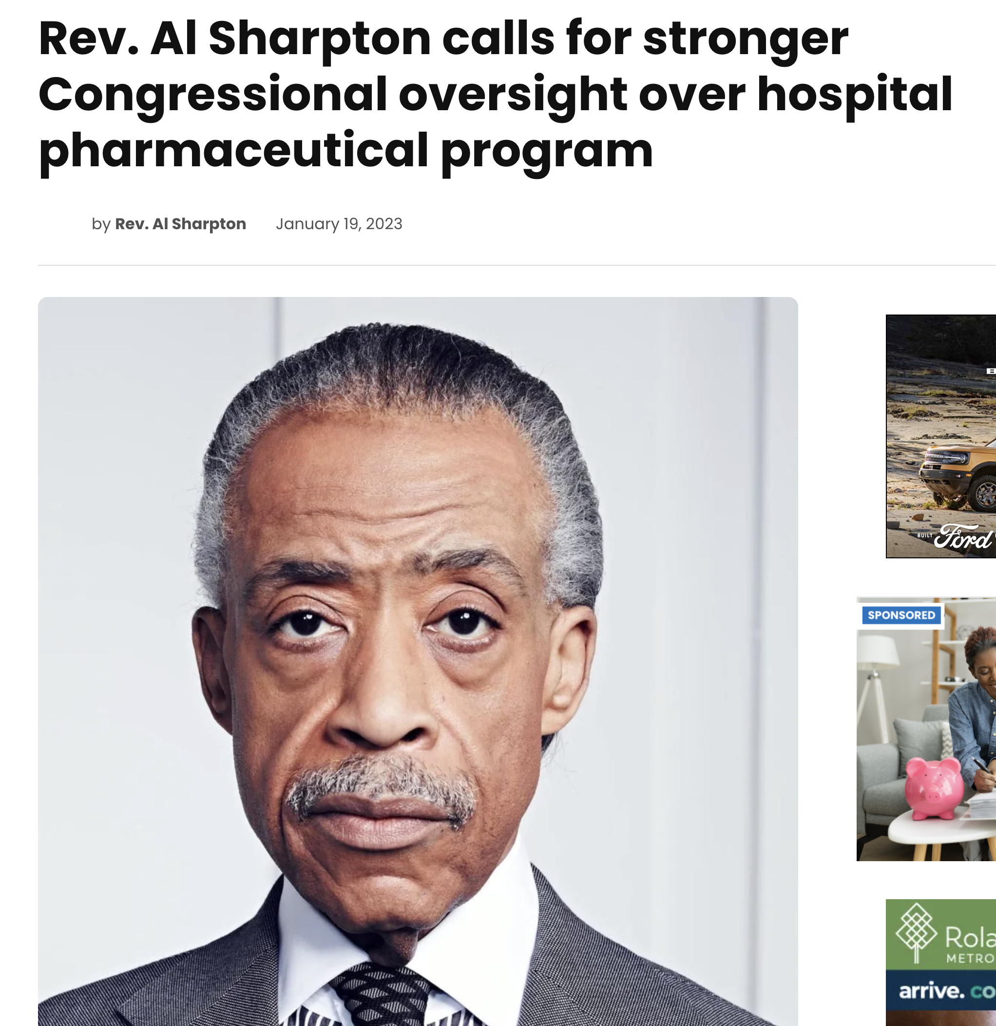
Investigative Reports & Calls for Oversight

Slide 21
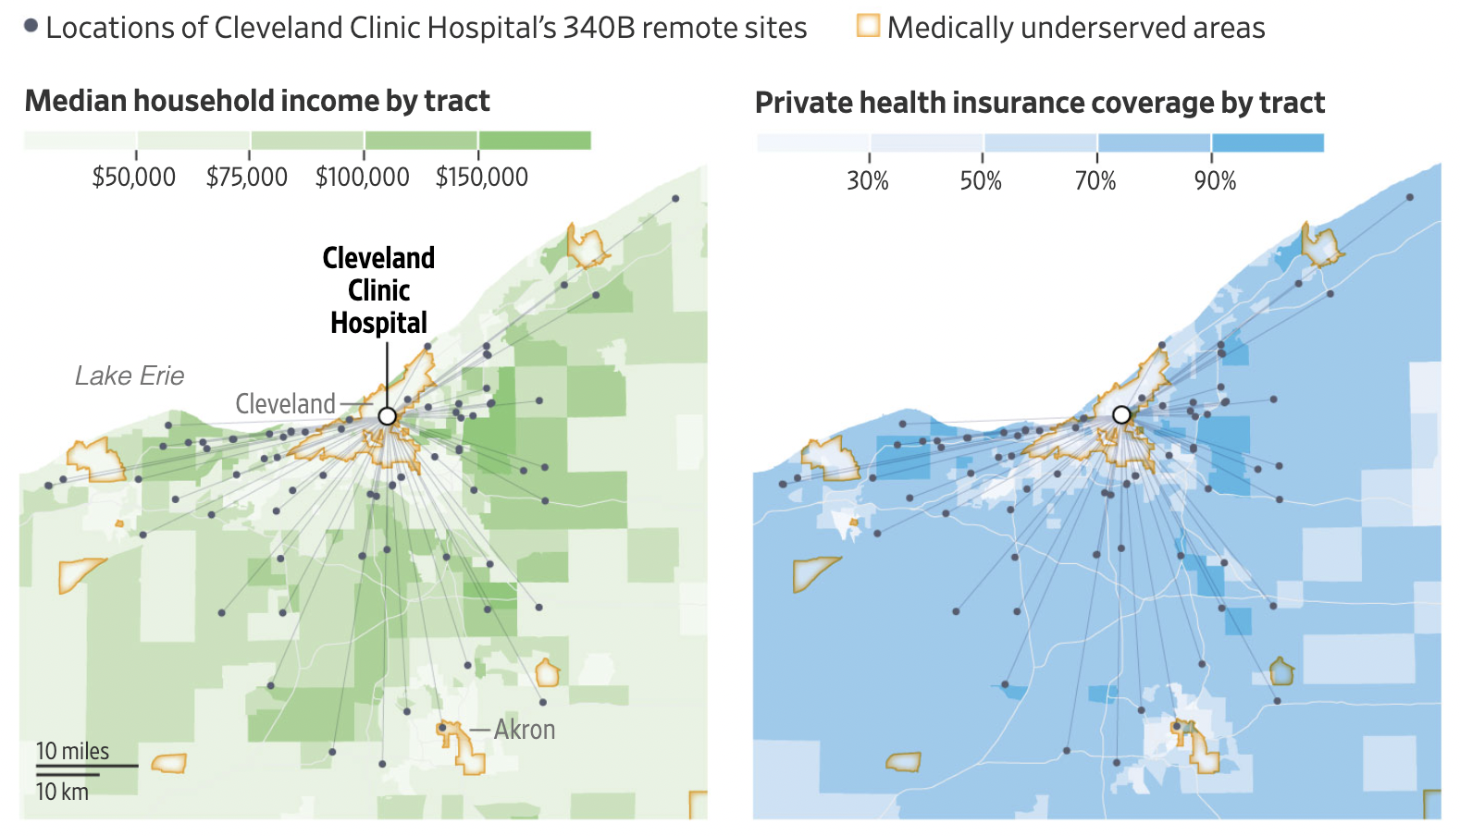
Wall Street Journal Investigative Report
“Most of the satellite 340B sites of Cleveland Clinic’s flagship hospital are in areas with higher levels of household income and private health insurance than its main campus. Locations can include multiple sites.”

Slide 22
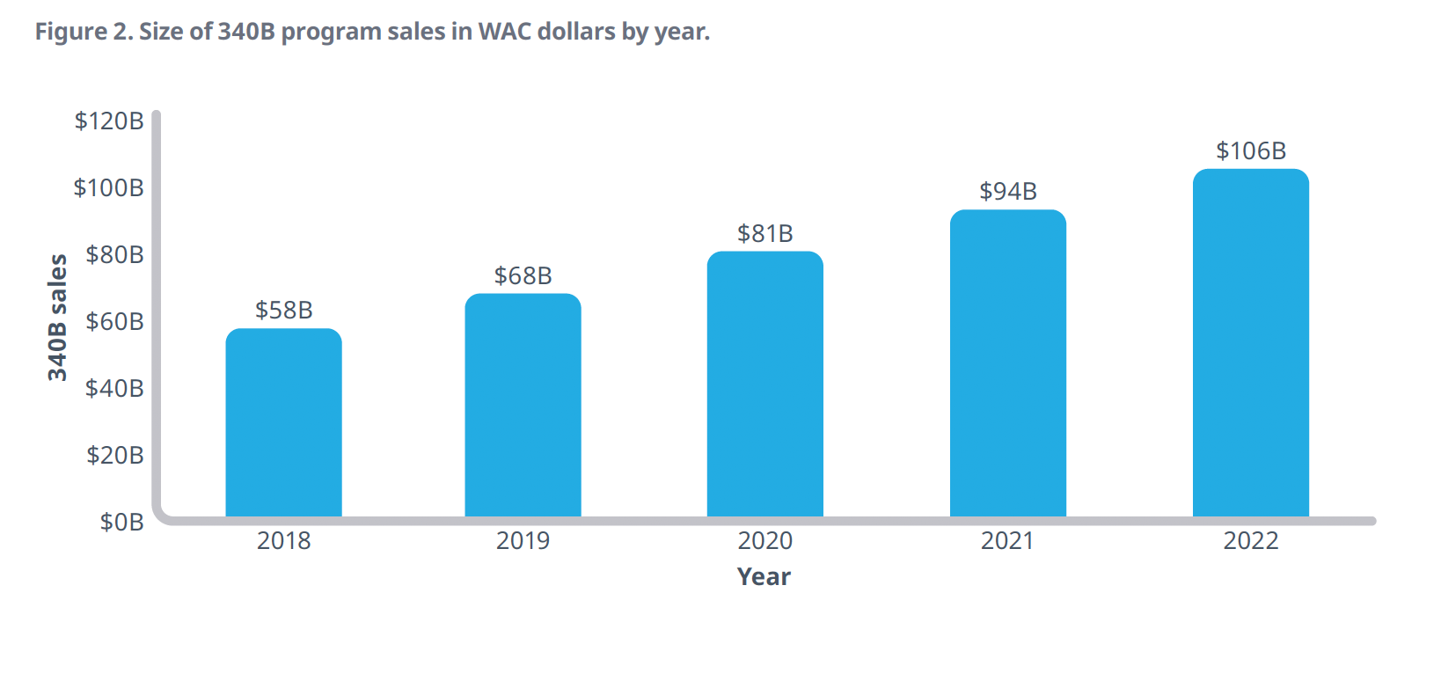
340B Growth
The 340B program has expanded from a handful of safety net providers to 50+% of all U.S. hospitals (Source: USC Schaeffer Center for Health Policy Economics)
  WAC list price value of 340B drug purchases $106 billion in 2022 (Source: IQVIA)
    Close to doubling from 2018
    Over 15% of the total U.S. pharmaceutical market
340B generated $40 billion in profits for participants (Source: Masia/Columbia University & SSR Health)
One estimate is that by 2026 340B will be the largest federal drug program, surpassing both Medicare and Medicaid drug programs (Source: Berkeley Research Group)

Slide 23

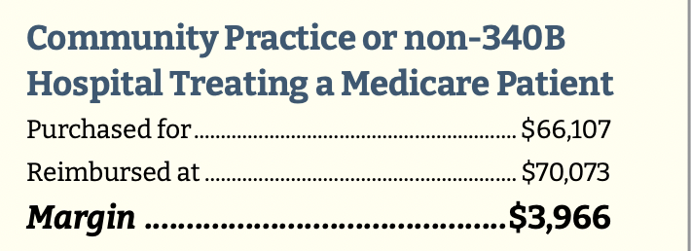
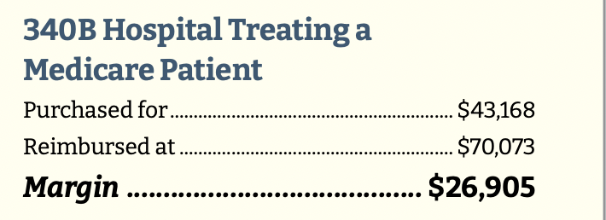
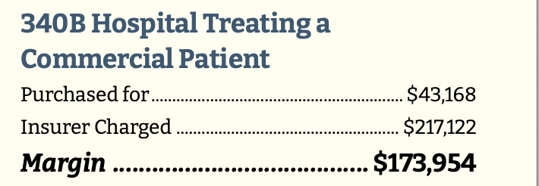
340B Drug Markups Excessive
Title, Text Layout

Slide 24
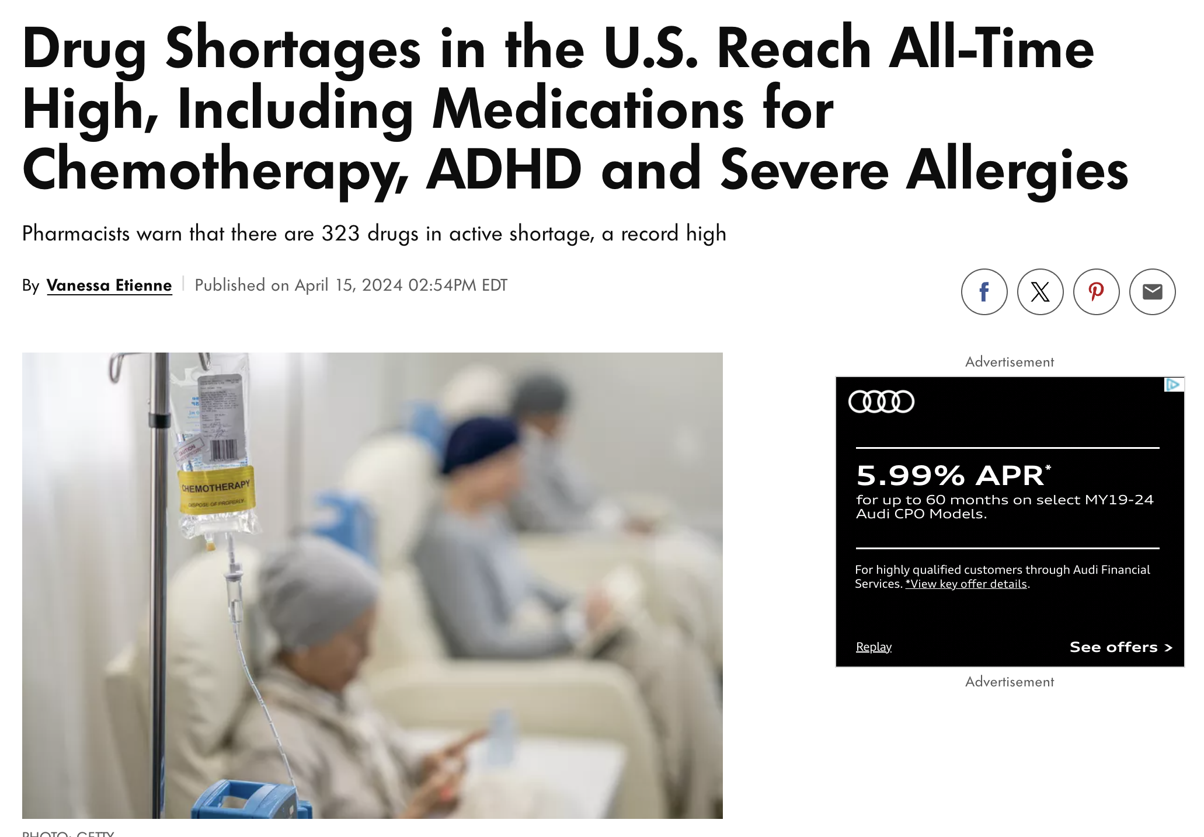
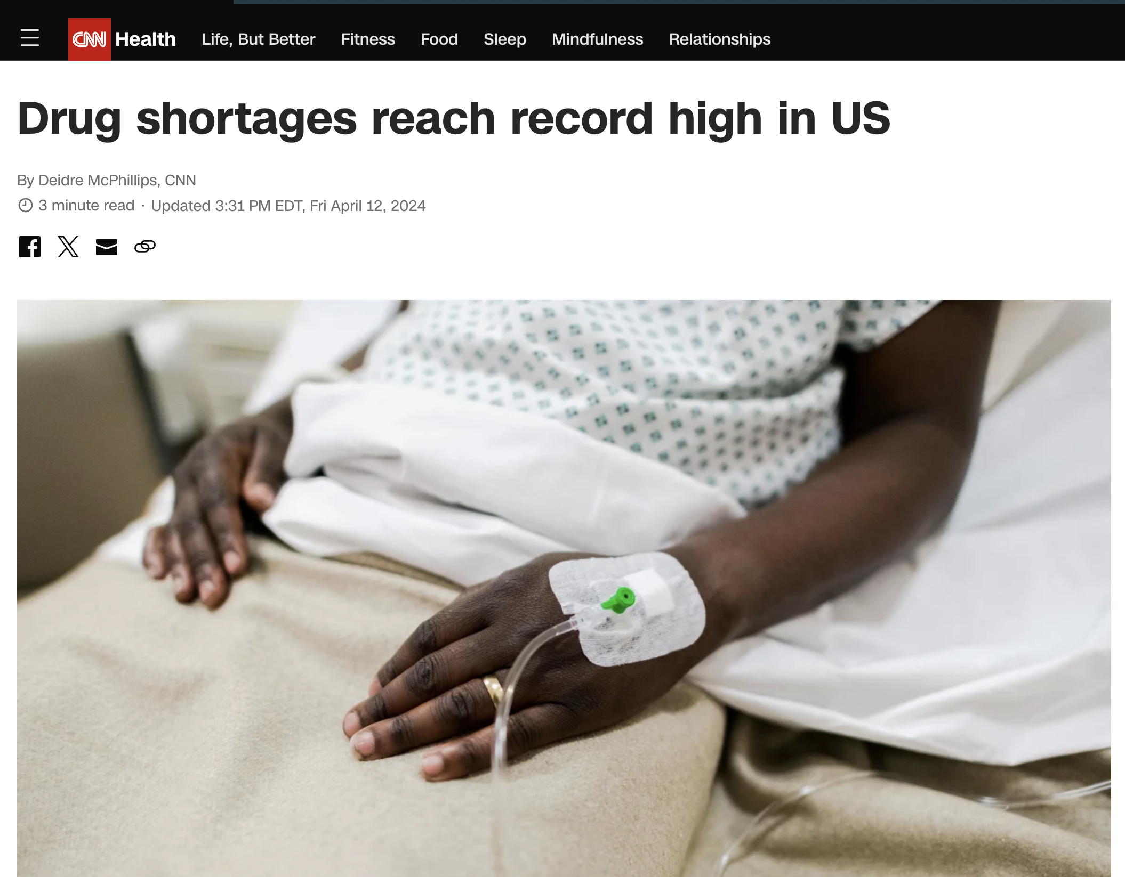
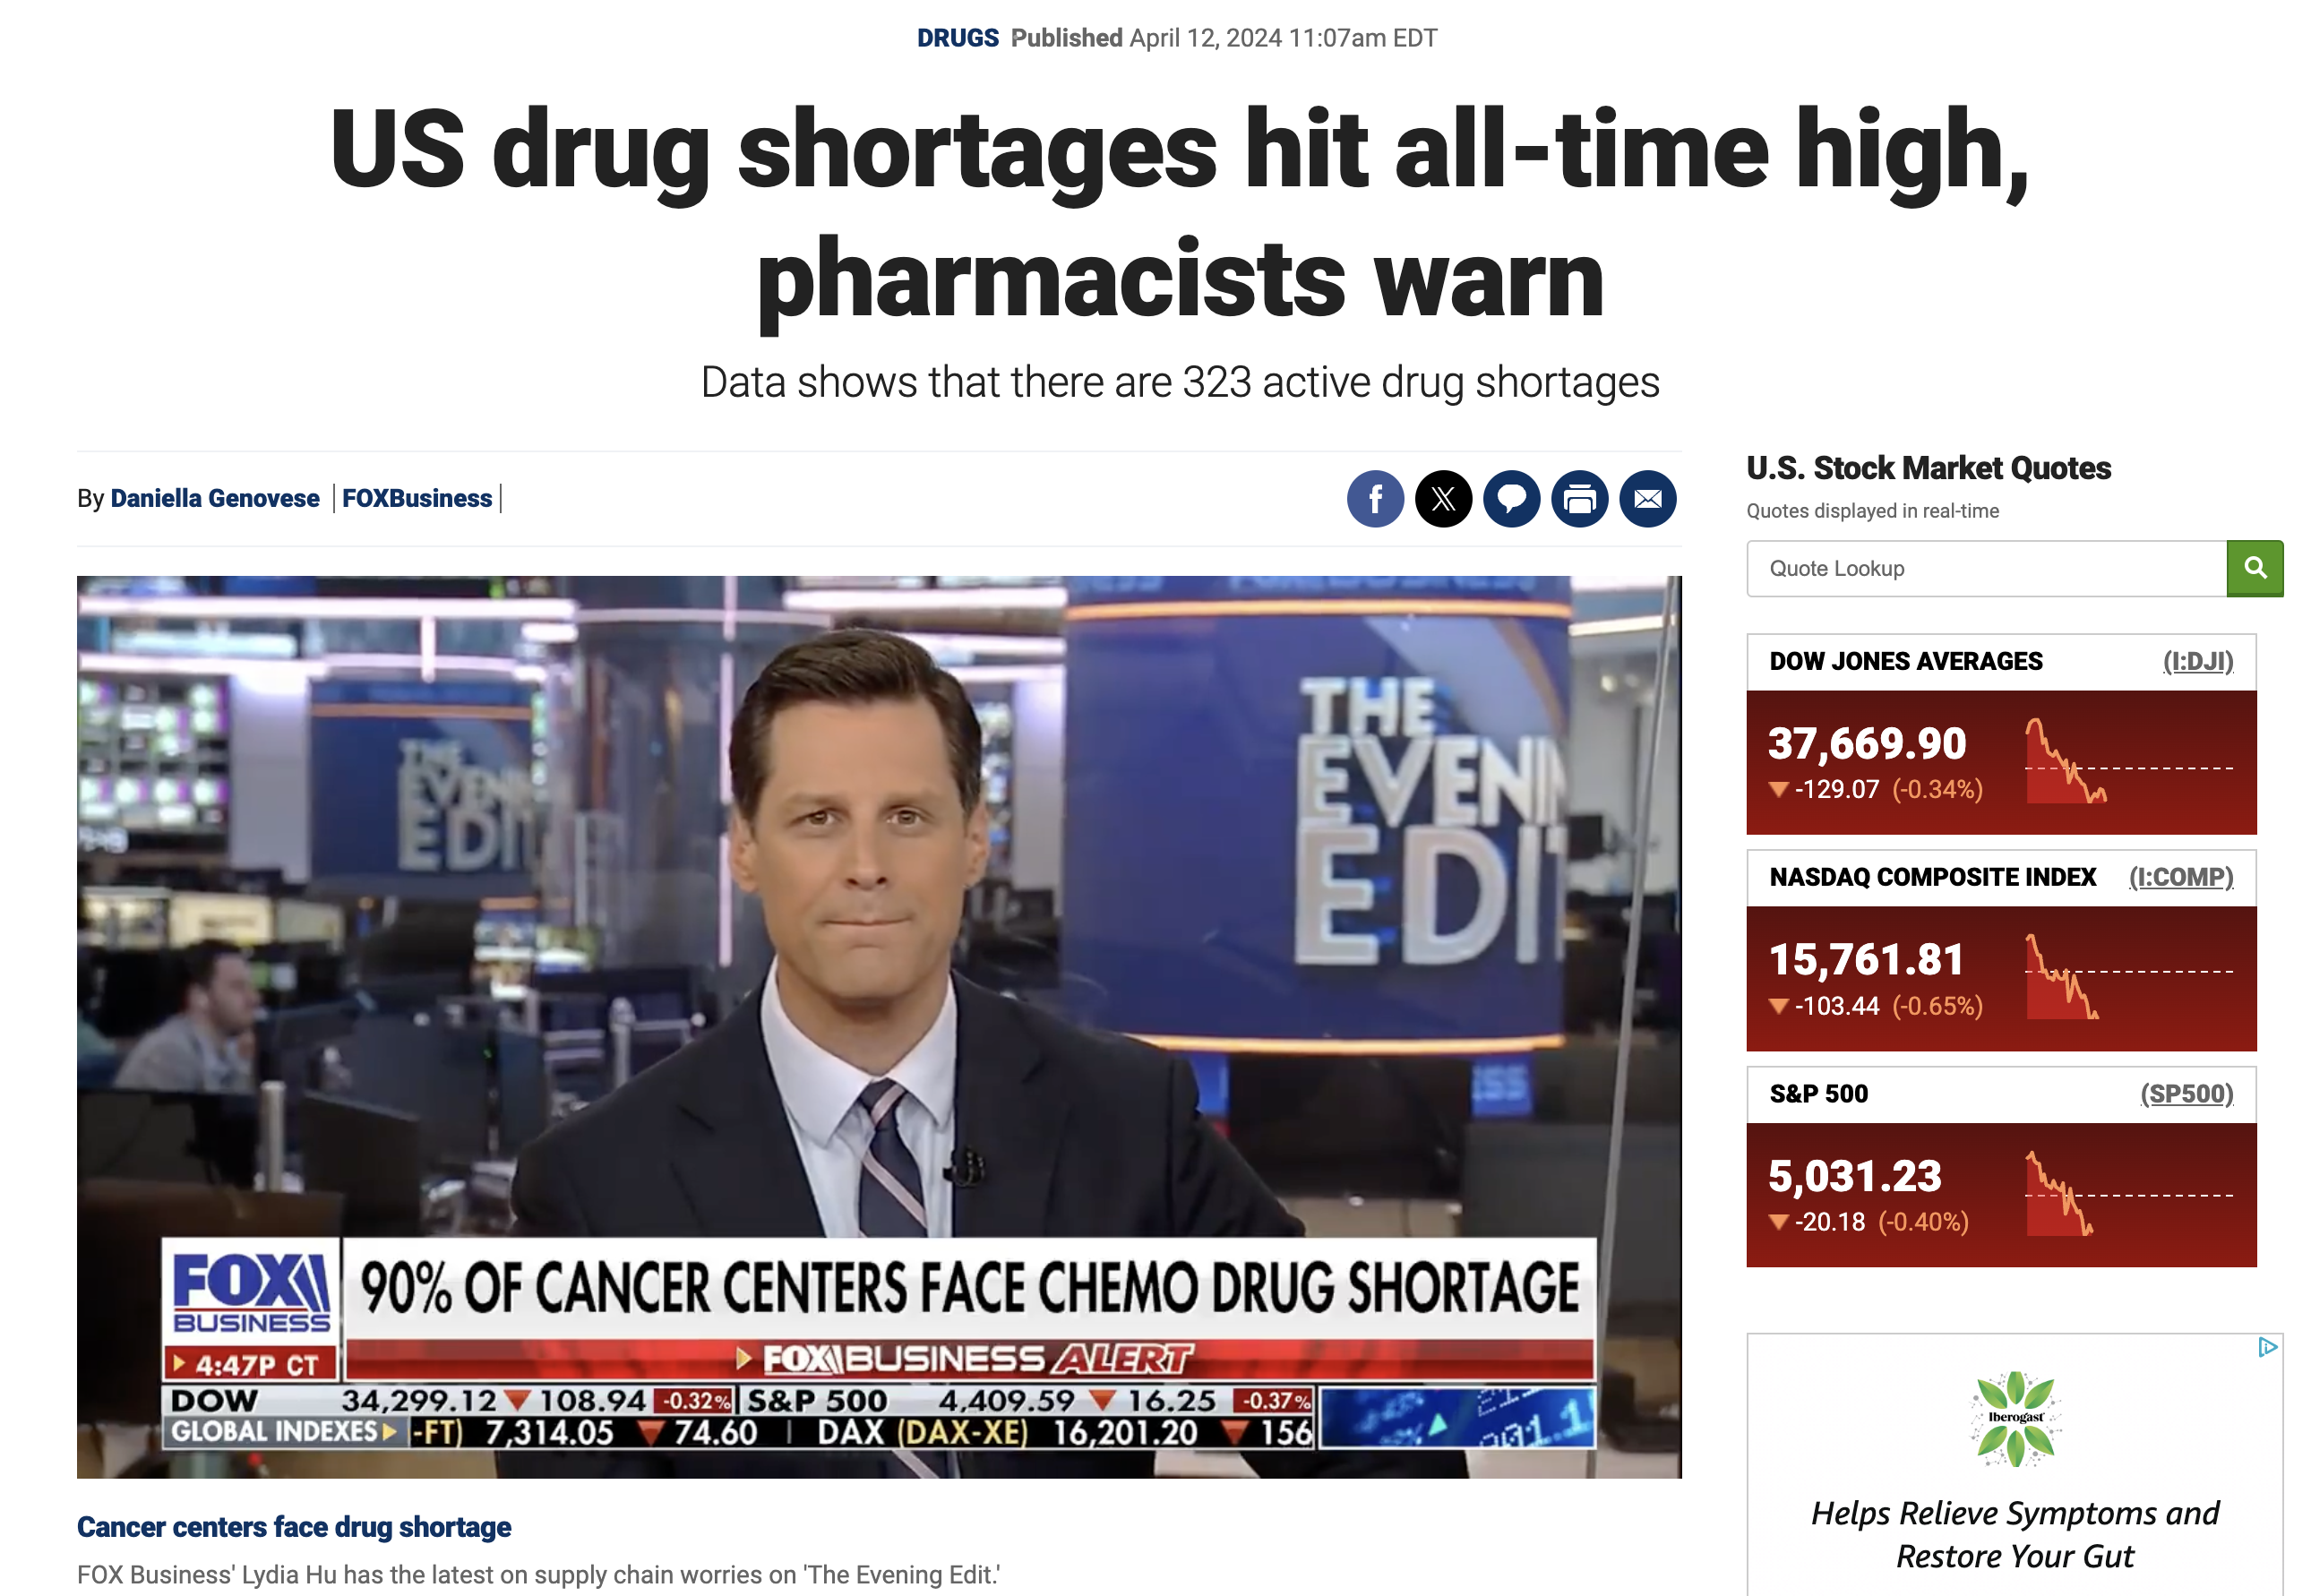
Drug Shortages Well Documented

Slide 25
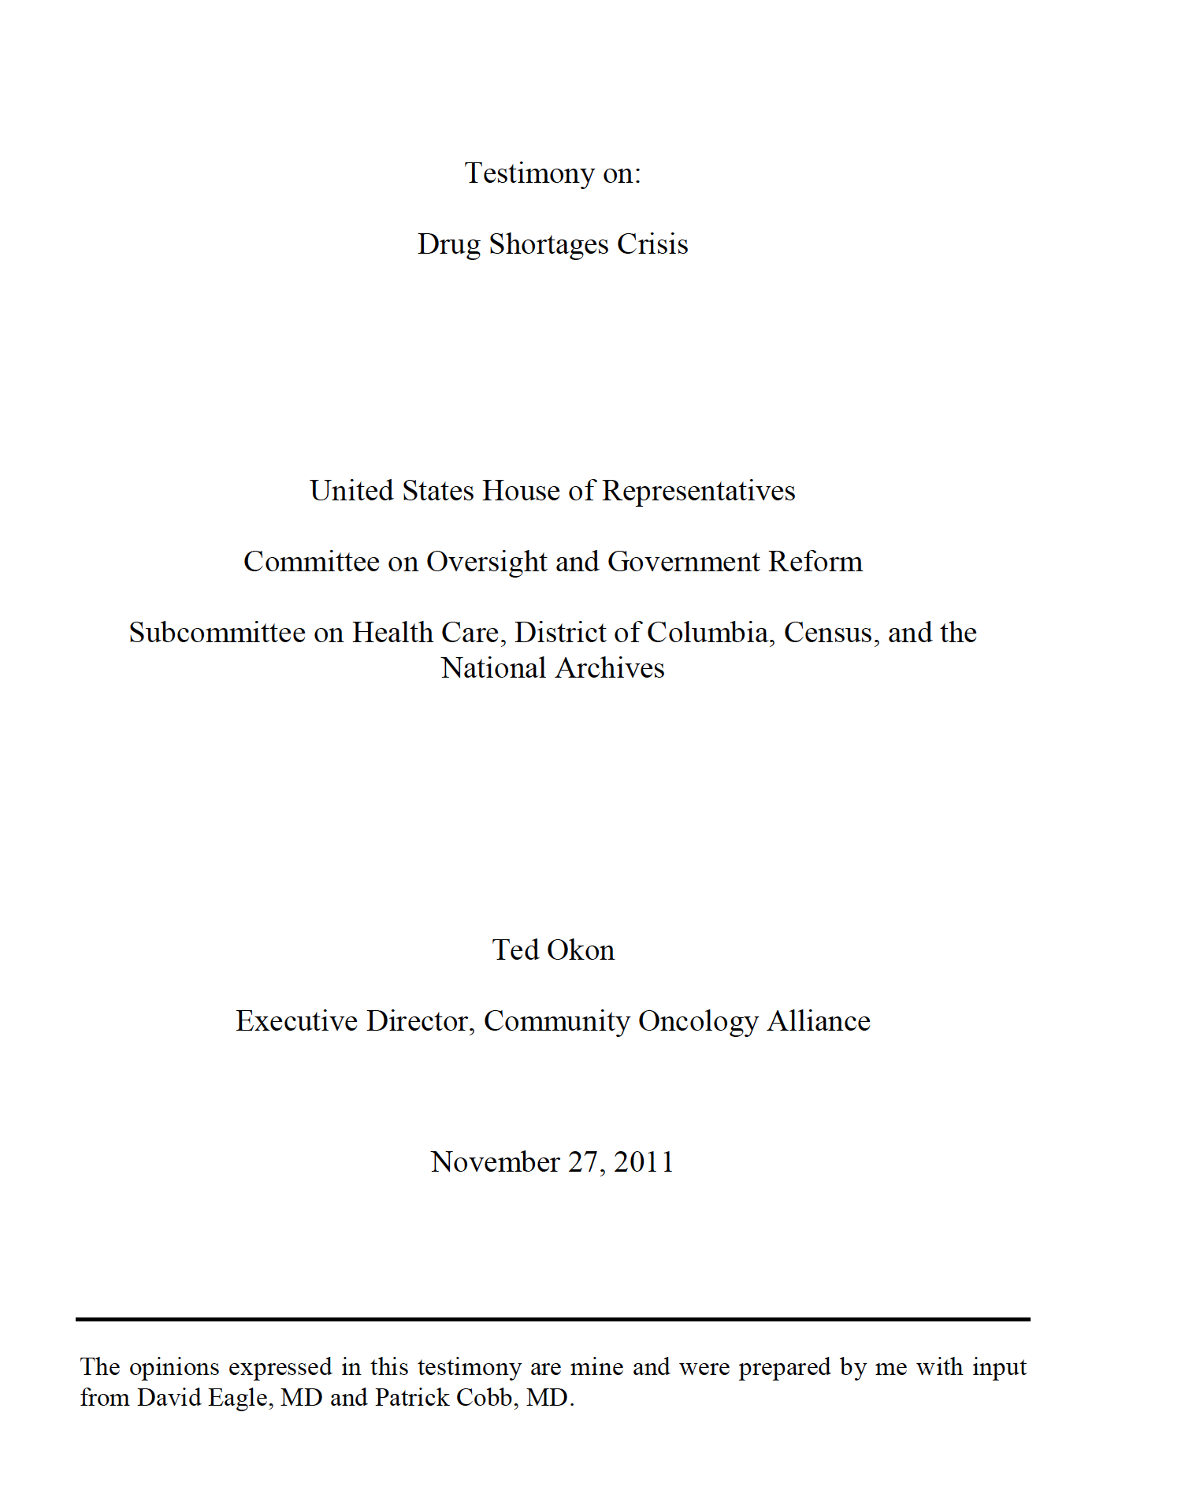
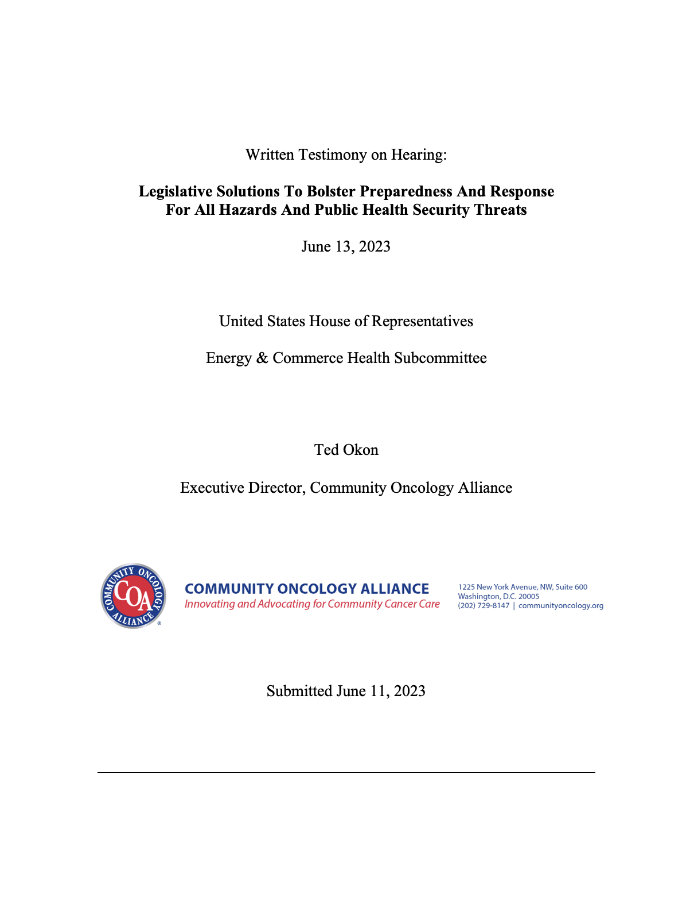
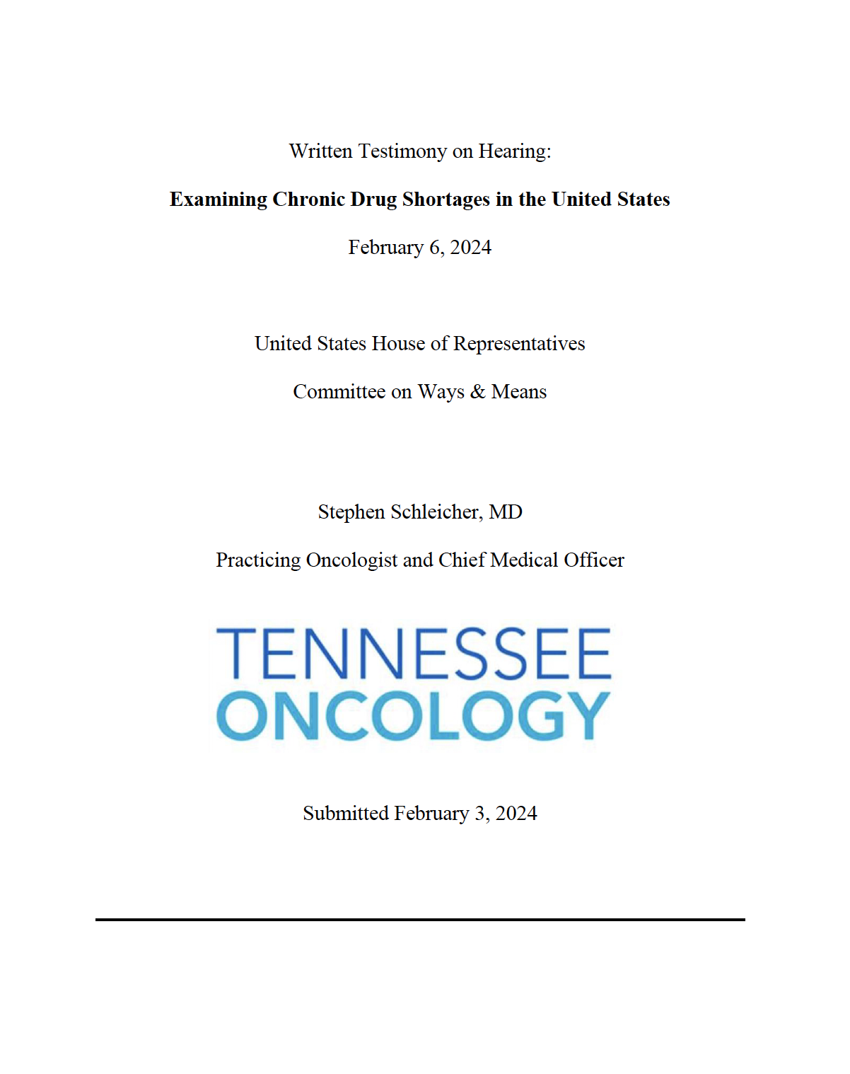
Drug Shortages: Solutions
Problem won’t be fundamentally fixed until underlying financial problem is addressed
  Discounts and rebates making low-cost generic drugs financially not viable
  ASP reimbursement doesn’t work
Basic problem Congress has is acknowledging that fixing the problem of drug shortages means paying more for generics
  Fundamentally that simple!

Slide 26
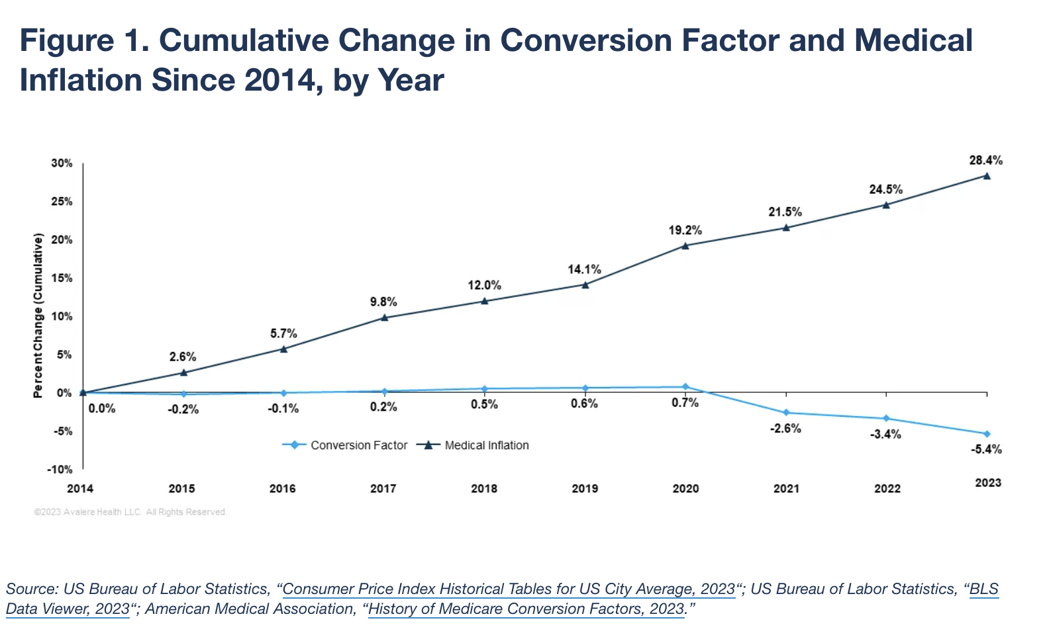
Stopping Physician Pay Cuts

Slide 27
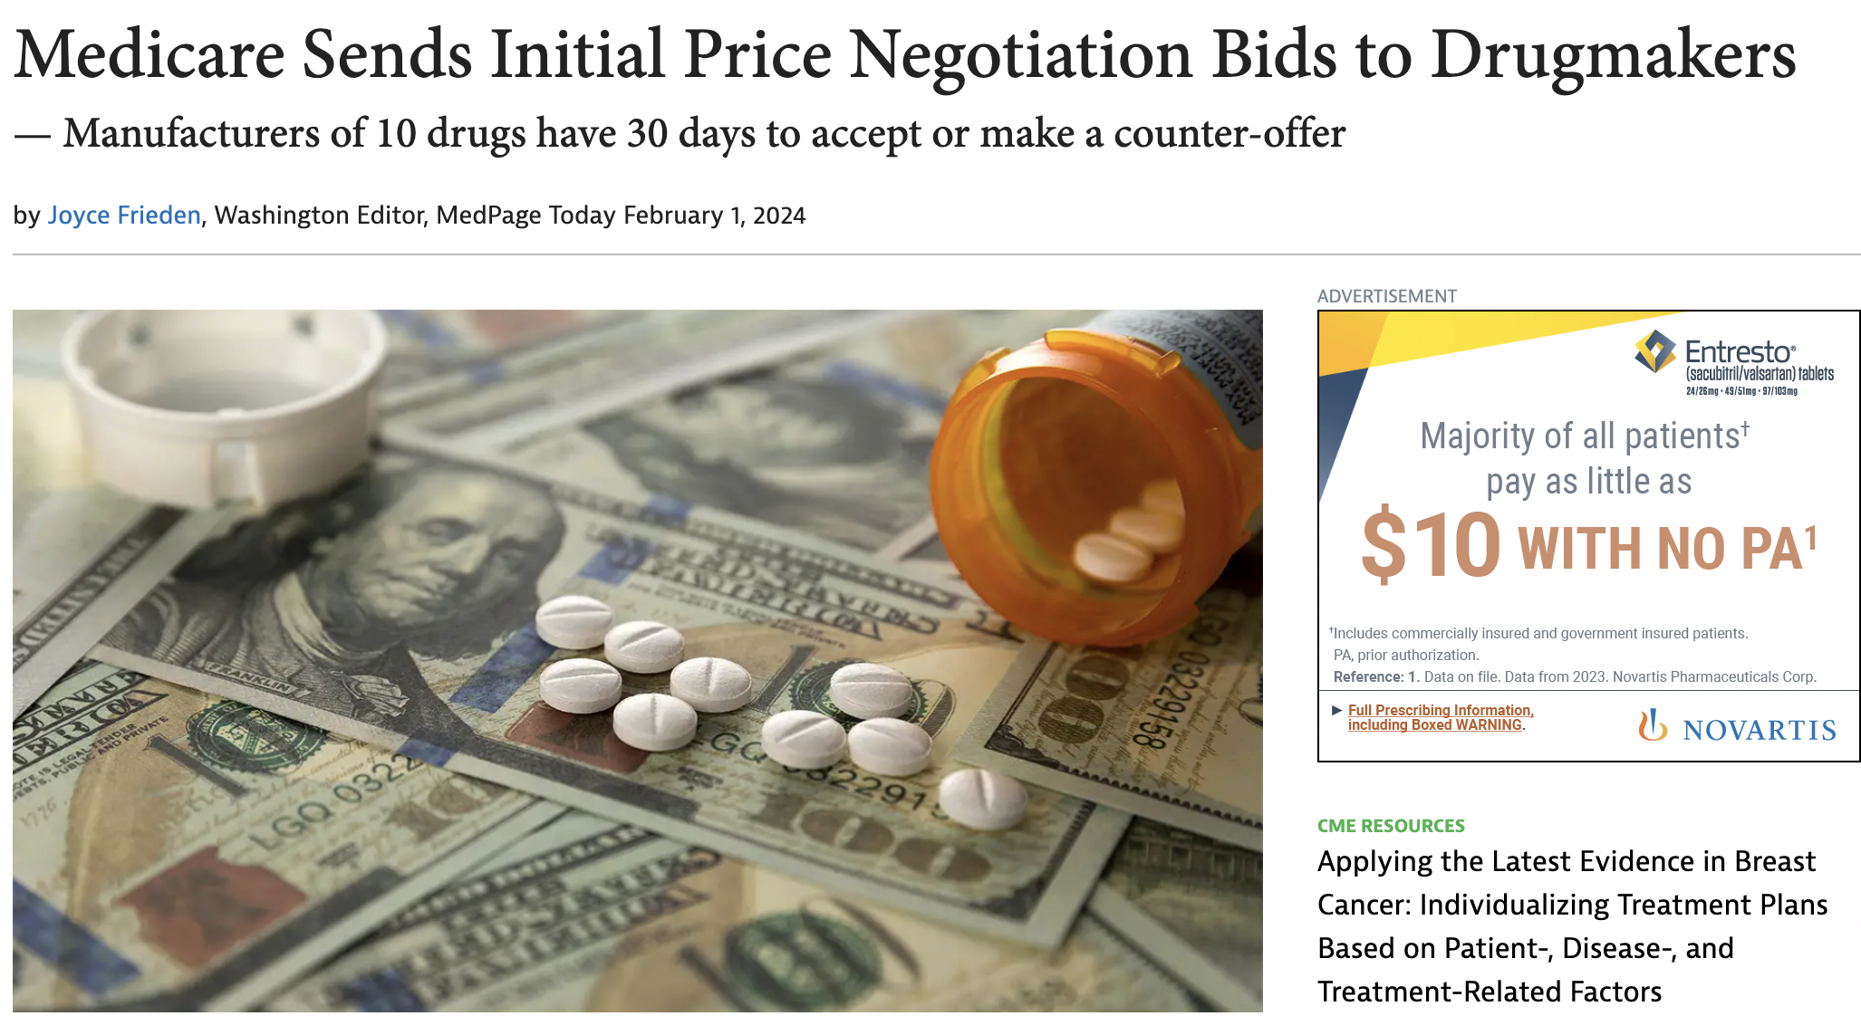
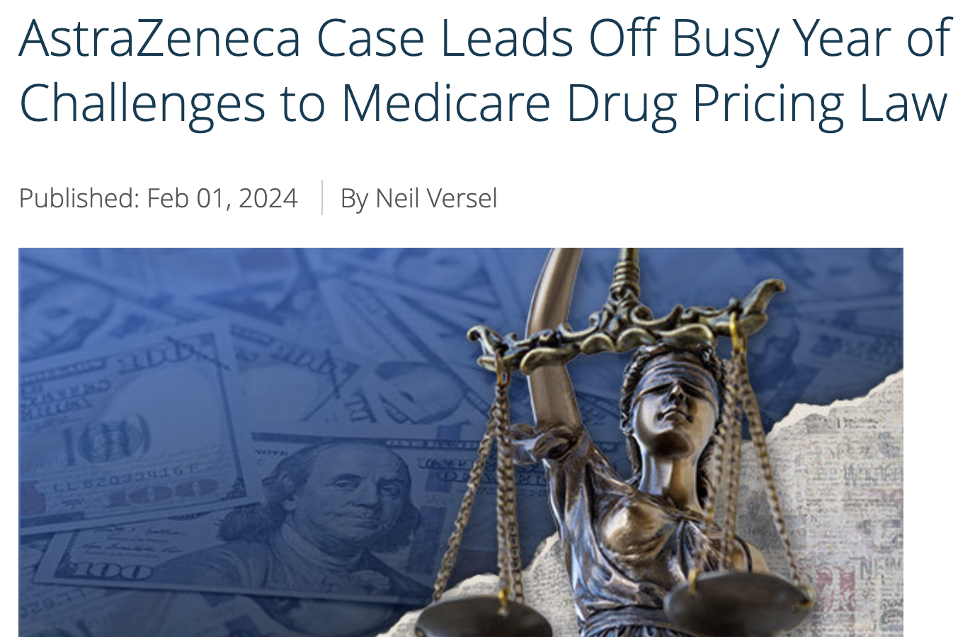
IRA Drug Price “Negotiations”

Slide 28
Back to the Good and the Bad
Title, Text Layout
Good news is there are more working groups, hearings, and legislation on the spectrum of health care issues
  PBMs
  Site-neutral payments
  340B
  Drug shortages
  Physician pay
  Cyber security
Bad news is that Congress is hopelessly broken, can’t get out of its own way, and won’t advance any meaningful legislation likely until the lame duck session
  Barely funded the government to prevent it from shutting down
  Stuck passing foreign aid to Ukraine and Israel

Slide 29
Snapshot of COA Legislative Priorities & Action
Title, Text Layout
Helping practices with any aftermath on Change Healthcare
Suing CMS over Stark drug delivery restrictions and pushing for legislation
  H.R. 5526 already passed
Fighting for Medicare payment increases for physicians
  Use site-neutral payments and 340B as “pay-fors”
Push for PBM legislation to advance in the Congress
  Includes transparent, ”reasonable and relevant” reimbursement, and much more
Possibly taking legal action regarding Express Scripts (and others?) low-ball reimbursement
Helping practices sort out the latest FTC ruling on non-compete clauses
Working on solutions to IRA drug price negotiations
Ramping up state legislative activities

Slide 30
COA State Policy Program Focuses on PBMs, Clinical Pharmacy Operations, and Patient Access to Care
Title, Text Layout
State Policy Issue Focus
PBMs Clinical Pharmacy Operations Patient Access
Primary Policy Portfolio
For questions concerning this update or state legislation focused on oncology, contact COA state team lead James Lee at jlee@coacancer.org

Slide 31
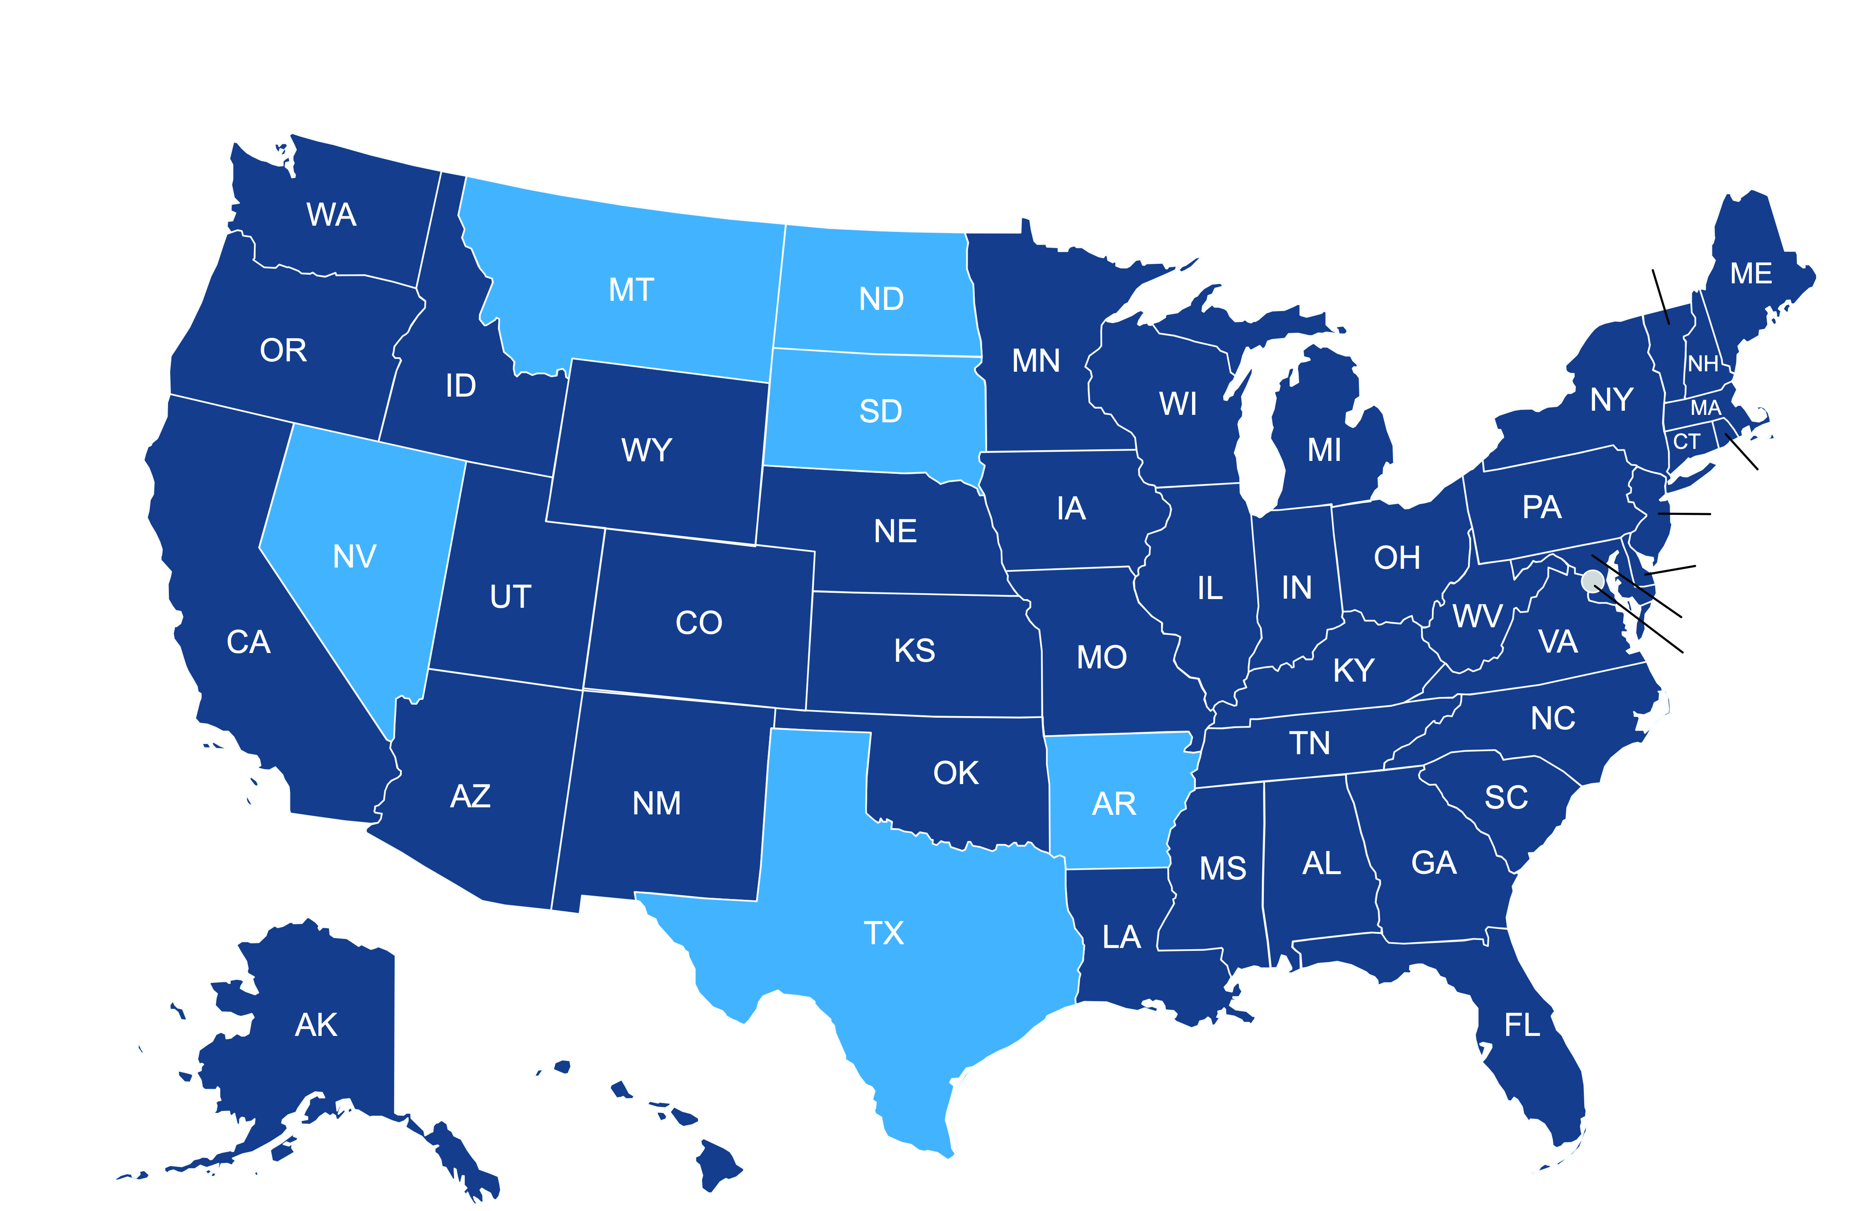
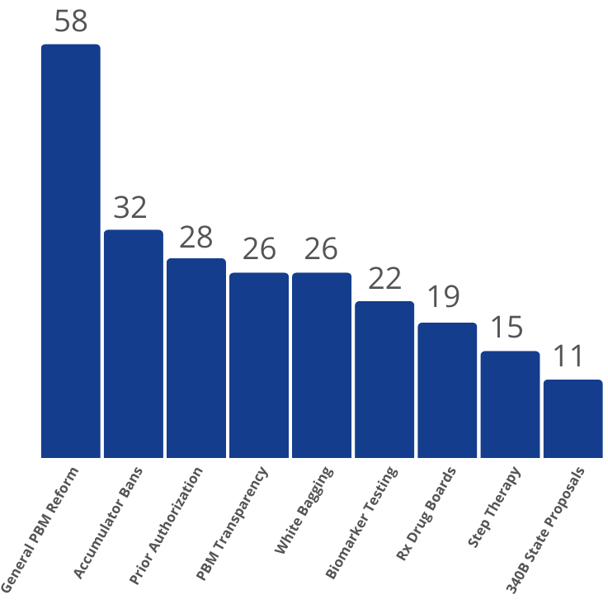
COA State Policy Team Monitoring 222 Policy Proposals Introduced Across 44 State Legislatures in 2024
State Policy Trends
States with Tracked Legislation
VT
RI
NJ
DE
MD
DC
2024 Legislation
Last updated 3/28
Last updated 3/28
For questions concerning this update or state legislation focused on oncology, contact COA state team lead James Lee at jlee@coacancer.org

Slide 32
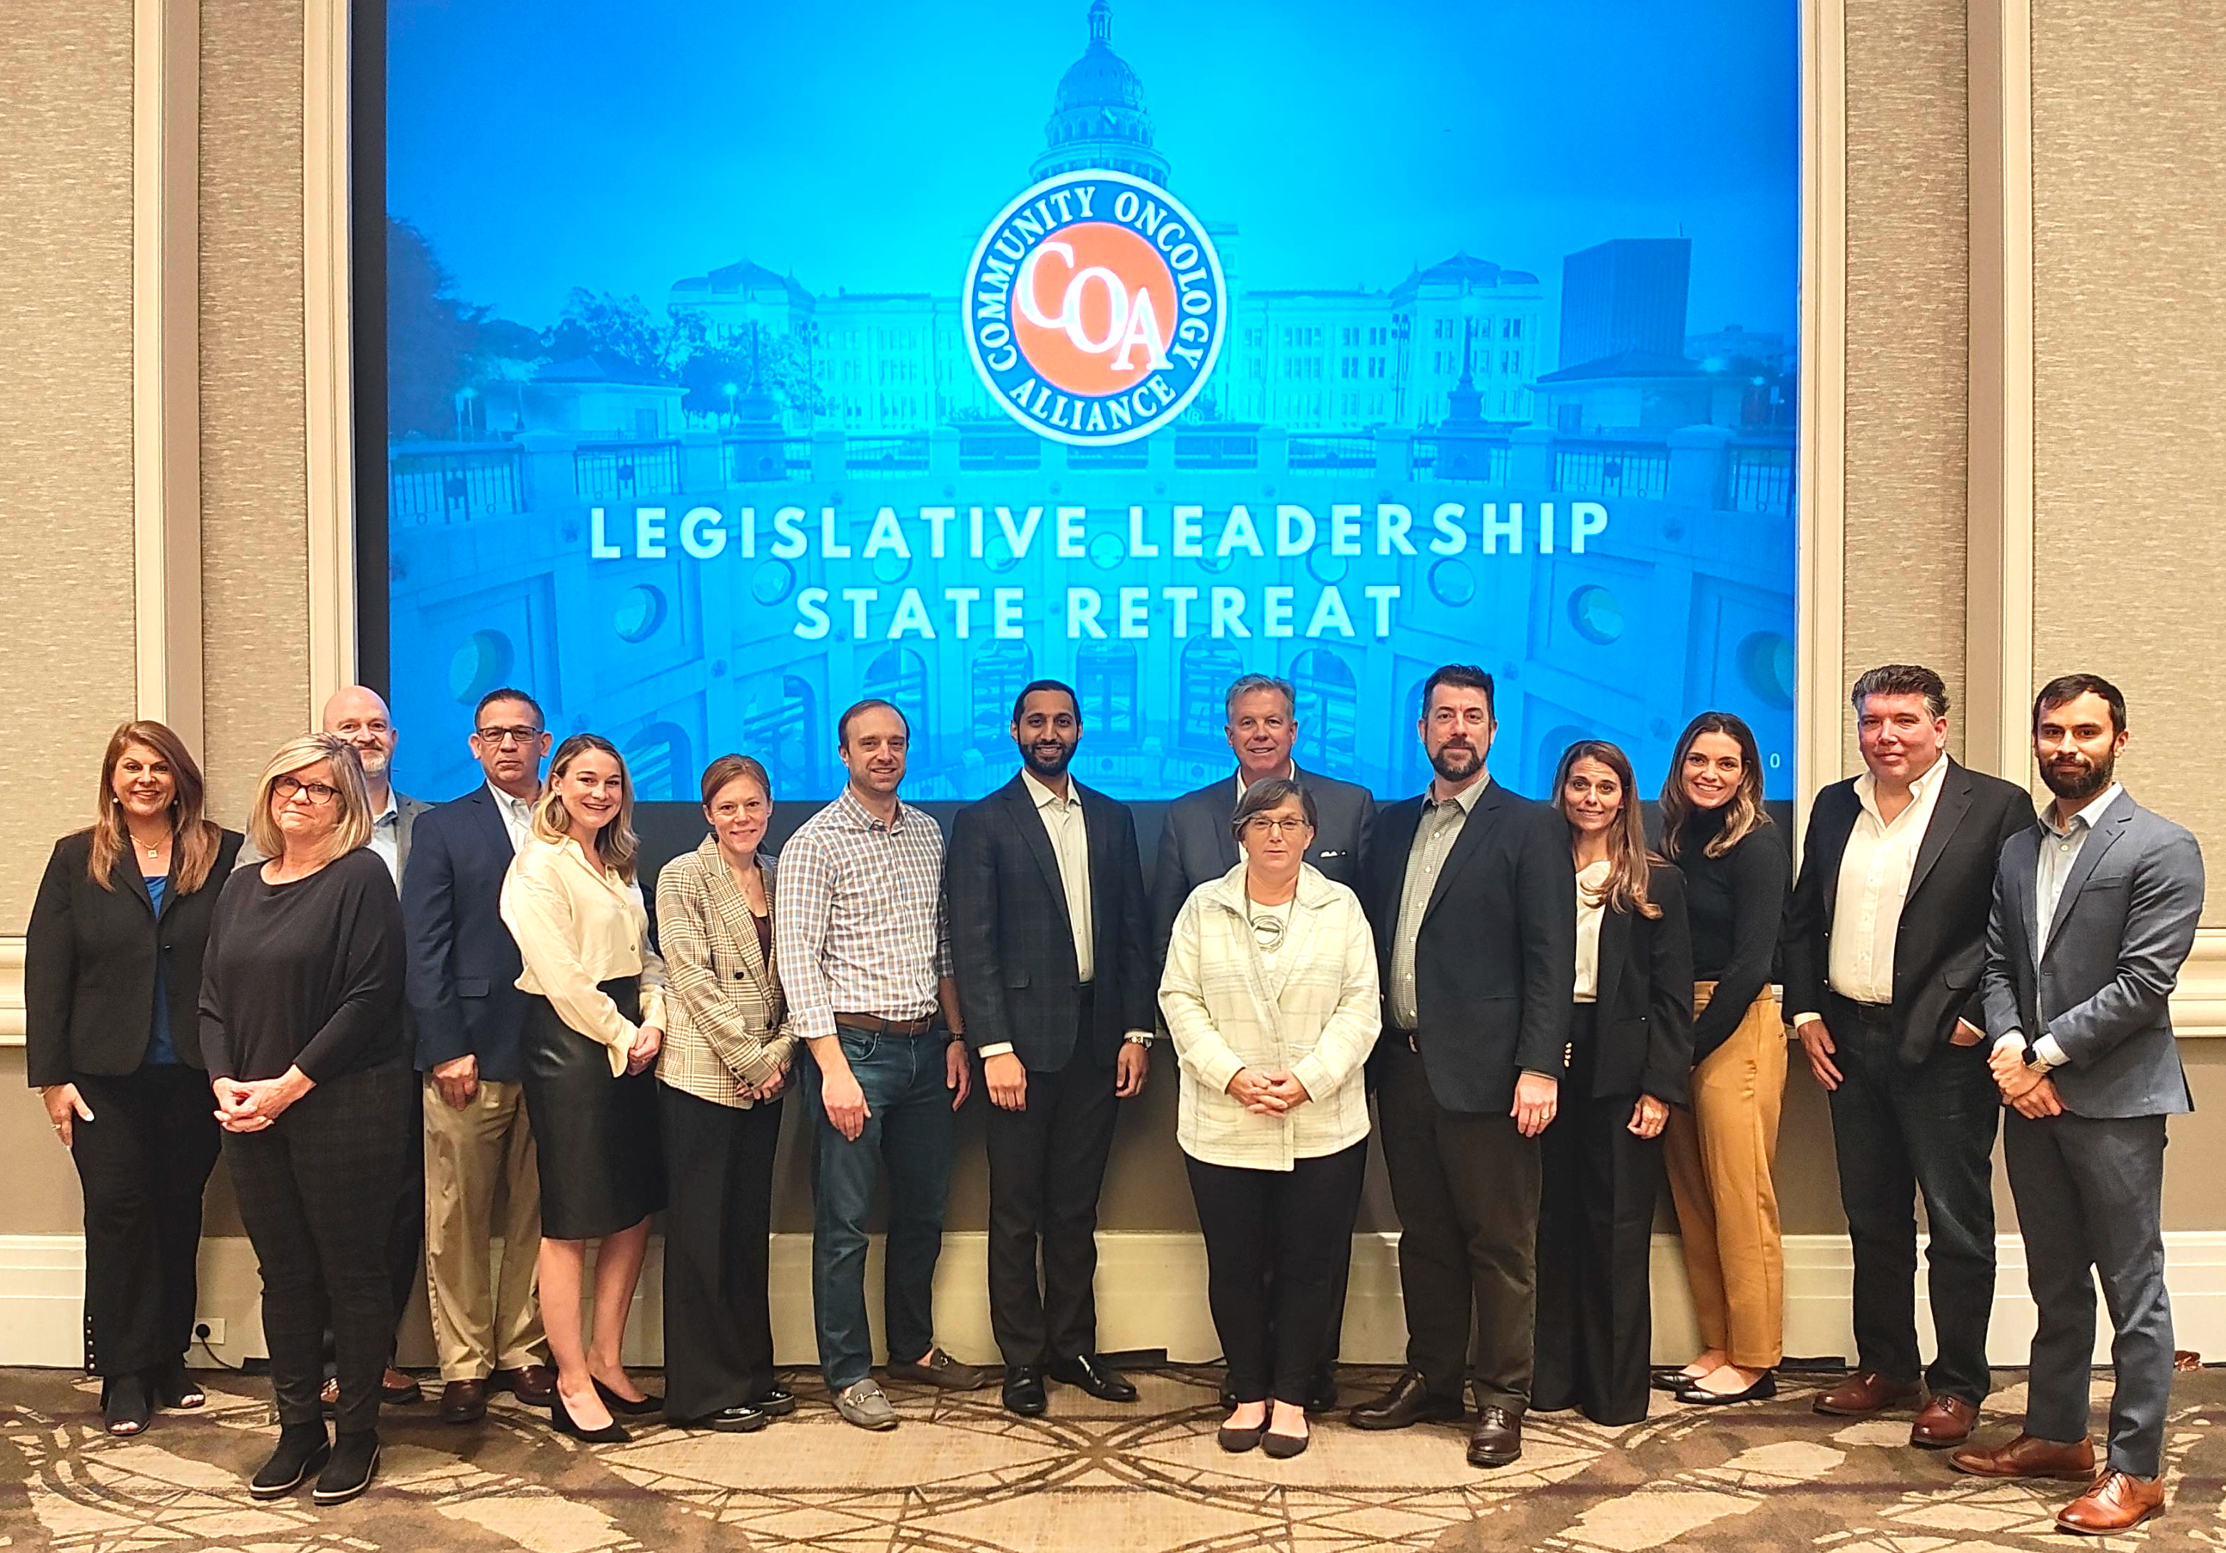
Join us at COA’s East Coast State Policy Retreat set for September 8-9, 2024 in Washington, D.C.
Title, Text Layout
For questions concerning this update or state legislation focused on oncology, contact COA state team lead James Lee at jlee@coacancer.org

Slide 33
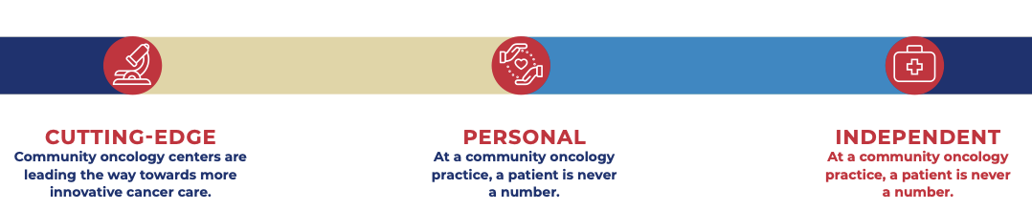
What is the Value of Independent
Community Oncology?

Slide 34
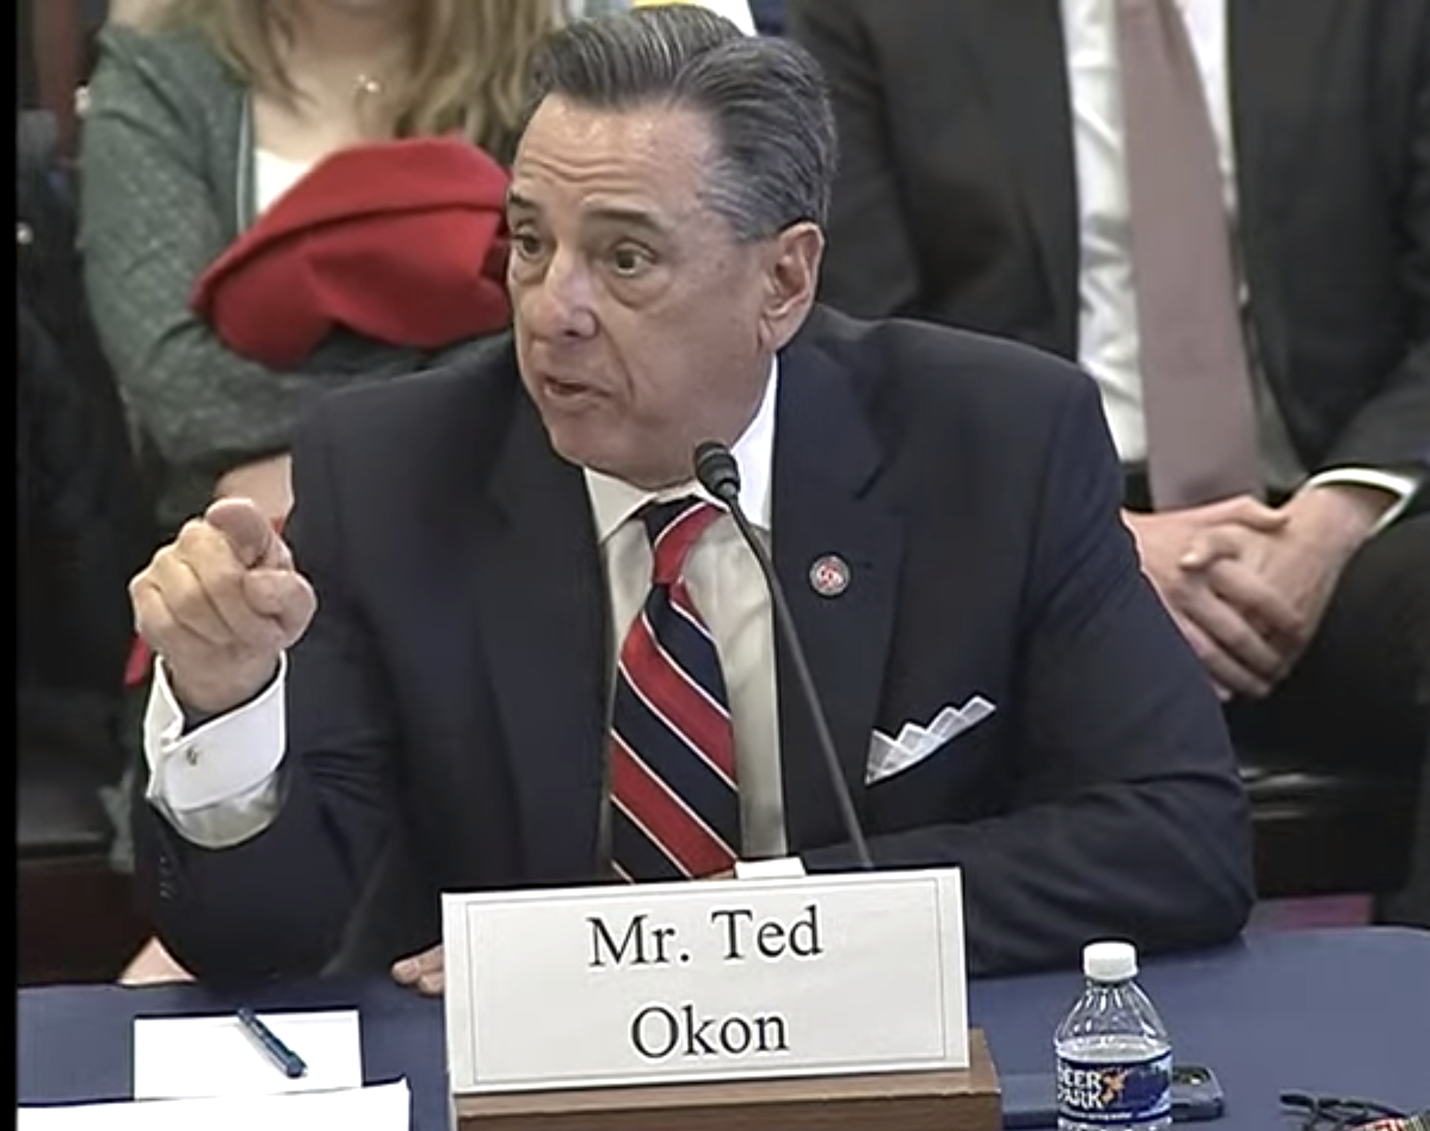
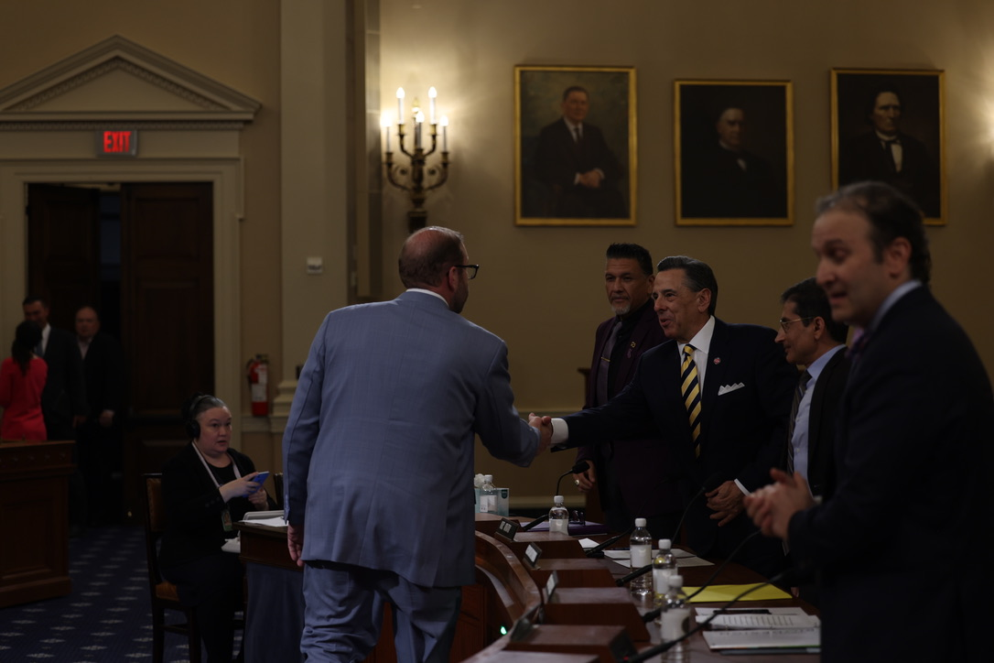
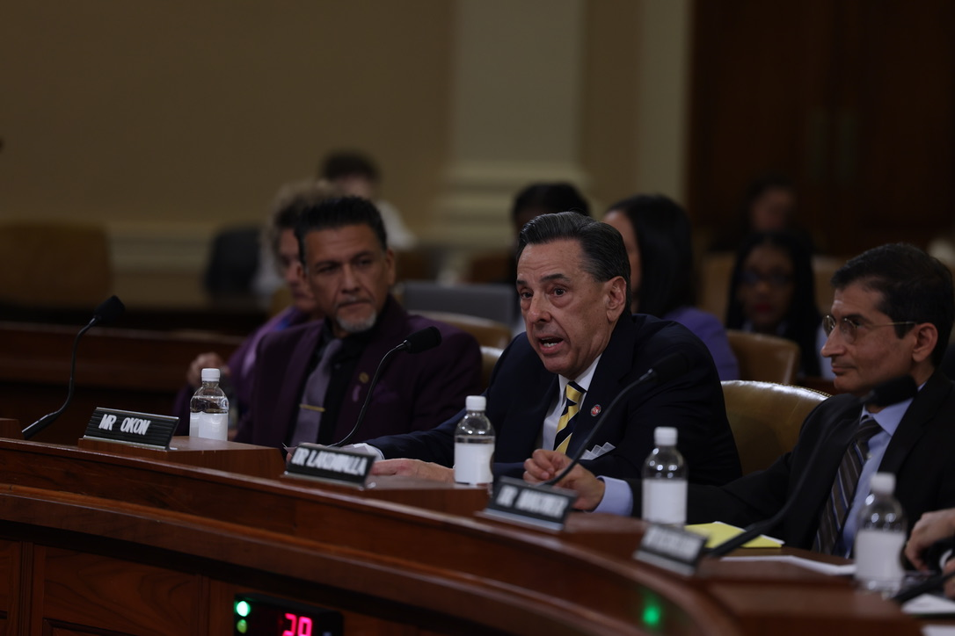
Questions?
Ted Okon
Email: tokon@COAcancer.org
Web: www.CommunityOncology.org
Twitter: @TedOkonCOA

