Slide 1
Social Determinants of Health (SDOH)
Cassidy Lewis, MSW
Reimbursement Analyst | onPoint Oncology

Slide 2
Disclaimer
The information described herein is subject to change as many of the details herein are subject to interpretation. This is our first review of the regulations and more information may be available after this presentation.
This presentation is in an abbreviated format. We have omitted parts of the Regulation for brevity.
CPT codes and descriptions only are copyright 2020 American Medical Association (AMA). All rights reserved. The AMA assumes no liability for data contained or not contained herein.
All Medicare information is derived from published rules; however, interpretations may be erroneous and typos may be evidenced. It is mandatory that coding and billing is based on information derived from each practice or clinic.
This is not legal or payment advice.
This information is valid for the date of presentation only.
This presentation should not be reproduced without the permission of the author and is time-sensitive
Notes:
Put in a separate page for web sites of regulations

Slide 3



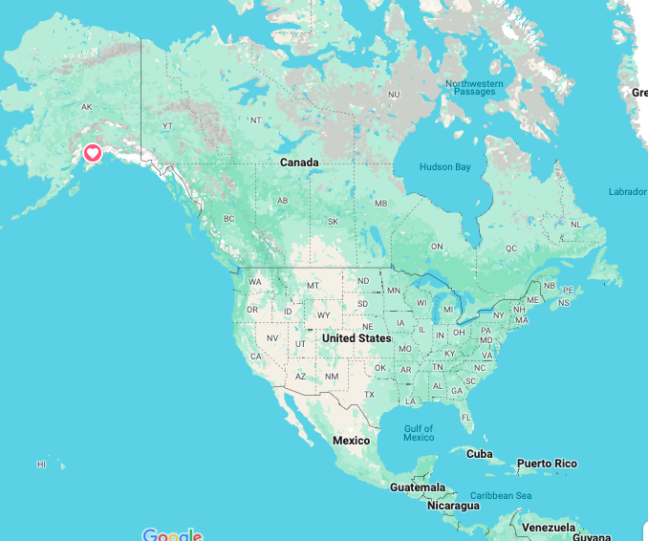

About Me

Slide 4
Social Determinants of Health: Defined
Social determinants of health (SDOH) are nonmedical factors that influence health outcomes. They include the conditions in which people are born, grow, work, live, and age and the broader set of forces and systems shaping the conditions of daily life.
Five Domains, per Healthy People 2030:
Economic Stability
Education Access and Quality
Health Care Access and Quality
Neighborhood and Environment
Social and Community Context
SDOH contributes to health disparities and inequities.
Notes:
https://odphp.health.gov/healthypeople/priority-areas/social-determinants-health

Slide 5
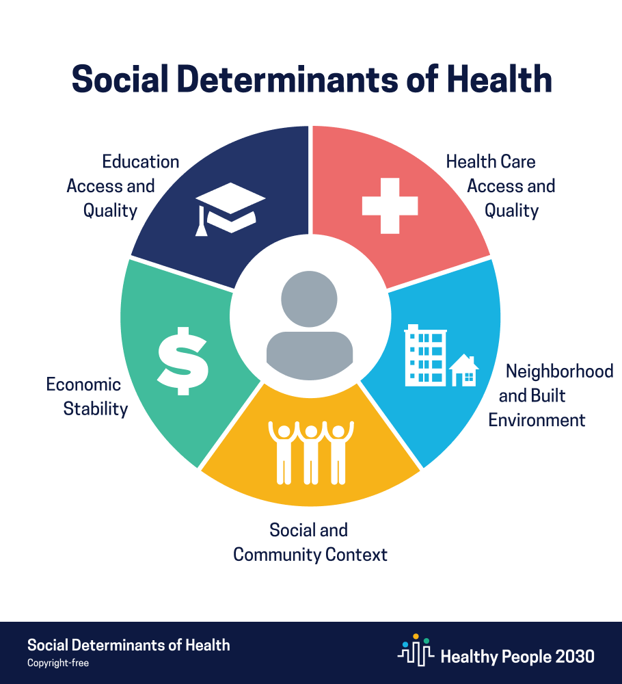
Social Determinants of Health: Defined
Five Domains, per Healthy People 2030:
Economic Stability
Education Access and Quality
Health Care Access and Quality
Neighborhood and Environment
Social and Community Context
Examples include:
Safe housing, transportation, and neighborhoods
Racism, discrimination, violence
Education, job opportunities, income
Access to nutritious food, clean air, and water
Notes:
https://odphp.health.gov/healthypeople/priority-areas/social-determinants-health
https://health.gov/healthypeople/priority-areas/social-determinants-health

Slide 6
Why engage with Social Determinants of Health?
Empower providers to identify and address health disparities
Identify community and population needs
Monitor SDOH intervention effectiveness and patient outcomes
Utilize data to advocate for patients and create new policies to address health equity and access
In 2024, CMS established a standalone code for evaluating SDOH—G0136.
Through social history, structured health risk assessments, and screening tools, SDOH information can be collected before, during, or after a healthcare encounter.
Notes:
https://www.cms.gov/files/document/cms-2023-omh-z-code-resource.pdf

Slide 7
A moment to caution...
The codes listed herein are not intended for screening and require follow-up. Assessing social determinants is intrinsically different from traditional screening for medical problems.
Discovering a need and being ill-equipped to address it can create potential harm for the patient and frustration for the physician.

Slide 8
A moment to caution... (Cont.)
To avoid these unintended consequences and make screening an invaluable part of the clinical process, practices need to ensure that risk assessment and screening are:
Patient- and family-centered
Integrated with referrals to community-based resources
Comprehensive across all patient populations,
Focused on leveraging the strengths of patients, families, and communities.
Notes:
https://www.aafp.org/pubs/fpm/issues/2018/0500/p7.html

Slide 9
HCPCS Codes: Services to Address Social Determinants of Health
Social Determinants of Health (SDOH) Risk Assessment HCPCS G0136 | Administration of a standardized, evidence-based Social Determinants of Health Risk Assessment tool.
Community Health Integration (CHI) HCPCS G0019 and G0022 | Activities performed by certified or trained auxiliary personnel (including a community health worker) under the direction of a physician or other practitioner; to address social determinants of health (SDOH) need(s) that are significantly limiting ability to diagnose or treat problem(s)
Principal Illness Navigation (PIN) HCPCS G0023, G0024, G0140, G0146 | Services focused on serious, high-risk illness by certified or trained auxiliary personnel under the direction of a physician or other practitioner, including a patient navigator or certified peer specialist. (G0140 and G0146 limited to the treatment of behavioral health conditions.)
Notes:
https://www.aafp.org/family-physician/practice-and-career/getting-paid/coding/G0136-sdoh-assessment.html
https://codingintel.com/screening-for-social-determinants-of-health-sdoh/

Slide 10
Social Determinants of Health (SDOH) Risk Assessment (G0136) | Community Health Integration (CHI) (G0019 and G0022) | Principal Illness Navigation (PIN) (G0023, G0024, G0140, G0146)
Patient has one or more known or suspected SDOH needs that may interfere with diagnosis or treatment. Must assess food insecurity, housing insecurity, transportation needs, and utility difficulties. | Patient has SDOH need(s) that significantly limit the practitioner’s ability to diagnose or treat the problem(s) addressed in the visit | The patient has a serious, high-risk condition expected to last 3 months or longer. The patient has a significant risk of hospitalization, nursing home placement, acute exacerbation, functional decline, or death. It requires a disease-specific care plan, with frequent adjustments of medication or treatment regimen; or the substantial assistance from the caregiver.
Intended to identify any individual with known or suspected SDOH needs. Ex.) Person tells the provider they recently lost their job, are hungry, “can’t make ends meet” | Intended to help patients with SDOH concerns which may inhibit proper care Ex.) Person experiencing homelessness, poor nutrition, person is underinsured or uninsured | Intended to help patients with serious conditions navigate their healthcare treatment Ex.) A person is diagnosed with gastric cancer. The person does not have secure housing or transportation, and the closest oncology office is 8 miles away.

Slide 11
SDOH Risk Assessment (G0136)
Code | Long Descriptor | National RVU
G0136 | Administration of a standardized, evidence-based Social Determinants of Health Risk Assessment, 5-15 minutes, not more often than every 6 months | Non-Facility: $18.44 Facility: $8.73
May be reported with:
✓ Outpatient E/M visits
✓ Transitional Care Management
✓ Psychiatric and behavioral assessments
✓ Annual Wellness Visit
✓ Hospital Discharge Visits
Notes:
https://www.aafp.org/family-physician/practice-and-career/getting-paid/coding/G0136-sdoh-assessment.html

Slide 12
SDOH Risk Assessment (G0136)
Example:
The provider has not seen a patient in a while. Due to limited transportation, the patient calls the office and requests a specific time and date .The patient also requested a refill on a refrigerated medication that went bad due to no electricity in their home.
If the patient has not had an SDOH risk assessment in the past six months, the provider may furnish an SDOH risk assessment as an optional part of the annual wellness visit, an evaluation and management visit, or behavioral health office visit.
Notes:
https://www.aafp.org/family-physician/practice-and-career/getting-paid/coding/G0136-sdoh-assessment.html

Slide 13
SDOH Risk Assessment
Suggested appropriate tools for reporting G0136 include:
  PRAPARE Tool
  Health Related Social Needs Screening Tool (ACH-HRSN)
Screening tools often contain between 10—20 questions for the five domains mentioned previously:
Economic Stability
Education Access and Quality
Health Care Access and Quality
Neighborhood and Environment
Social and Community Context
Results are recorded and uploaded to the patient's electronic health record if functionality exists.

Slide 14
Community Health Integration (CHI)
Code | Long Descriptor | National RVU
G0019 | Community health integration services performed by certified or trained auxiliary personnel, including a community health worker, under the direction of a physician or other practitioner; 60 minutes per calendar month, to address social determinants of health (SDOH) need(s) that are significantly limiting ability to diagnose or treat problem(s) addressed in an initiating visit | Non-Facility: $77.96 Facility: $47.55
G0022 | Community health integration services, each additional 30 minutes per calendar month (List separately in addition to G0019). | Non-Facility: $48.52 Facility: $33.32

Slide 15
Community Health Integration (CHI)
The billing practitioner initiates CHI services during an initiating visit, where the provider identifies unmet SDOH needs that limit the ability to diagnose or treat the patient. The identical practitioner bills for the subsequent CHI services the auxiliary personnel provides. Initiating visits are performed by the practitioner*and include:
An E/M visit
  It cannot be a low-level (level 1 or 99211) E/M visit performed by clinical staff
  Can be the E/M visit provided as part of Transitional Care Management (TCM) services
Annual Wellness Visit
*Only one practitioner can bill for CHI services per month. This ensures a single point of contact for addressing social needs and helps avoid a fragmented approach and duplicate services.
Notes:
https://www.cms.gov/files/document/mln9201074-health-equity-services-2024-physician-fee-schedule-final-rule.pdf-0

Slide 16
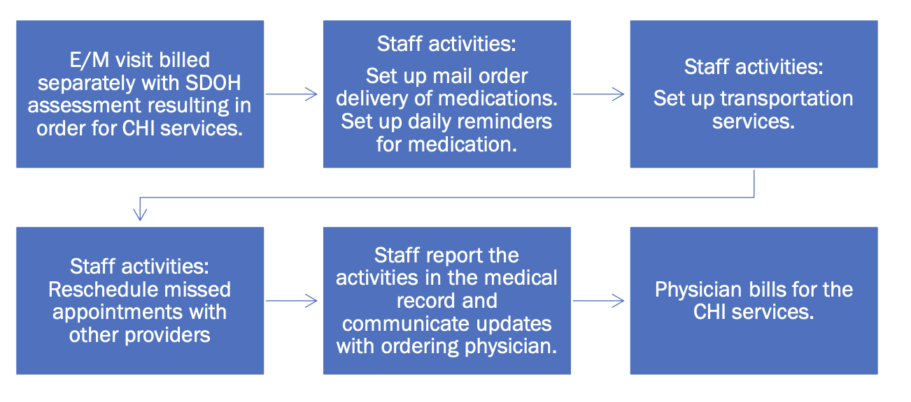
Community Health Integration – Case Study
Patient is a patient with breast cancer who the physician noted has short term memory loss due to chemotherapy, lack of caregiver support (lives alone), forgets to take her aromatase inhibitor and fill her prescription and has missed several appointments due to transportation.

Slide 17
Community Health Integration – Case Study
The activities performed would be reported with:
An appropriate level office and/or outpatient evaluation and management service (99202-99215),
The SDOH risk assessment code (G0136),
The appropriate CHI service code(s) are dependent on the time documented (G0019-G0022).
Appropriate ICD-10-CM Z codes would be reported to indicate the patient's identified SDOH needs. The medical record should reflect SDOH needs and services provided.

Slide 18
Principle Illness Navigation
Code | Long Descriptor | RVU
G0023 | Principal Illness Navigation services by certified or trained auxiliary personnel under the direction of a physician or other practitioner, including a patient navigator; 60 minutes per calendar month. | Non-Facility: $77.96 Facility: $47.55*
G0024 | Principial illness navigation services, each additional 30 minutes per calendar month. List separately in addition to G0023 | Non-Facility: $48.52 Facility: $33.32
G0140 | Principal Illness Navigation – Peer Support by certified or trained auxiliary personnel under the direction of a physician or other practitioner, including a certified peer specialist; 60 minutes per calendar month | Non-Facility: $77.96 Facility: $47.55
G0146 | Principal Illness Navigation – Peer Support; additional 30 minutes per calendar month. List separately in addition to G0140 | Non-Facility: $48.52 Facility: $33.32
*PIN services were initially designed as incident-to services, so they were only to be performed in a non-facility setting. However, this was changed, and it can be performed in POS 22 under the Facility fee.

Slide 19
Principal Illness Navigation
The billing practitioner initiates PIN services during a visit addressing a severe and high-risk condition, illness, or disease that:
It is expected to last at least three months and places the patient at significant risk of hospitalization, nursing home placement, acute exacerbation or decompensation, functional decline, or death
Requires development, monitoring, and frequent revision of a disease-specific care plan or substantial assistance from a caregiver
A healthcare practitioner initiates PIN services during an initial visit, during which they identify the medical necessity of PIN services and establish an appropriate treatment plan. The identical practitioner bills for the subsequent PIN services that auxiliary personnel provide. The billing practitioner personally performs initiating visits, including:
E/M visits, other than low-level E/M visits performed by clinical staff
A Medicare AWV supplied by a practitioner who meets PIN service requirements

Slide 20
Principal Illness Navigation (Personnel)
Since there isn’t a Medicare benefit for paying navigators and peer support specialists directly, CMS will pay for their services as incidental-to the services of the healthcare practitioner who directly bills Medicare.
The auxiliary personnel may be external to, and under contract with, the practitioner or their practice, such as through a CBO that employs navigators, peer support specialists, or other auxiliary personnel, if they meet all “incident to” requirements and conditions for payment of PIN services, including licensure and applicable state requirements.
Ex.) Peer Support Specialists, SAMHSA.
Notes:
https://www.cms.gov/files/document/mln9201074-health-equity-services-2024-physician-fee-schedule-final-rule.pdf-0

Slide 21
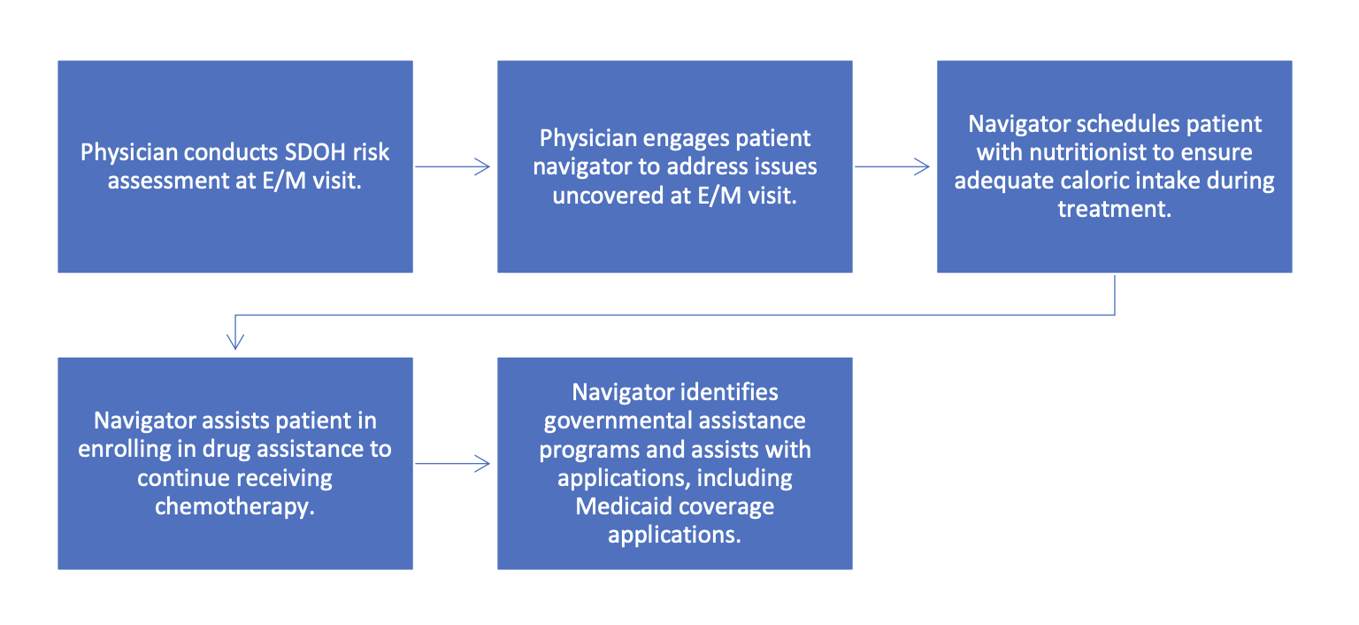
PIN Case Study
Patient was diagnosed with gastric cancer, is undergoing biweekly chemotherapy, and has experience nausea and vomiting as side effects of treatment. Recently, the patient lost employment and subsequently insurance coverage.

Slide 22
Case Study Continued
The navigator documented approximately 105 minutes of time in providing these services.
The initiating physician/QHP may report the following for the month:
An appropriate E/M code (99202-99215) along with the G0136 for the SDOH risk assessment as part of the initiating visit
G0023 for the first 60 minutes and G0024 for an additional 30 minutes of PIN services provided by the navigator

Slide 23
A note for CHI and PIN
Both CHI and PIN code description include a person-centered assessment, performed to understand better the individual context of a person’s condition and SDOH needs
”Conducting a person-centered interview to understand the patient’s life story, strengths, needs, goals, preferences, and desired outcomes, including understanding cultural and linguistic factors, and including unmet SDOH needs (that aren’t billed separately)”

Slide 24
Reporting and Reimbursement
 | SDOH Risk Assessment | Community Health Integration | Principal Illness Navigation
Primary Code | G0136: 5-15 minutes | G0019: First 60 minutes | G0023, G0140: First 60 minutes
Additional Time | n/a | G0022: Each additional 30 minutes (No frequency limit) | G0024, G0146 Each Additional 30 Minutes
Episode of Care | Every 6 months | Per calendar month | Per Calendar Month

Slide 25
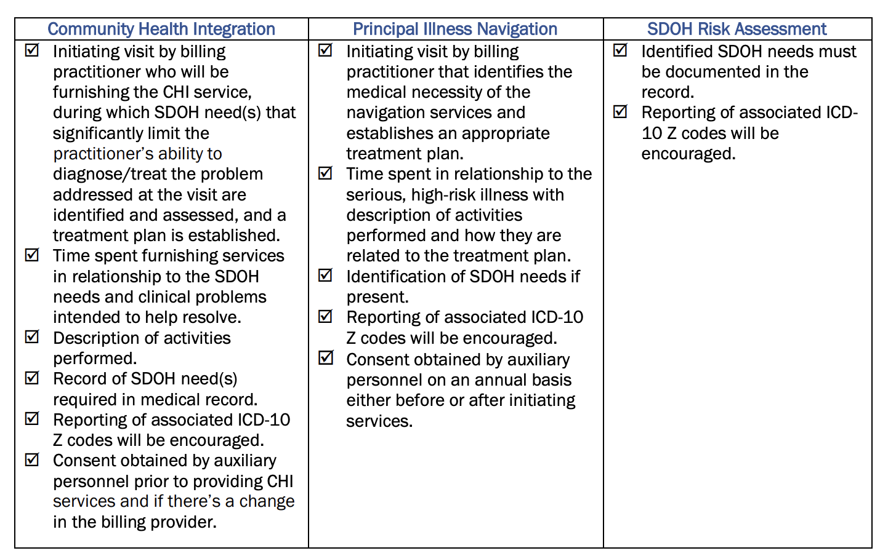
Reporting and Documentation

Slide 26
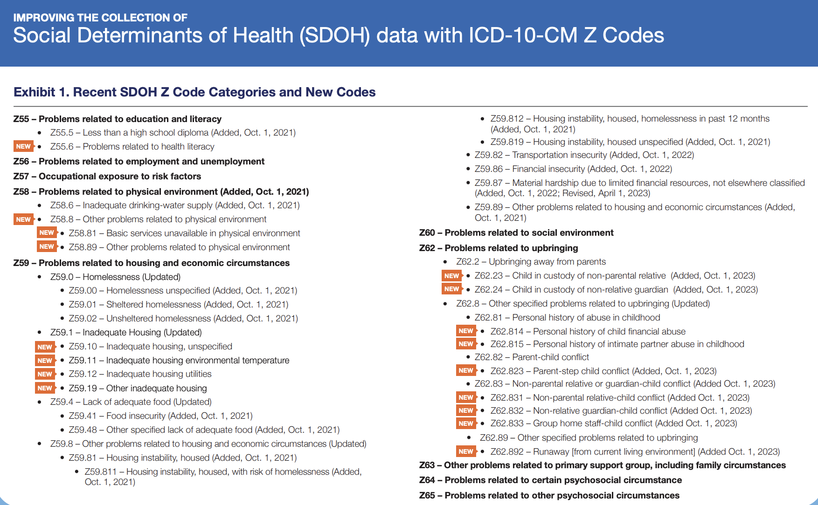

Slide 27
Workflow Considerations – Who is the care team?
SDOH risk assessment, screening, and assistance should not be the sole responsibility of the physician; instead, it should be a team-based effort integrated into the practice care management workflow.
Stakeholders include:
  Patient Navigators
  Health Coaches/Nutritionists
  Community Health Workers
  Case Managers
  Social Workers
  Nurses and Medical Assistants
  Peer Support Specialists
Notes:
https://www.aafp.org/pubs/fpm/issues/2018/0500/p7.html

Slide 28
Workflow Considerations – Cont.
  Who will perform the screening?
  Can you specify the exact location where the screening will take place?
  Where will the data be stored?
  How will results be communicated to the team?
  How will the team prioritize patient needs?
  What is the follow-up strategy, who is responsible, and how will it be documented?
  For example, a practice may decide that the medical assistant is responsible for administering an annual screening after rooming the patient and entering the results in real-time as social history in the EHR for the physician to review.
  If a patient is currently experiencing housing instability, food insecurity, and domestic violence, the physician would first decide which issue to address, document the care plan and follow-up plan in the EHR, and instruct the medical assistant to handle the referral details with the patient.
Notes:
https://www.aafp.org/pubs/fpm/issues/2018/0500/p7.html

Slide 29
MOST IMPORTANT – LIST OF REFERRALS!!!
  For any workflow to succeed, practices must develop a list of referral resources to connect patients to needed community services, such as transportation or meal programs, utility assistance programs, and substance use services.
  National Lines are a great place to start
  Dial 211 for essential community help services
  Dial 311 for non-emergency municipal services
  Dial 988 for Suicide and Crisis Lifeline

Slide 30
References
AAFP (2024). A Practical Approach to Screening for Social Determinants of Health. American Academy of Family Physicians. Retrieved March 19, 2025, from https://www.aafp.org/pubs/fpm/issues/2018/0500/p7.html
AAFP (2025). Using HCPCS Code G0136 for Social Determinants of Health Risk Assessment. American Academy for Family Physicians. Retrieved March 19, 2025, from https://www.aafp.org/family-physician/practice-and-career/getting-paid/coding/G0136-sdoh-assessment.html
AAFP (2025). Using HCPCS Codes G0019 and G0022 for Community Health Integration (CHI) Services. American Academy for Family Physicians. Retrieved March 19, 2025, from https://www.aafp.org/family-physician/practice-and-career/getting-paid/coding/g0019-g0022-chi-services.html
AAFP (2025). Using HCPCS Codes G0023, G0024, G0140 and G0146 for Principal Illness Navigation (PIN) Services. American Academy for Family Physicians. Retrieved March 19, 2025, from https://www.aafp.org/family-physician/practice-and-career/getting-paid/coding/g0023-g0024-g0140-g0146-PIN-codes.html
CMS (2024). Improving the Collection of Social Determinants of Health Data with ICD-10-CM Z Codes. CMS.gov. Retrieved March 19, 2025, from https://www.cms.gov/files/document/cms-2023-omh-z-code-resource.pdf

Slide 31
References (Cont.)
CMS (2024). Medicare and Medicaid Programs; CY 2024 Payment Policies under the Physician Fee Schedule and Other Changes to Part B Payment and Coverage Policies; Medicare Shared Savings Program Requirements; Medicare Advantage; Medicare and Medicaid Provider and Supplier Enrollment Policies; and Basic Health Program. Federal Register. Retrieved March 19, 2025, from https://public-inspection.federalregister.gov/2023-24184.pdf
CodingIntel (2024, January 18). CMS Finalizing Principal Illness Navigation (PIN) Services. Retrieved March 19, 2025, from https://codingintel.com/principal-illness-navigation-pin-services/
CodingIntel (2025). Community Health Integration (CHI) Services. Retrieved March 19, 2025, from https://codingintel.com/community-health-integration-chi-services/
CodingIntel (2025). HCPCS Code G0136 for Assessment Social Determinants of Health (SDoH). Retrieved March 19, 2025, from https://codingintel.com/screening-for-social-determinants-of-health-sdoh/
Healthy People 2030, U.S. Department of Health and Human Services, Office of Disease Prevention and Health Promotion. Retrieved March 19, 2025, from https://odphp.health.gov/healthypeople/objectives-and-data/social-determinants-health

